Slide 1
Spirit of innovation or historical tradition? The complex dilemma of EU policy for renowned products Cristina Vaquero-Piñeiro, Department of Economics, Roma Tre University Eleonora Pierucci, Department of Economics, Roma Tre University

Slide 2
Why?
The European Green Deal, the flagship economic and environmental initiative of the EC, requires policy adjustments in various sectors to make sure that no one is left behind (EC, 2020). Within the EU Green Deal, the Farm to Fork strategy is the strategy aiming to make agricultural and food systems more sustainable, with the CAP as a key channel to support the transition.
To bolster the competitiveness, sustainability, and resilience of the agrifood systems, research and innovation has been recognised instrumental as they can create new opportunities and accelerating the necessary transition to overcome structural sectorial barriers. The CAP incentives and support the adoption of innovations recognising “fostering knowledge and innovation” as one of the ten objectives of the 2023-2027 programming period
At the same time, “improve the response of EU agriculture to societal demands on food and health, including high-quality […] food” (EC, 2020). The EU Geographical Indications (GIs) policy, established in 1992 and just recently in March 2024 (Reg. EU, 2024/xx), singled out the GI scheme at the centre of the European Green Deal

Slide 3
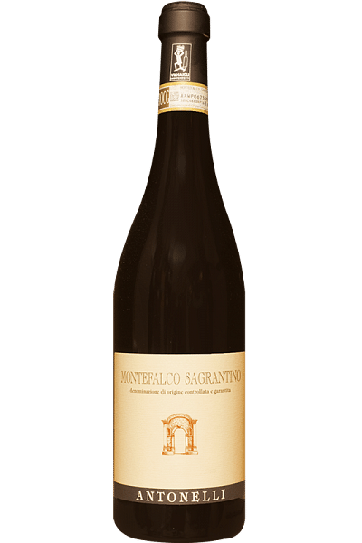
Tradition Geographical Indications
What are GIs?
GI is a sign used on agri-food products that have a specific geographical origin and possess qualities and reputation that are essentially or exclusively due to a particular geographical environment, made of natural and human factors (Reg. No.2012/1151, food; Reg. No.2013/1308, wine; Reg. No.2019/787, spirit; Reg. No.2014/251, aromatised wines)
GIs link agri-food products with the region of origin
The distinctive features of these products are the results of all the contextual environmental, human, historical characteristics, and cultural habits of their region of origin

Slide 4
Why GIs are so acclaimed?
Paolo de Castro (S&D, Italy) as rapporteur highlighted that the GI scheme “is no longer merely a cultural issue affecting a few countries or a region, but has unique economic, social and political significance, creating value without the need of any public fund”
Non-market goals: produce public goods (e.g., landscapes, De Simone et al. 2023), address market failures (information asymmetry, Stranieri et al. 2017), support sub-optimal production conditions (small farmers)
Economics benefits at both firm and territorial level in national and international markets: population growth and employment rate (Crescenzi et al., 2022), sector added value (Cei et al., 2018), and tourism attractiveness (De Simone et al., 2023), exports (Giua et al., 2024), attraction of FDI (Crescenzi et al., 2023)., quality of imports (Curzi and Vaquero-Piñeiro, 2024)
A quite huge gap remains however on to what extents the traditional knowledge-based orientation of GI production affects the innovation

Slide 5
Why should GIs negatively impact innovation?
Josling (2006), Bowen and Zapata (2009), Kuhne and Gellynck (2009) introduced in their studies the idea the traditional culture of production of GIs may not fit well with innovation:
Moerland (2019): geographical indications and innovation do not seem to fit well together
Stranieri et al. (2023): the diffusion of GIs enhanced innovative activities, but only for laggard regions farer from the technological frontier
Guerrere et al. (2009): the application of innovations may damage the traditional character of traditional food products
Basole (2015): concluded that GI will discourage innovation
Mancini et al. (2019): innovation can mediate the diffusion of traditional knowledge among producers
Why should GIs positively impact innovation?
PSs may be used to establish higher sustainability and innovation requirements (EC, 2024; Ruitz et al. (2018)
virtuous inter-organizational formal and informal networks that characterized GI territories (Crescenzi et al. 2022)
The coordination that lies beyond the GI system management may support the AKIS system

Slide 6
Do the acknowledgment affect the innovative activity of the region of origin? Is the GI policy adoption beneficial, or not, to innovation adoption?
Today, the issue is however like never before relevant:
the increasing diffusion of the GI system
the EU Green Deal objectives, innovation is crucial to keeping agrifood firms competitive (Curzi et al., 2022; Läpple and Thorne, 2019)
the 2024 EU Law extents the GI protection to craft and manufacturing products

Slide 7
Research design
Period: 1991-2020
At the beginning of our sample (1991) no one of the municipalities are acknowledged by an EU GI. This change in 1992 when the policy has been introduces
Focus: Italy
A pioneering country of the GI system from the 60s, and nowadays the EU country with the highest number of product certified (853, whose more than 500 are wines)
Level: Municipalities (the most disaggregated level available)
Data original geo-referenced database
Official information from Product Specifications (Crescenzi et al., 2023)
Administrative census data (ISTAT); Sensoring data
Patent data, source: REGPAT

Slide 8
Research design
Treatment: Wine PDOs
the wine sector is the agrifood sector more involved in innovation (Pomarici et al., 2021)
the first sector with a public certification system for sustainable production (Equalitas, since 2024)
PDOs exact matching between territory and production, and have specific restriction for innovations in vineyards
Outcomes: Agrifood patents
agricultural sector as well as those related to foodstuffs (food processing), at which we add the beer and wine industry.
Not only pure: innovators can target domain not exclusively linked to the agricultural and food sector. The majority of registered patent has in fact more than one domain and are not exclusively linked to the agrifood activities

Slide 9
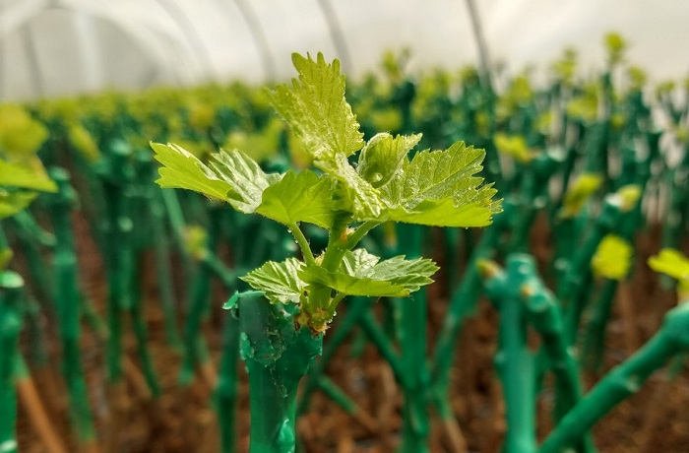
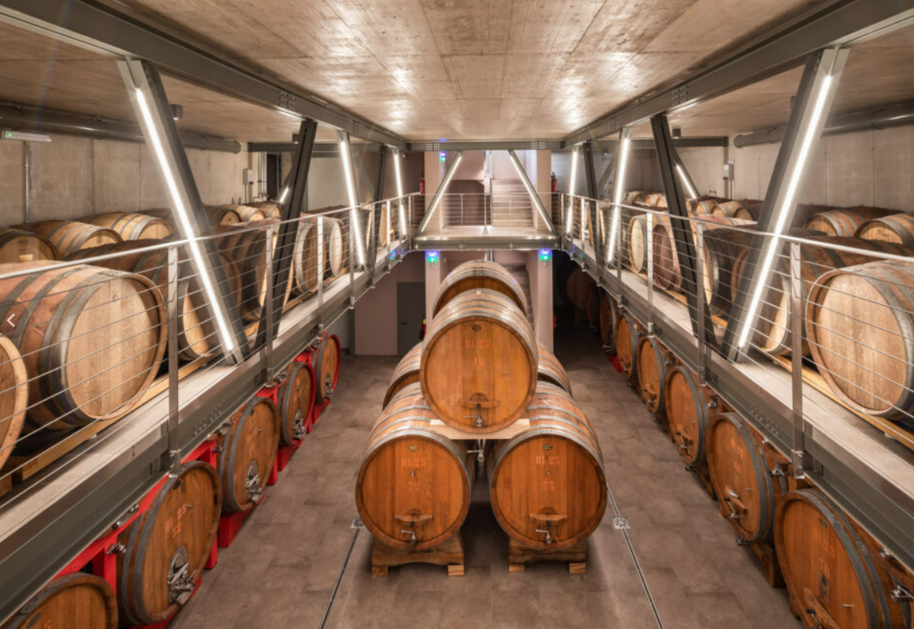
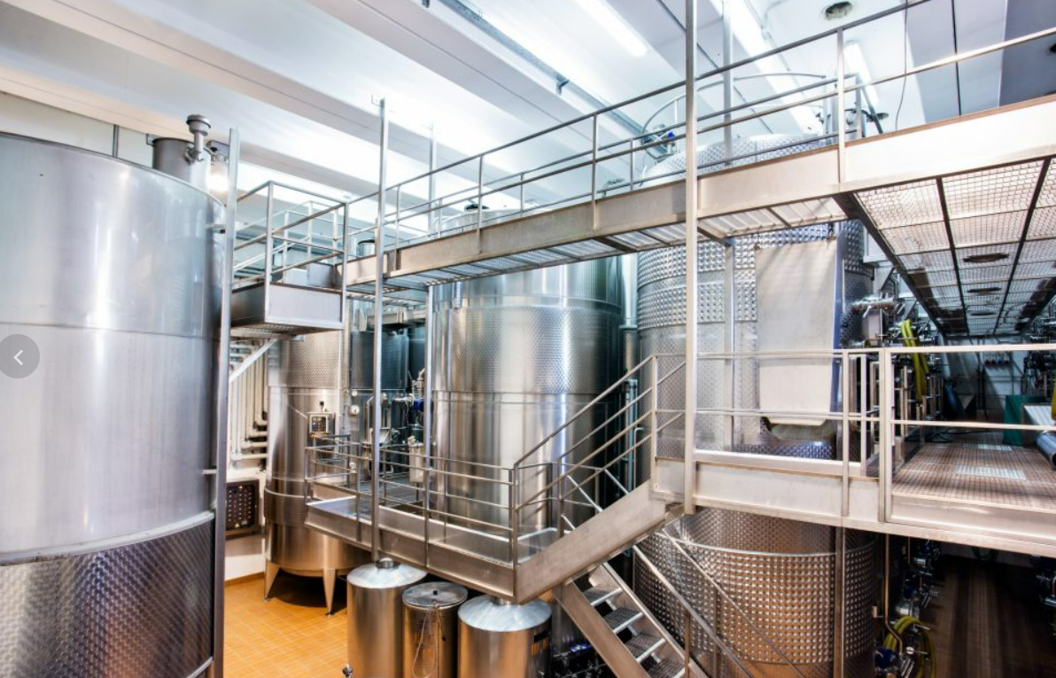

Slide 10
This paper adds to the existing literature by:
exploiting time-spatial effect’s variability at local level (municipality)
considering the entire set of agri-food patents (including wine and beer sectors)
disentangling the heterogeneity of the effect along the supply chain (agriculture vs food processing)
looking at the entire policy period 1992-2022 (quality)
applying counterfactual methods
Stranieri et al. (2023) is the first paper that empirically investigates the GI-innovation link finding that GIs affects innovative activities, but the effect is mediated by the region’s distance from the technological frontier
a quite huge territorial aggregations (NUTS2)
limit it to agricultural and food manufacturing patents, without considering the patent registered in the wine and beer sector
only quantitative outcomes (number of innovations) without considering the quality of the innovation→

Slide 11
AGRICULTURE; FORESTRY; ANIMAL HUSBANDRY; HUNTING; TRAPPING; FISHING
A01B | SOIL WORKING IN AGRICULTURE OR FORESTRY; PARTS, DETAILS, OR ACCESSORIES OF AGRICULTURAL MACHINES OR IMPLEMENTS, IN GENERAL
A01C | PLANTING; SOWING; FERTILISING
A01D | HARVESTING; MOWING
A01F | THRESHING (combines A01D 41/00); BALING OF STRAW, HAY OR THE LIKE; STATIONARY APPARATUS OR HAND TOOLS FOR FORMING OR BINDING STRAW, HAY OR THE LIKE INTO BUNDLES; CUTTING OF STRAW, HAY OR THE LIKE; STORING AGRICULTURAL OR HORTICULTURAL PRODUCE
A01G | HORTICULTURE; CULTIVATION OF VEGETABLES, FLOWERS, RICE, FRUIT, VINES, HOPS OR SEAWEED; FORESTRY; WATERING (picking of fruits, vegetables, hops or the like A01D 46/00; propagating unicellular algae C12N 1/12)
A01H | NEW PLANTS OR PROCESSES FOR OBTAINING THEM; PLANT REPRODUCTION BY TISSUE CULTURE TECHNIQUES [5]
A01J | MANUFACTURE OF DAIRY PRODUCTS (for chemical matters, see subclass A23C)
A01K | ANIMAL HUSBANDRY; AVICULTURE; APICULTURE; PISCICULTURE; FISHING; REARING OR BREEDING ANIMALS, NOT OTHERWISE PROVIDED FOR; NEW BREEDS OF ANIMALS
A01L | SHOEING OF ANIMALS
A01M | CATCHING, TRAPPING OR SCARING OF ANIMALS (appliances for catching swarms or drone-catching A01K 57/00; fishing A01K 69/00-A01K 97/00; biocides, pest repellants or attractants A01N); APPARATUS FOR THE DESTRUCTION OF NOXIOUS ANIMALS OR NOXIOUS PLANTS
A01N | PRESERVATION OF BODIES OF HUMANS OR ANIMALS OR PLANTS OR PARTS THEREOF (preservation of food or foodstuff A23); BIOCIDES, e.g. AS DISINFECTANTS, AS PESTICIDES OR AS HERBICIDES (preparations for medical, dental or toiletry purposes which kill or prevent the growth or proliferation of unwanted organisms A61K); PEST REPELLANTS OR ATTRACTANTS; PLANT GROWTH REGULATORS
A01P | BIOCIDAL, PEST REPELLANT, PEST ATTRACTANT OR PLANT GROWTH REGULATORY ACTIVITY OF CHEMICAL COMPOUNDS OR PREPARATIONS [2006.01]
FOODSTUFFS
A21B | BAKERS' OVENS; MACHINES OR EQUIPMENT FOR BAKING (domestic baking equipment A47J 37/00; combustion apparatus F23; domestic stoves or ranges being wholly or partly ovens F24B, F24C)
A21C | MACHINES OR EQUIPMENT FOR MAKING OR PROCESSING DOUGHS; HANDLING BAKED ARTICLES MADE FROM DOUGH
A21D | TREATMENT, e.g. PRESERVATION, OF FLOUR OR DOUGH FOR BAKING, e.g. BY ADDITION OF MATERIALS; BAKING; BAKERY PRODUCTS; PRESERVATION THEREOF [2006.01]
A22B | SLAUGHTERING
A22C | PROCESSING MEAT, POULTRY, OR FISH (preserving A23B; obtaining protein compositions for foodstuffs A23J 1/00; fish, meat or poultry preparations A23L; disintegrating, e.g. chopping meat, B02C 18/00; preparation of proteins C07K 1/00)
A23B | PRESERVING, e.g. BY CANNING, MEAT, FISH, EGGS, FRUIT, VEGETABLES, EDIBLE SEEDS; CHEMICAL RIPENING OF FRUIT OR VEGETABLES; THE PRESERVED, RIPENED, OR CANNED PRODUCTS
A23C | DAIRY PRODUCTS, e.g. MILK, BUTTER OR CHEESE; MILK OR CHEESE SUBSTITUTES; MAKING THEREOF (obtaining protein compositions for foodstuffs A23J 1/00)
A23D | EDIBLE OILS OR FATS, e.g. MARGARINES, SHORTENINGS, COOKING OILS (obtaining, refining, preserving C11B, C11C; hydrogenation C11C 3/12)
A23F | COFFEE; TEA; THEIR SUBSTITUTES; MANUFACTURE, PREPARATION, OR INFUSION THEREOF
A23G | COCOA; COCOA PRODUCTS, e.g. CHOCOLATE; SUBSTITUTES FOR COCOA OR COCOA PRODUCTS; CONFECTIONERY; CHEWING GUM; ICE-CREAM; PREPARATION THEREOF [2006.01]

Slide 12
FOODSTUFFS
A23J | PROTEIN COMPOSITIONS FOR FOODSTUFFS; WORKING-UP PROTEINS FOR FOODSTUFFS; PHOSPHATIDE COMPOSITIONS FOR FOODSTUFFS [4]
A23K | FEEDING-STUFFS SPECIALLY ADAPTED FOR ANIMALS; METHODS SPECIALLY ADAPTED FOR PRODUCTION THEREOF
A23L | FOODS, FOODSTUFFS, OR NON-ALCOHOLIC BEVERAGES, NOT COVERED BY SUBCLASSES A21D OR A23B-A23J; THEIR PREPARATION OR TREATMENT, e.g. COOKING, MODIFICATION OF NUTRITIVE QUALITIES, PHYSICAL TREATMENT (shaping or working, not fully covered by this subclass, A23P); PRESERVATION OF FOODS OR FOODSTUFFS, IN GENERAL [2006.01]
A23N | MACHINES OR APPARATUS FOR TREATING HARVESTED FRUIT, VEGETABLES, OR FLOWER BULBS IN BULK, NOT OTHERWISE PROVIDED FOR; PEELING VEGETABLES OR FRUIT IN BULK; APPARATUS FOR PREPARING ANIMAL FEEDING-STUFFS (machines for cutting straw or fodder A01F 29/00; disintegrating, e.g. shredding, B02C; severing, e.g. cutting, splitting, slicing, B26B, B26D)
A23P | SHAPING OR WORKING OF FOODSTUFFS, NOT FULLY COVERED BY A SINGLE OTHER SUBCLASS
CHEMISTRY – WINE and BEER
C12C | BEER; PREPARATION OF BEER BY FERMENTATION (ageing or ripening by storing C12H 1/22; methods for reducing the alcohol content after fermentation C12H 3/00; methods for increasing the alcohol content after fermentation C12H 6/00; venting devices for casks, barrels or the like C12L 9/00); PREPARATION OF MALT FOR MAKING BEER; PREPARATION OF HOPS FOR MAKING BEER
C12F | RECOVERY OF BY-PRODUCTS OF FERMENTED SOLUTIONS (removal of yeast from wine or sparkling wine C12G 1/08); DENATURED ALCOHOL; PREPARATION THEREOF [6]
C12G | WINE; PREPARATION THEREOF; ALCOHOLIC BEVERAGES (beer C12C); PREPARATION OF ALCOHOLIC BEVERAGES NOT PROVIDED FOR IN SUBCLASSES C12C OR C12H
C12H | PASTEURISATION, STERILISATION, PRESERVATION, PURIFICATION, CLARIFICATION OR AGEING OF ALCOHOLIC BEVERAGES; METHODS FOR ALTERING THE ALCOHOL CONTENT OF FERMENTED SOLUTIONS OR ALCOHOLIC BEVERAGES (deacidification of wine C12G 1/10; preventing winestone precipitation C12G 1/12; simulation ageing by flavouring C12G 3/06) [6]
C12J | VINEGAR; PREPARATION OR PURIFICATION THEREOF

Slide 13
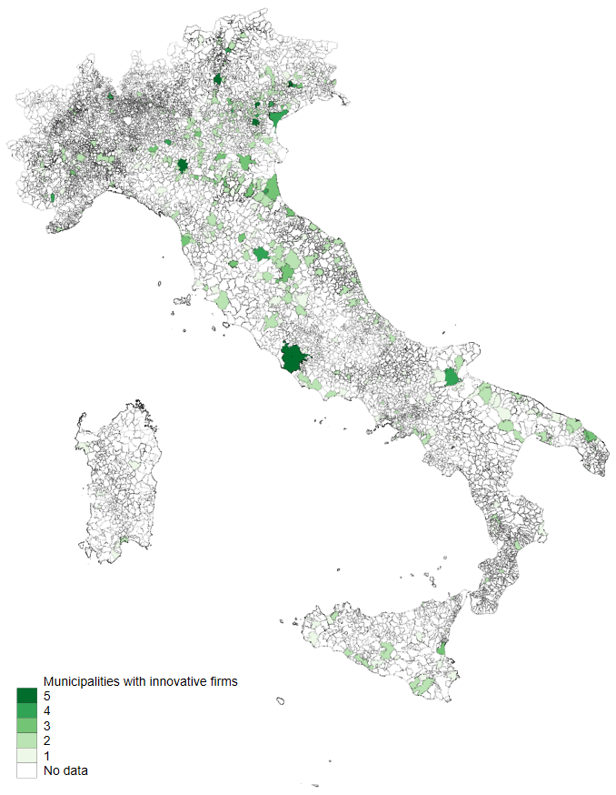
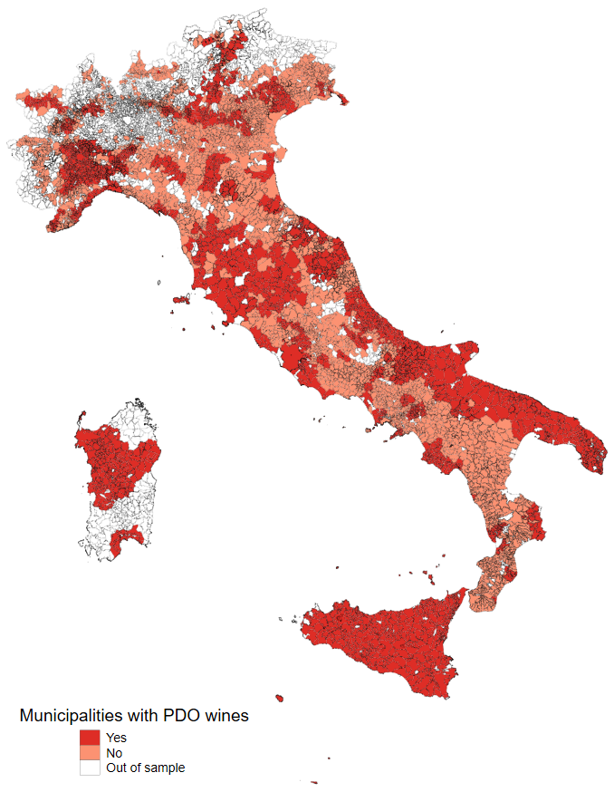

Slide 14
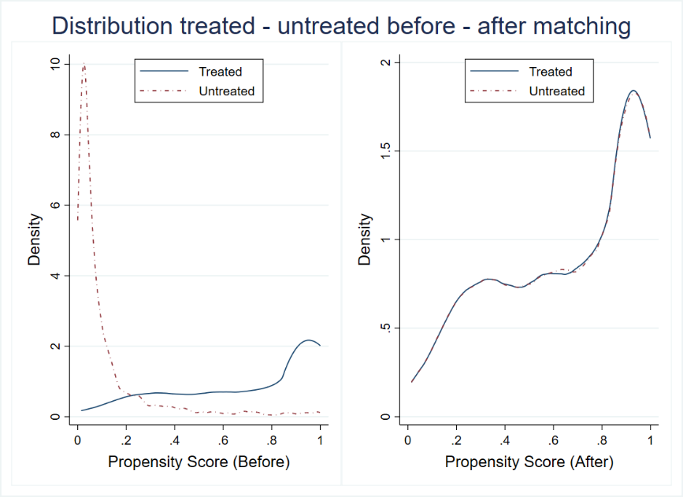
Methodology
1. one to many k-nearest PSM (Rosenbaum and Rubin, 1983)
Controls: population density, elderly rate, remote housing, high-education rate, employment rate, distance from major cities, Utilised Agricultural Area, winegrowing farms density, winegrowing farms' physical size, family farms, Utilised Agricultural Area diffusion, altitude, spatial lagged wine PDO, spatial lagged agri-food patent
108 municipalities are off support
Matching balance and parallel-trend test satisfied

Slide 15
Empirical strategy
2. DiDs Static
5 years pre-post
a static picture of the phenomenon
i is the municipality and t is the pre-post period
Post_{it}∗PDO_{it} is the interaction term between these two variables and capture the effect of the presence of a PDO acknowledgment
Controls: dummy variable accounting for the presence of PGI wines, unbalanced covariates (population density), NUTS3 fixed effects
Innovation_{it} is declined in terms of the probability of having at least one patent in the technological fields under analysis (i.e., log transformation of the binary variable + 1).
Innovation_{it} = a + β1PDO_{it} + β2Post_{it} + β3(Post_{it}∗PDO_{it}) + Controls_{it} +µ_{i} + ε_{it}

Slide 16
Methodology
3. DiDs dynamic (à la Callaway and Sant’Anna)
cohort based dynamic estimation used when a unit becomes treated at a given time and remained treated for all the next times.
i is the municipality and t is year
PDO_{it} is the dummy that capture the presence of a PDO acknowledgment
Controls: dummy variable accounting for the presence of PGI wines, unbalanced covariates (population density), NUTS3 fixed effects
Innovation_{it} is declined in terms of the probability of having at least one patent in the technological fields under analysis (i.e., log transformation of the binary variable + 1).
Innovation _{i,t} = $α+ β_{1}{PDO}_{it}{+Controls}_{it−1}+{\text{γ}}_{i}+{\text{μ}}_{t}+ε_{it}$

Slide 17
Results
The impact of GI policy on agrifood innovation
Even if the magnitude of the effect is lower, in comparison with the non-treated municipalities, the inclusion within a GI area generates an average increase in the probability of registering an innovation patent in the technological fields under analysis in treated areas
 | Agrifood patent | Agricultural patent | Food patent | Only Agrifood patent
 | (1) | (2) | (3) | (4)
PDO*Post | 0.0026*** | 0.0014*** | 0.0012*** | 0.0013**
 | (0.0006) | (0.0005) | (0.0004) | (0.0005)
Treated (PDO) | Yes | Yes | Yes | Yes
Post | Yes | Yes | Yes | Yes
PGI control | Yes | Yes | Yes | Yes
Unbalanced covariates | Yes | Yes | Yes | Yes
NUTS3 fixed effects | Yes | Yes | Yes | Yes
Constant | Yes | Yes | Yes | Yes
Observations | 3,209 | 3,209 | 3,209 | 3,209
R2 | 0.1 | 0.06 | 0.05 | 0.06

Slide 18
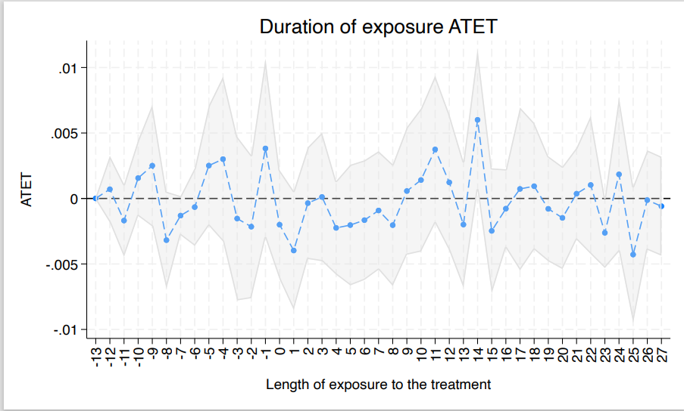
Results
The impact of GI policy on agrifood innovation over time
The effect seems to not increase as exposure to treatment augments

Slide 19
AGRI
FOOD

Slide 20
Conclusions and policy advices
There is not exclusion competition between GIs and innovation, even if there is no evidence of a clear increasing effect
Empirical approach for policy evaluation
So, to “foster knowledge and innovation” …
a more inclusive and cohesion strategy is needed to spur innovation. CAP and AKIS; regional policies (i.e., Cohesion Policy), specific national strategy (such as the SNAI strategy in Italy) or EU plans (e.g., Smart Specialization Strategy)
Regarding the new EU Law of GIs (2024), innovation performance should be
supported by the introduction of a more simplified and short amendment procedures for changing existing products specifications,
limited by the fact that the EU did not introduce specific sustainability requirements
ex-ante socio-economic conditions and inter-organizational relationships bias - National or sub-national institutional supports become fundamental

Slide 21
Cristina Vaquero-Piñeiro, Department of Economics, Roma Tre University cristina.vaqueropineiro@uniroma3.it
Thank you for your attention!

