Slide 1
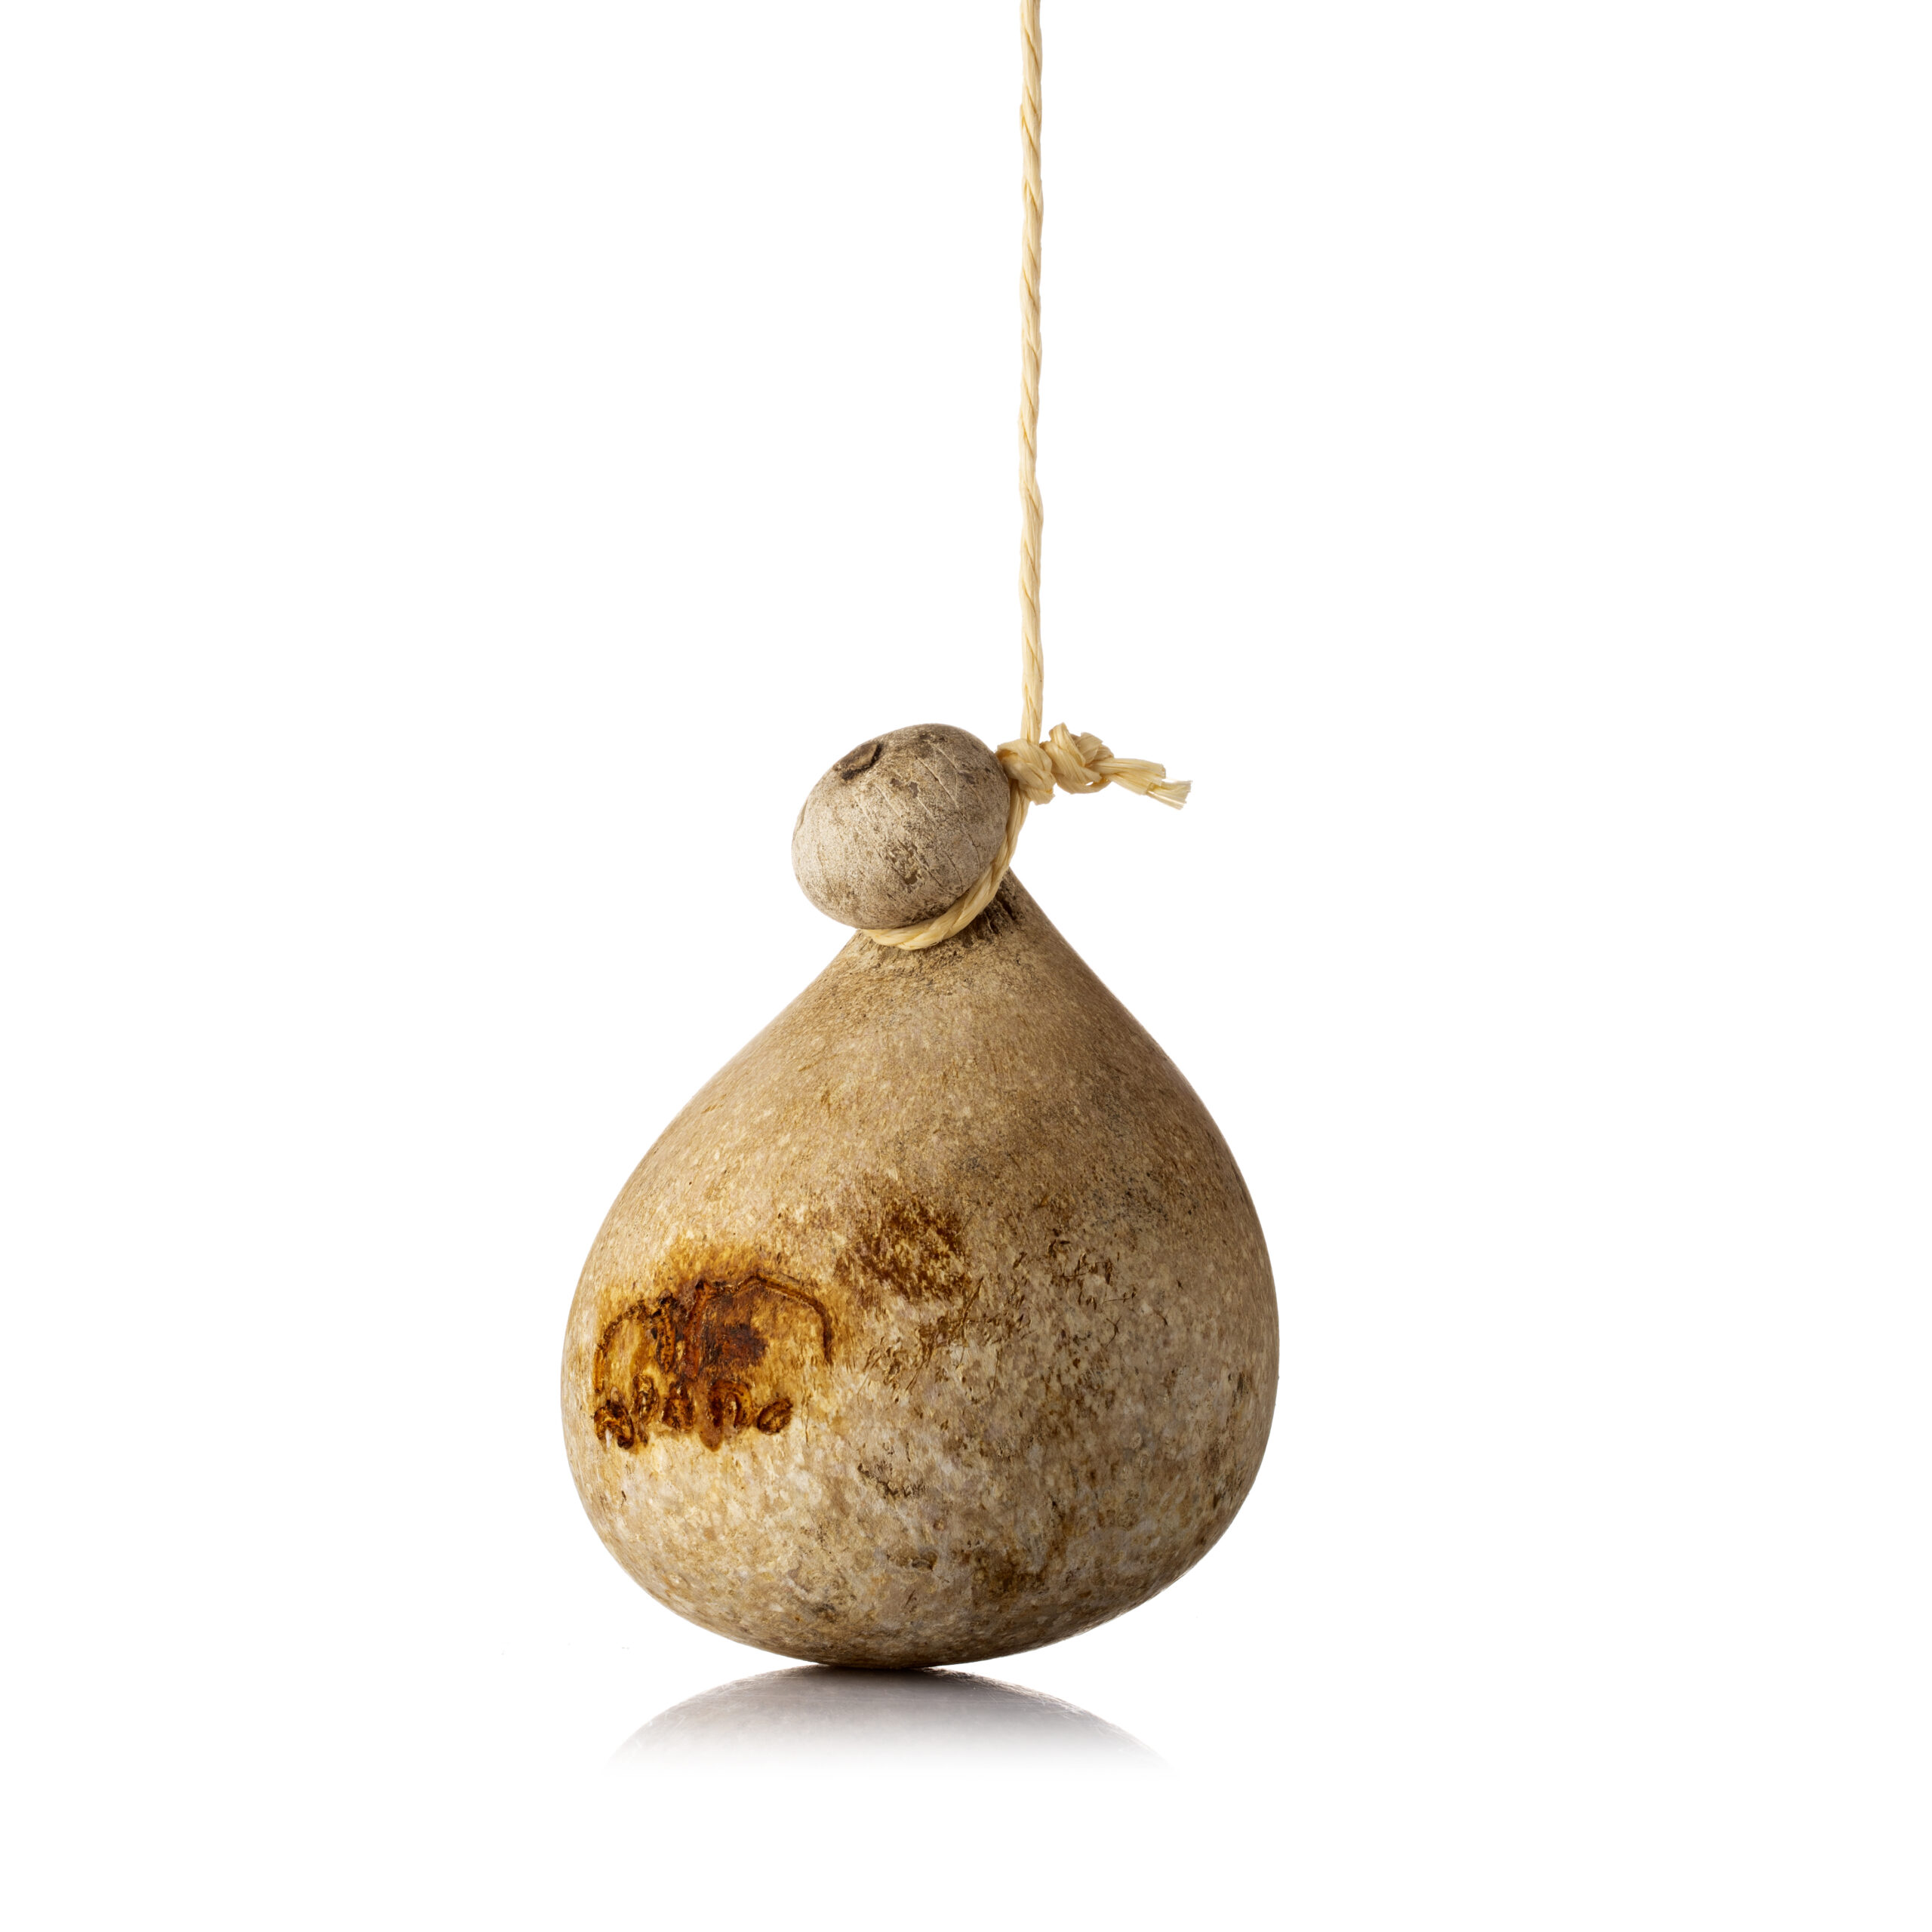
International Conference Parma 2024 “The Role of Origin in the Sustainability of localised Food Systems” 20-22 November 2024
A Hedonic Price Analysis of
PDO Caciocavallo Cheese and Competitors
Giovanni Ottomano Palmisano, Enrica Morea,
Rocco Roma, Claudio Acciani, Annalisa De Boni
University of Bari Aldo Moro,
Department of Soil, Plant and Food Sciences, Italy

Slide 2
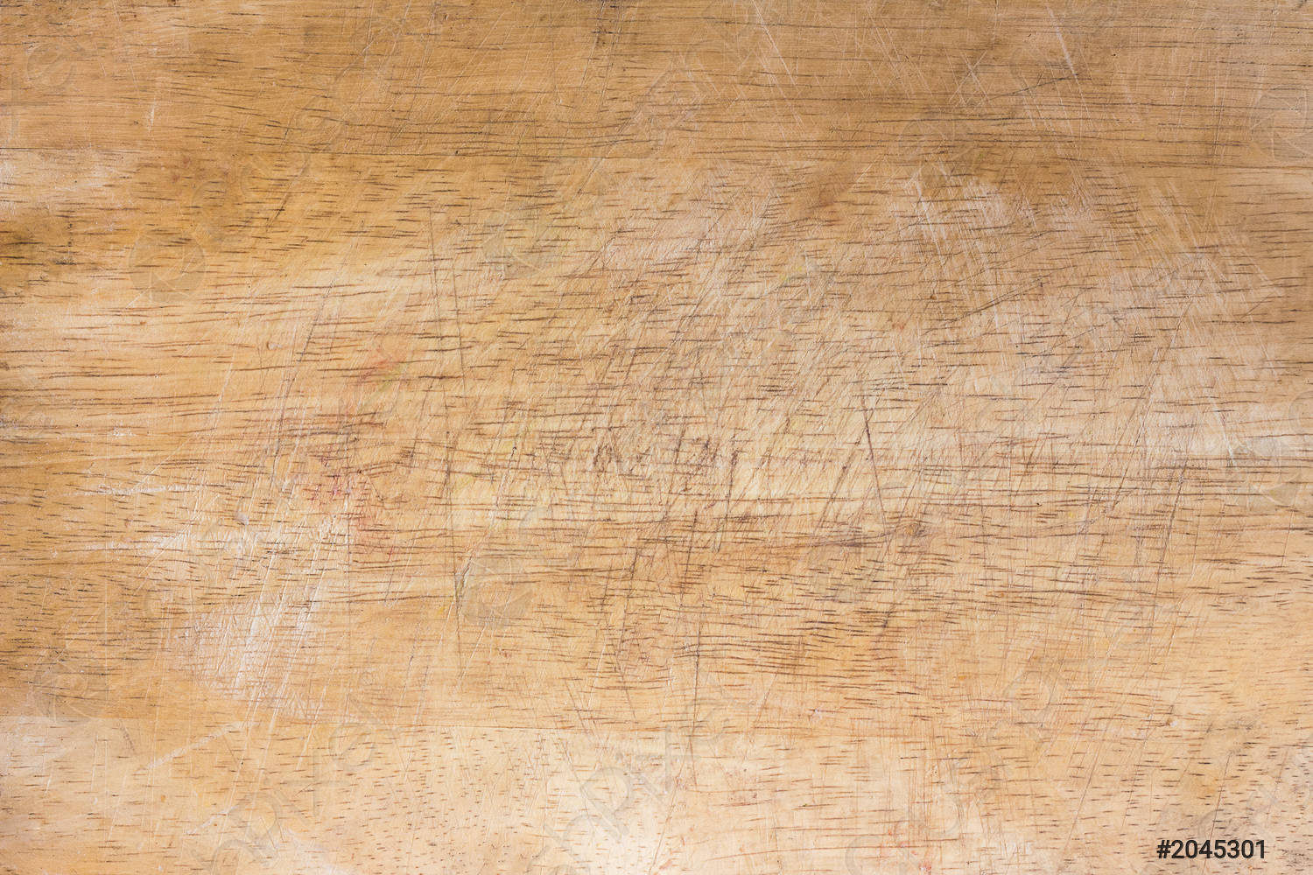
Introduction
the European cheese market accounts to about 13 billion euros in 2023. European cheese consumption in 2023 was around 20.5 kg per capita. The countries with the highest annual cheese consumption are France (26.2 kg), Germany (24.1 kg), Greece (23.3 kg), Finland (22.4 kg) and Italy (21.7 kg).
Rising prices for milk and dairy products have led to a contraction in demand corresponding to a decrease of 1% of quantities purchased, despite an increase of 14% percent of household spending in the first ten months of 2023; however, this trend did not affect the consumption of hard cheeses.
Recently, cheese producers differentiated their products from those of market competitors by introducing new attributes (e.g. the sustainability of the production process, origin and quality, use of local raw materials and the traditionality of the cheese, different purchase channels.

Slide 3
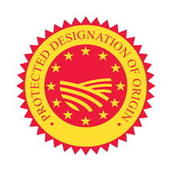
Introduction
The Italian dairy sector is well-known with nearly 500 types of cheese, including 56 cheeses with Geographical Indications (53 PDO, 2 PGI and 1 TSG cheeses).
Pasta filata cheeses take a consistent share of the supply chain; caciocavallo is one of the most popular pasta filata cheeses among consumers; the term refers to a wide range of semi-hard cheeses, including those from Italy (caciocavallo Silano, Podolico, Molisano, Pugliese, Corleonese, etc.), the Balkans (Kashkaval Balkan) and Russia (kashkavalo).

Slide 4
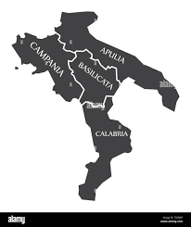
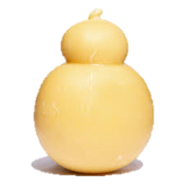
Introduction
In 1993, the Consortium for the Protection of “Formaggio Caciocavallo Silano” was established and subsequently recognized by the Italian Ministry of Agricultural, Food and Forestry Policies. The production area of ​​Caciocavallo Silano is located in some territories of the regions Basilicata, Calabria, Campania, Molise and Puglia.
Region | No. of producers | Production (tons) | % of production | Production (Euro)
Basilicata | 4 | 200.873 | 16 | 2,008,730
Calabria | 4 | 367.635 | 29 | 3,676,354
Campania | 2 | 495.234 | 39 | 4,952,340
Molise | 3 | 94.752 | 8 | 947,514
Puglia | 4 | 104.858 | 8 | 1,048,582

Slide 5
Aim of the research
Nevertheless, there is lack of research that analyse the role of different attributes in influencing the price of caciocavallo cheese, including the purchase channels.
This study intends to explore the market of caciocavallo silano cheese using an approach that highlights how prices vary according to certain attributes, which can differentiate this cheese from the market competitors.

Slide 6
Materials and methods
Two focus groups were carried out to identify the most relevant attributes influencing caciocavallo price:
The first with the actors involved in the caciocavallo silano cheese supply chain, specifically milk producers and processors, and representatives of producer organisations, retail and wholesale traders;
The second with the consumers.

Slide 7
Materials and methods
Twelve attributes were identified and the subsequent data collection was performed in Apulia region (Southern Italy) from different purchase channels (supermarkets, discount stores, local markets, specialized and e-commerce shops, and direct purchase by the producer). Then, the hedonic price method was applied:
Pj = f(Zj)
where Z is a vector of attributes belonging to the product j, while f(.) is an unspecified functional form. This equation highlights that the price P consumers pay for the product j, is a function of the monetary value of each of the Z attributes embedded in the product j.

Slide 8
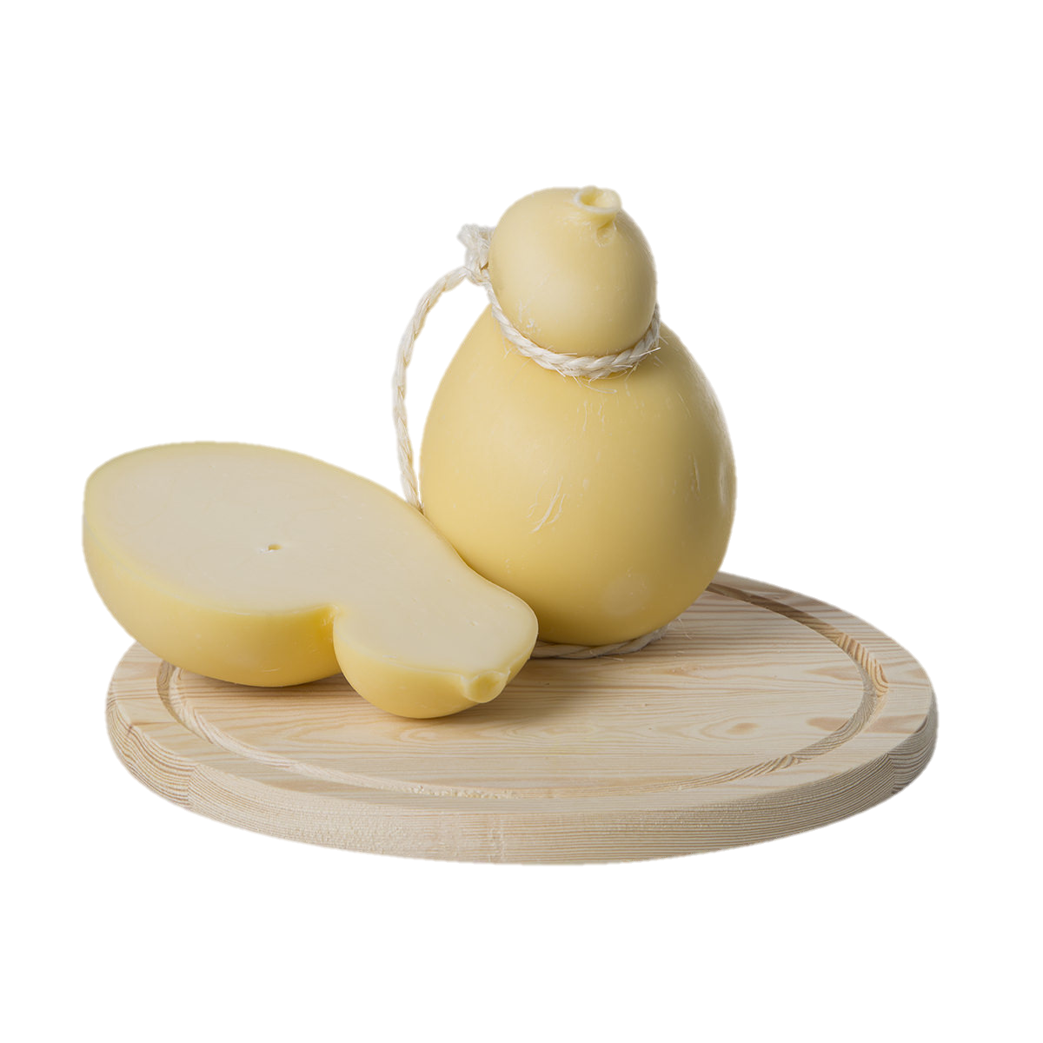
Results
A total of 118 observations were collected in the first quarter of 2024. The equation is as follows:
ln (packaged_product_price) = constant + x1 (Discount) + x2 (Specialized) + x3 (Direct) + x4 (e_commerce) + x5 (Market) + x6 (PDO) + x7 (Organic) + x8 (Private_label) + x9 (Seasoning_90 days) + x10 (Vacuum_pack) + x11 (l_Product_weight)

Slide 9
Results
Considering the “baseline” product (caciocavallo silano cheese with reference attributes that are omitted in the equation), the price per kg is equal to the inverse operation of the logarithmic transformation: exp (2.90) = 18.17 Euros/kg.
 | Coefficient | p-value | Impact on price (%) | Impact on price (€/kg)
Const | 2.90 | <0.0001 ***
Discount | −0.07 | 0.20
Specialized | −0.20 | 0.0005 *** | -20% | -3.63
Direct | −0.13 | 0.1284
e_commerce | 0.33 | <0.0001*** | +33% | +5.99
Market | −0.14 | 0.30
PDO | −0.03 | 0.45
Organic | 0.03 | 0.72
Private_label | −0.10 | 0.21
Seasoning_90gg | 0.00 | 0.96
Vacuum_pack | −0.03 | 0.72
l_Product_weight | 0.98 | <0.0001 *** | 0.98 (elasticity)

Slide 10
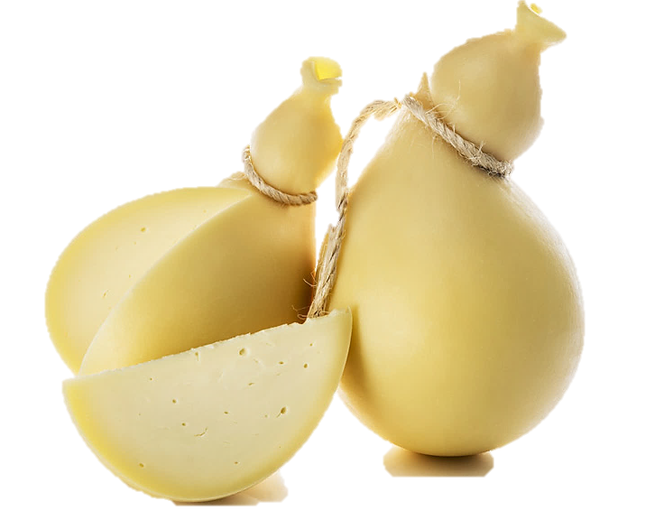
Results
The sale through specialized shops determines a negative price variation of 20%, then the price is 14.54 Euros/kg, everything else remaining constant;
The sale through e-commerce stores leads to a positive price variation of 33%, thus the price is 24.7 Euros/kg, everything else remaining constant;
Regarding the certification attributes, neither DOP nor organic certifications affected the price variation.

Slide 11
Main conclusions
The results confirmed the influence of distribution channels on the final price. The sale through e-commerce stores led to the highest positive price variation, which may be due to the possibility of buying a typical food product where it is not normally available (outside the production area) through conventional purchase channels (e.g. supermarkets and hypermarkets)
About a third of the product sold via e-commerce was PDO certified. This certification, although it should represent an additional quality guarantee for the consumers using this purchase channel, did not influence price variation.

Slide 12
Main conclusions
The negative variation in prices for sales through specialized shops cannot be considered robust because of the poor representation of this attribute in the sample. However, specialized shops usually source directly from producers, reducing the transaction costs.
Research is still ongoing, particularly with the intention of implementing the dataset specifically with regard to PDO cheeses and some sale channels (e.g. specialized shops, street markets), which, at this stage, were poorly represented in the sample analysed.

Slide 13
Thank you for the attention
Giovanni Ottomano Palmisano giovanni.ottomanopalmisano@uniba.it

