Slide 1
Understanding the Trade-offs at Stake for More Sustainable GIs Outcomes: Identifying Underlying Good Practices
Isabella Maglietti Smith and Dominique Barjolle,
ORIGIN FOR SUSTAINABILITY

Slide 2
Introduction
Geographical Indications (GIs) face sustainability challenges due to trade-offs between economic, environmental, social, and governance objectives.
This contribution explores these trade-offs and proposes examples good practices to address those trade-offs

Slide 3
Objective
What key trade-offs exist between economic, environmental, social, and governance outcomes that could potentially hinder the sustainability of Geographical Indications (GIs)?
What are the underlying causes of these trade-offs, and what impacts do they have?
What sustainable practices could help prevent these trade-offs, and how can these practices be scaled up to enhance the sustainability and value of Geographical Indications?
Understand the trade-offs
at stake for
more sustainable GIs outcomes,
by identifying underlying good practices,
at stake for
→ the provision of public goods and
→ better valorise GIs sustainable outcomes.

Slide 4
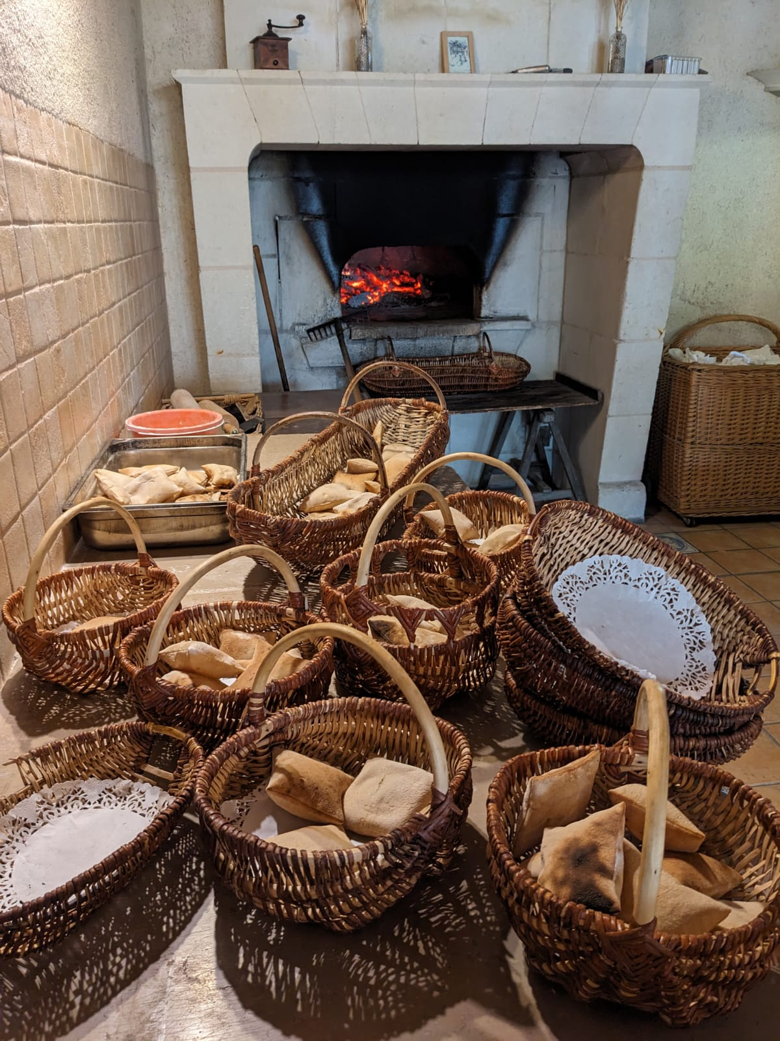
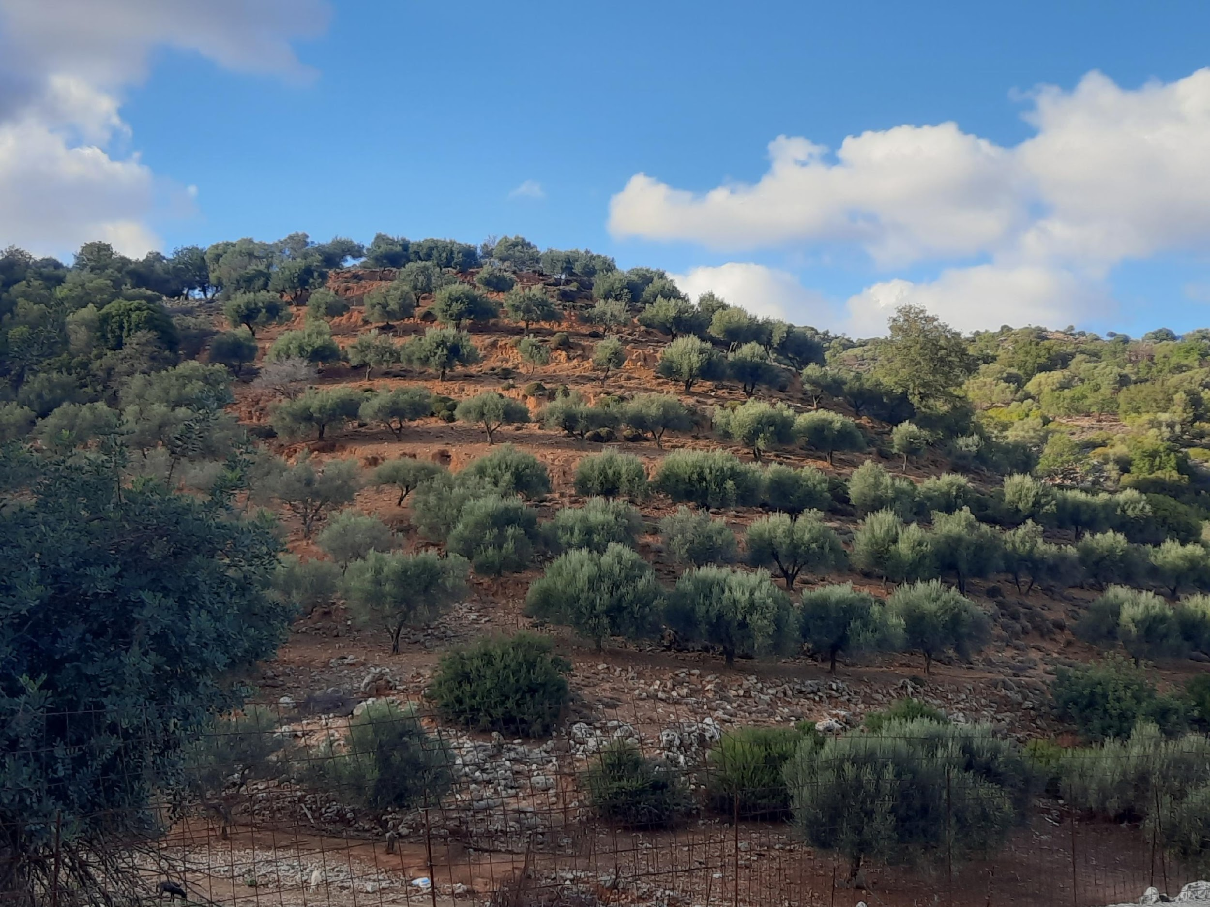
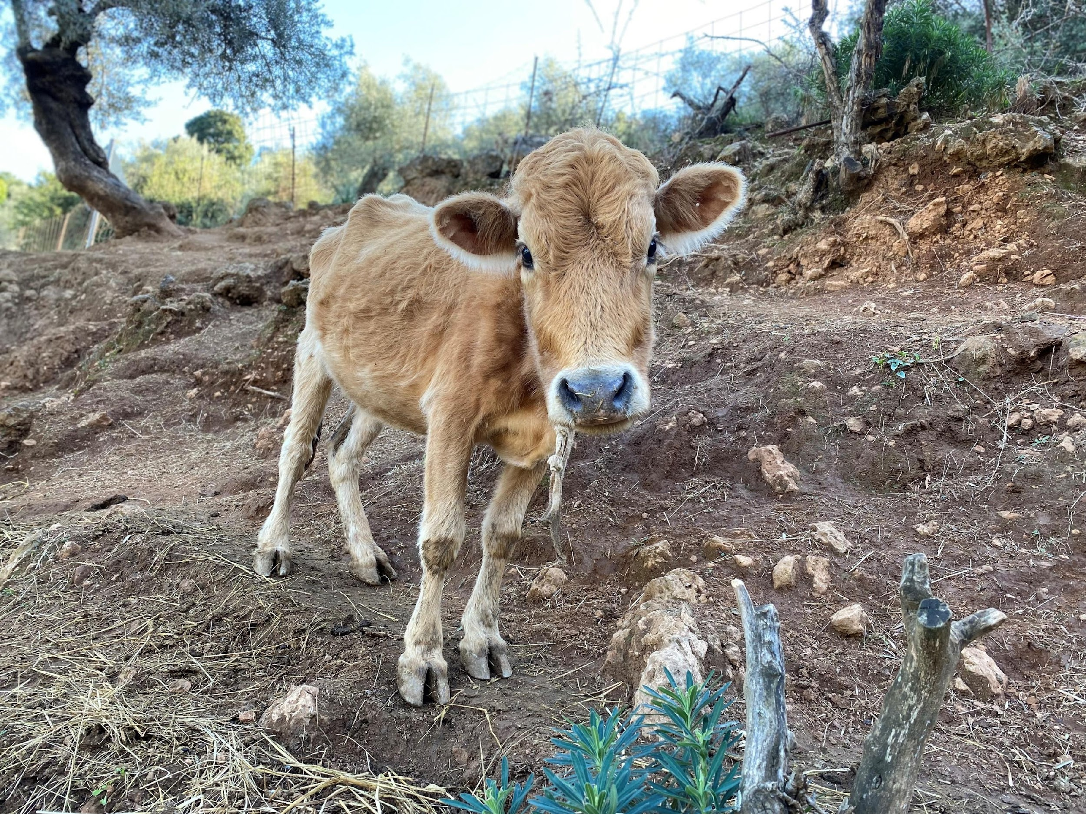
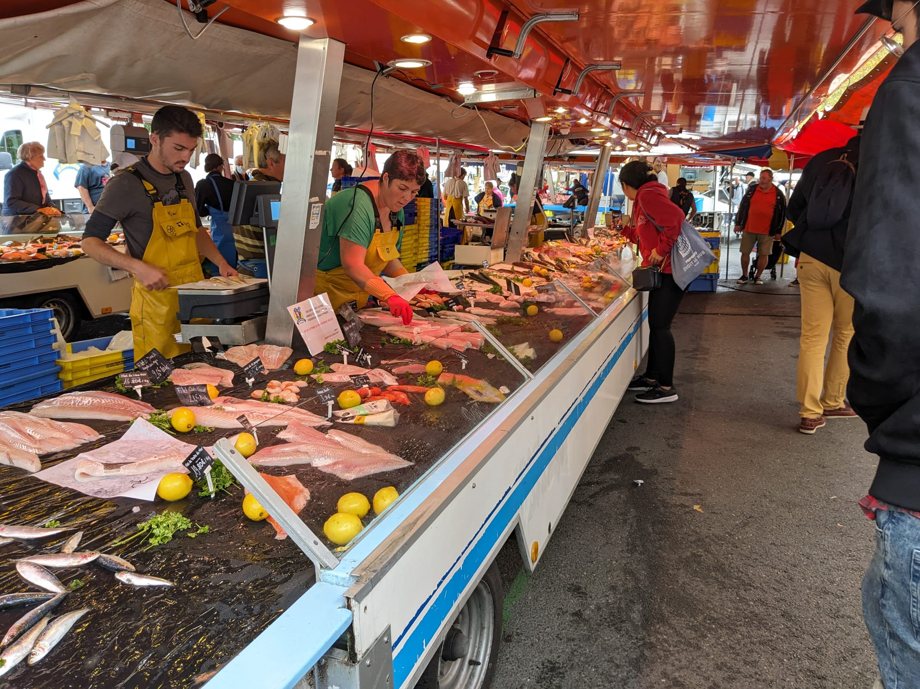
GI System
A system including all stakeholders and activities that contribute to the production of the GI product. A GI system thus includes:
the GI producers
the other stakeholders involved directly or indirectly in the value chain, including but not limited to
public authorities,
NGOs,
research institutions,
Extension services and
other institutions directly linked to the GI product (for example tourism activities in the production area). (ref. FAO-SINERGI Guide)

Slide 5
Sustainable practices in the Art. 7 in New EU Reg. 2024-1143
A (sustainable) practice (which) contributes to one or more social, environmental or economic objectives, such as:
climate change mitigation and adaptation, the sustainable use and protection of landscapes, water and soil, the transition to a circular economy, including the reduction of food waste, pollution prevention and control, and the protection and restoration of biodiversity and ecosystems;
the production of agricultural products in ways that reduce the use of pesticides and manage risks resulting from such use, or that reduce the danger of antimicrobial resistance in agricultural production;
animal welfare;
a fair income for producers, diversification of activities, promotion of local agricultural production, and valorisation of the rural fabric and local development;
preservation of agricultural employment by attracting and sustaining young producers and new producers of products benefiting from a geographical indication;
improving working and safety conditions in agricultural and processing activities.

Slide 6
Workshop #1 - Identify the specific aspects in all four dimensions - Methodology
Participants worked in small groups to identify which dimensions—environmental, social, economic, and governance—best demonstrate GI sustainability. They explored specific aspects within each dimension (e.g., biodiversity for environmental, fair income for economic), discussed overlaps and trade-offs, and ranked dimensions based on perceived importance.
Which dimensions/aspects demonstrate GI sustainability (environmental, social, economic, governance)?

Slide 7
Sustainability Dimensions
Workshop #1 Results
Article 7 EU Regulation 2024/1143 sustainability definition topics
Social
Local community identification with GI products
Producers’ pride and self-esteem
Short value chain and engagement of young farmers
Governance: democratic functioning, collective action, cooperation
Work conditions: fair wages, decent income, fair governance
Diversity and inclusion: generational gap, gender awareness, cultural value
Social innovation and international cooperation (fairs and advertising)
Nutriscore and nutrient presence (EFSA claims)
Health impact: good bacteria, minerals, pesticide residues
Environmental
Landscape and biodiversity: reduction in landscape/ecosystem diversity
Resource use: water resilience, collective water management
Eco-friendly practices: low-input use, blacklisted harmful inputs
Carbon/water footprint: tracking impact and Life Cycle Assessment
Circular economy: waste management and local resource use
Air and soil quality: limited pesticide use, soil preservation
Animal welfare: balance of on-farm feed, humane livestock practices
Economic
Production costs and fair remuneration for producers
Consumer price and market dynamics: fair prices, premium pricing
Value chain and competition: balancing GI and non-GI products, market share
Income data: total production data, farm size, and location-based impact
Market access and diversification: growth through diverse channels
Value chain resilience: supporting local and export markets
Innovation and product control: specialization, resilience to shocks
Governance
Democratic governance: participatory decision-making, fair power distribution
Producer cooperation: strong local ties, value chain relations
Regulatory adaptation: policies tailored to support GI sustainability
Support structures: local and international support through networks and agencies

Slide 8
Workshop #2 - Identify the trade-offs and good practices - Methodology
Participants were divided into six groups (G1-G6), each analyzing trade-offs between two sustainability components:
G1: Social-Economic
G2: Environment-Economic
G3: Governance-Economic
G4: Social-Environment
G5: Social-Governance
G6: Governance-Environment
The analysis considered GI systems at territorial scale (local production) and global scale (consumption), using a full value chain perspective. Groups identified trade-offs, their impacts, and proposed sustainable practices , providing actionable insights for enhancing GI sustainability.

Slide 9
Economy - Environment
Economy
Environment
Economic gains from intensification
Milk quota management for the purpose of controlling quantity and therefore keeping fair prices to farmers
Biodiversity losses
Grazing techniques and rules to manage quantity instead of quota (that have many consequences to the intensity of animal/ha linked over-use of inputs on the pastures, at the detriment to biodiversity of plants and in the soils
Good practice (example)
Repurposing whey for economic and environmental benefits

Slide 10
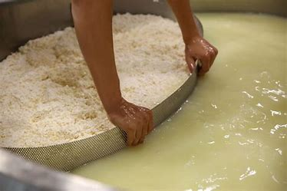
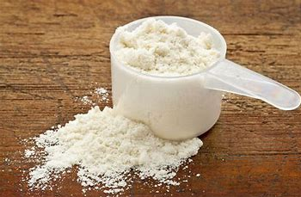
Good practice (example)
Whey as a Byproduct in Cheese Production
Trade-off: Environmental sustainability versus Economic viability
Environmental Component: Repurposing whey (produce ‘ricotta’/animal feed/fertilizer/whey-based) reduces waste, minimizes the environmental impact, and promotes a circular economy. Disposing of whey into the environment without treatment is prohibited under EU environmental laws.
Economic Component: It requires additional investment, increasing production costs. This practice not only reduces waste but also creates additional income sources, supports local economies, and minimizes environmental impact.
Powder milk/
Whey protein
Animal feed
Repurpose
Milk whey
Ricotta
Natural fertilizer

Slide 11
Economy - Social
Economy
Social
Lack of economic return to the farmers
(very high workload at extremely low income)
Innovations improving competitiveness, including the reduction of labor costs
Disinterest of the young generation in uptaking the farms
Reduction of employment perspectives for agricultural manpower leading to shortcomings in competent manpower availability
Good practice (example)
Supporting young farmers allowing them to invest for better working conditions

Slide 12
Governance – Economy
Governance
Economy
Decision making system (dominant actors that take control over the GI system)
Trust deficit in PDO/PGI governance
Difficulties to balance between fairness and effectiveness
Inefficiencies in fixing quality / quantity, therefore lack of capacity to address the market conjoncturel changes (leads to price fluctuations for all stakeholders, especially the farmers)
Good practice (example)
Improve decision making processes and fix better rules for having fair representation of all stakeholders, incl. minorities

Slide 13
Social - Environment
Social
Environment
Traditional husbandry practices
Social pressure for the wolf protection
Overgrazing in certain GI which have market success (intensification)
Wolf predation of animals put pressure on herders - risk of disparition of some GI
Good practice (example)
Adapt the regulations on wolf protection in order to reduce pressure of predation

Slide 14
Governance - Social
Governance
Social
Lack of democratic decision-making processes
Lack of inclusion
Bad prices for farmers hinder their motivation towards GI long term perspectives, including sustainability practices
Lack of motivation for women and youth to stay in the GI system
Good practice (example)
Improve governance in order to include women and youth perspectives

Slide 15
Governance - Environment
Governance
Environment
Top-down decisions on environmental protection in the code of practice
No short term environmental benefits
Good practice (example)
Pilot changes towards more care to natural resources before changing code of practice

Slide 16
Conclusion
Sustainable GIs require navigating intricate trade-offs through a multi-stakeholder approach.
Promoting scalable sustainability practices aligned with economic, environmental, governance and social long term objectives can synergize all four dimensions, ensuring the resilience and sustainability of GIs.
The collaboration among producers, policymakers, and consumers is pivotal in balancing these trade-offs effectively.

Slide 17
Thank you

Slide 18
Q&A
Discussion

