Slide 1
International Conference Parma 2024
Workshop n°3
THE TRUE COST OF WINE FROM A BIOREFINERY PERSPECTIVE
Breuillot Marie-Clémence (EPFL)
Barjolle Dominique (UNIL)
Notes:
(0’30)
Hello everyone,
My name is Marie-Clémence, and today I have the pleasure of joining you to present, together with Dominique Barjolle, the concept of True Cost Accounting of Food.
This contribution is part of my master’s thesis project, conducted at EPFL (Swiss Federal Institute of Technology).
And so, we will explore this concept through the case study of wine from a biorefinery perspective.
Without further ado, let’s dive in!

Slide 2
CONTENT
Introduction
Objectives
Methodology
Results
Conclusion
Challenges - Further research
The True Cost of Wine from a biorefinery perspective
Notes:
(0’25)
In this presentation, I will begin by introducing the concept of True Cost Accounting, outline the objectives that guided this contribution, then present the applied methodology in broad terms, and discuss the main results along with the insights they provide, as well as the challenges encountered and potential directions for further research.

Slide 3
Introduction
Objectives
Methodology
Results
Conclusion
Challenges
What is True Cost Accounting for Food (TCAF) ?
Environmental
Human Health
The True Cost of Wine from a biorefinery perspective
Tool to adress agrifood systems’ issues¹
Production costs
Hidden costs & benefits
Socio - Economic
True cost
Notes:
(0’45)
The prices of food and beverages that we pay as consumers rarely reflect the true costs and benefits associated with their production and consumption. In fact, there are so-called "h/i/dden" costs, resulting from the environmental, social, and health impacts of agricultural commodity-related activities, also called sometimes "negative externalities."
These include, for example, the degradation of natural resources, insufficient wage conditions, or diseases related to pesticide exposure.
These h/i/dden costs are generally ignored or seen as necessary trade-offs, and are ultimately externalized to society.

Slide 4
Introduction
Objectives
Methodology
Results
Conclusion
Challenges
What is True Cost Accounting for Food (TCAF) ?
Environmental
Human Health
The True Cost of Wine from a biorefinery perspective
Tool to adress agrifood systems’ issues¹
Informed decision-making
Policymakers – Farmers – Consumers..²
Production costs
Hidden costs & benefits
Socio - Economic
True cost
Notes:
(0’10)
In this context, the True Cost Accounting (TCA) methodology is proposed as a tool to guide structural changes toward more sustainable agri-food systems.

Slide 5
Introduction
Objectives
Methodology
Results
Conclusion
Challenges
What is True Cost Accounting for Food (TCAF) ?
Environmental
Human Health
The True Cost of Wine from a biorefinery perspective
Tool to adress agrifood systems’ issues¹
Informed decision-making
Policymakers – Farmers – Consumers..²
Production costs
Hidden costs & benefits
Socio - Economic
No harmonized methodology^{3,4}
Product-focused studies still limited
True cost
Notes:
(0’19)
TCA provides a holistic and systemic approach to measuring and valuing hidden costs and benefits alongside production costs, with the aim of facilitating informed and improved decision-making by policymakers, businesses, farmers, and consumers.

Slide 6
Introduction
Objectives
Methodology
Results
Conclusion
Challenges
What is True Cost Accounting for Food (TCAF) ?
Environmental
Human Health
The True Cost of Wine from a biorefinery perspective
Tool to adress agrifood systems’ issues¹
Informed decision-making
Policymakers – Farmers – Consumers..²
Production costs
Hidden costs & benefits
Socio - Economic
No harmonized methodology^{3,4}
Product-focused studies still limited
True cost
Notes:
(0’20)
While still a nascent field in academia, TCA has been around for many years in international organizations. As a result, there is a growing understanding of these costs at national and global levels, but it remains limited at the product level.
It is also important to note that, to date, no standardized (TCA) methodology exists.

Slide 7
Introduction
Objectives
Methodology
Results
Conclusion
Challenges
TCA: Current scope & Value of by-products integration
?
Food production
Significant source of biomass⁵
Comprehensive assessment
Biorefinery approach
Non-food
by-products
The True Cost of Wine from a biorefinery perspective
Non-food
by-products
Food processing
?
?
Distribution
Food
Materials
Energy
Consumption
Notes:
(0’20)
Nevertheless, the review of existing methods and frameworks reveals a common focus on assessing externalities within a defined scope that covers the entire food supply chain, from production to consumption, including food processing and distribution.

Slide 8
Introduction
Objectives
Methodology
Results
Conclusion
Challenges
TCA: Current scope & Value of by-products integration
?
Food production
Significant source of biomass⁵
Comprehensive assessment
Biorefinery approach
Non-food
by-products
The True Cost of Wine from a biorefinery perspective
Non-food
by-products
Food processing
?
?
Distribution
?
Food
Materials
Energy
Consumption
Notes:
(0’30)
One aspect is (therefore) overlooked: the externalities associated with non-food by-products in the downstream value chain.
By by-product we mean a substance that results from a production or transformation process, which is neither the final product intended by that process nor waste. But, it might have economic value or be reused for other industrial or commercial applications.

Slide 9
Introduction
Objectives
Methodology
Results
Conclusion
Challenges
TCA: Current scope & Value of by-products integration
?
Food production
Significant source of biomass⁵
Comprehensive assessment
Biorefinery approach
Non-food
by-products
The True Cost of Wine from a biorefinery perspective
Non-food
by-products
Food processing
?
?
Distribution
?
Food
Materials
Energy
Consumption
Notes:
(0’50)
The important thing to know is that by-products actually represent a significant source of biomass with considerable potential for various applications, including nutritional products, functional ingredients, and bioactive components.
And so depending on the way they are managed, by-products can generate additional environmental and socio-economic externalities ; either positive or negative.
By integrating them into TCA, we aim to achieve a more comprehensive assessment of the entire system, promoting a multi-stakeholder biorefinery approach that optimizes biomass conversion for markets such as food, materials, and energy.

Slide 10
Introduction
Objectives
Methodology
Results
Conclusion
Challenges
TCA: Current scope & Value of by-products integration
Wine production
?
~100 M l. of wine per year⁶
Food production
Significant source of biomass⁵
Comprehensive assessment
Biorefinery approach
Employment
Non-food
by-products
The True Cost of Wine from a biorefinery perspective
Non-food
by-products
9’000 winegrowers
40’000 jobs across supply chain⁷
Food processing
?
?
Distribution
Surface area
?
Food
Materials
Energy
Vineyard area: ~15’000 ha
International ranking: 10th in ratio to total land area⁶
Consumption
Notes:
(0’20)
Our first objective is to highlight the potential of exploring this under studied aspect, and the potential of enhancing circularity, to strengthen the sector’s resilience, social value, and economic competitiveness.

Slide 11
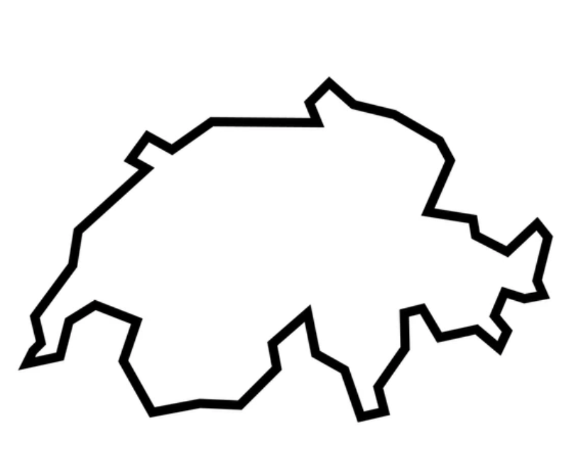
Introduction
Objectives
Methodology
Results
Conclusion
Challenges
The choice of wine…
Wine production
~100 M l. of wine per year⁶
Employment
The True Cost of Wine from a biorefinery perspective
9’000 winegrowers
40’000 jobs across supply chain⁷
Swiss PDO white wine
90% of stocks (2023)⁶
Surface area
Vineyard area: ~15’000 ha
International ranking: 10th in ratio to total land area⁶
Notes:
(1‘20)
So, you may ask, why wine?
The wine sector in Switzerland is a major economic driver. In 2023, annual wine production reached nearly 100 million liters. This sector directly employs about 9,000 winemakers and supports over 40,000 jobs across the entire supply chain, from production to distribution.
But wine is also a cultural heritage and a local craftsmanship. The majority of Swiss winemakers are committed to maintaining high-quality standards, whether through their production systems or labels, such as the PDO designation.
Finally, by-products from wine production present many opportunities for reuse. This leads us to our second objective: comparing recovery scenarios and evaluating their impact on the true cost to guide the implementation of biorefinery strategies.

Slide 12
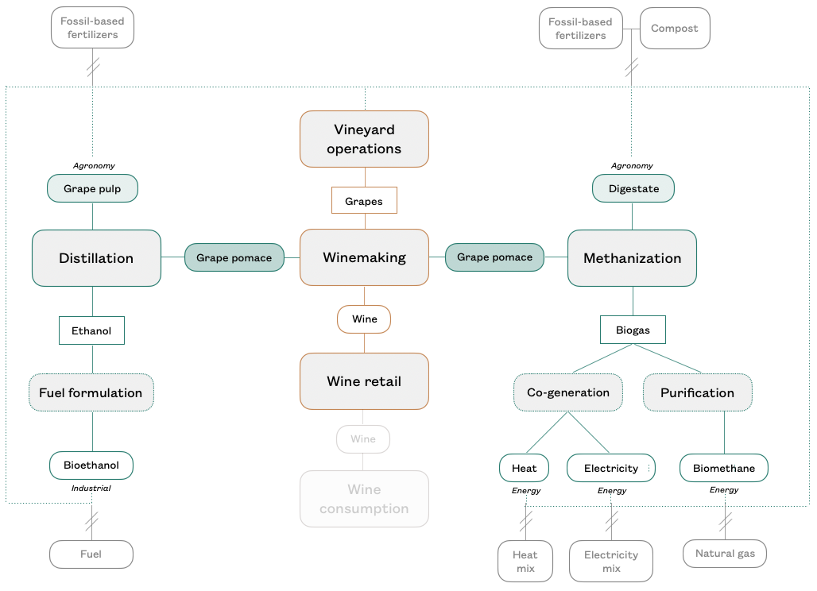
Introduction
Objectives
Methodology
Results
Conclusion
Challenges
Scope & Framework
Integrated Production
80% of winegrowers⁸
Cooperative Wineries
Biorefinery integration
Functional Unit
1l of PDO white wine
The True Cost of Wine from a biorefinery perspective
Notes:
(0’50)
Given the purpose of the study, the scope and frame focuses on three key stages: vineyard operations using integrated production, winemaking modeled on a cooperative system, and retail, all within the Swiss wine context.
It also includes the downstream recovery of gr/ai/pe pom/ai/ce — the residue left after pressing gr/ai/pe for wine — through three routes: agronomic, energy, and industrial. Two main valorisation methods, biogas production (methanization) and distillation, are analyzed.
Finally, the scope is expanded to compare with fossil-based and conventional systems that are replaced, and hidden costs and benefits are assessed per liter of wine produced.
NOTES:
Grape pomace/marc: Grape marc is the solid residue obtained after the pressing of fresh or fermented grapes during winemaking, including skins, seeds and sometimes stems. This by-product has the highest potential for valorisation and can be used in a variety of ways. Energetically, it can be processed through methanization to produce renewable gas. Agronomically, it can be used in composting or spread to enhance soil quality. For food and industrial
applications, grape pomace is used in distilleries for alcohol production; seeds can be processed in oil mills or used for pharmaceutical purposes and in the food industry, particularly for the extraction of polyphenols and tannins; and grape pulp can be valorized as animal feed, organic fertilizer, or as a biomass fuel

Slide 13
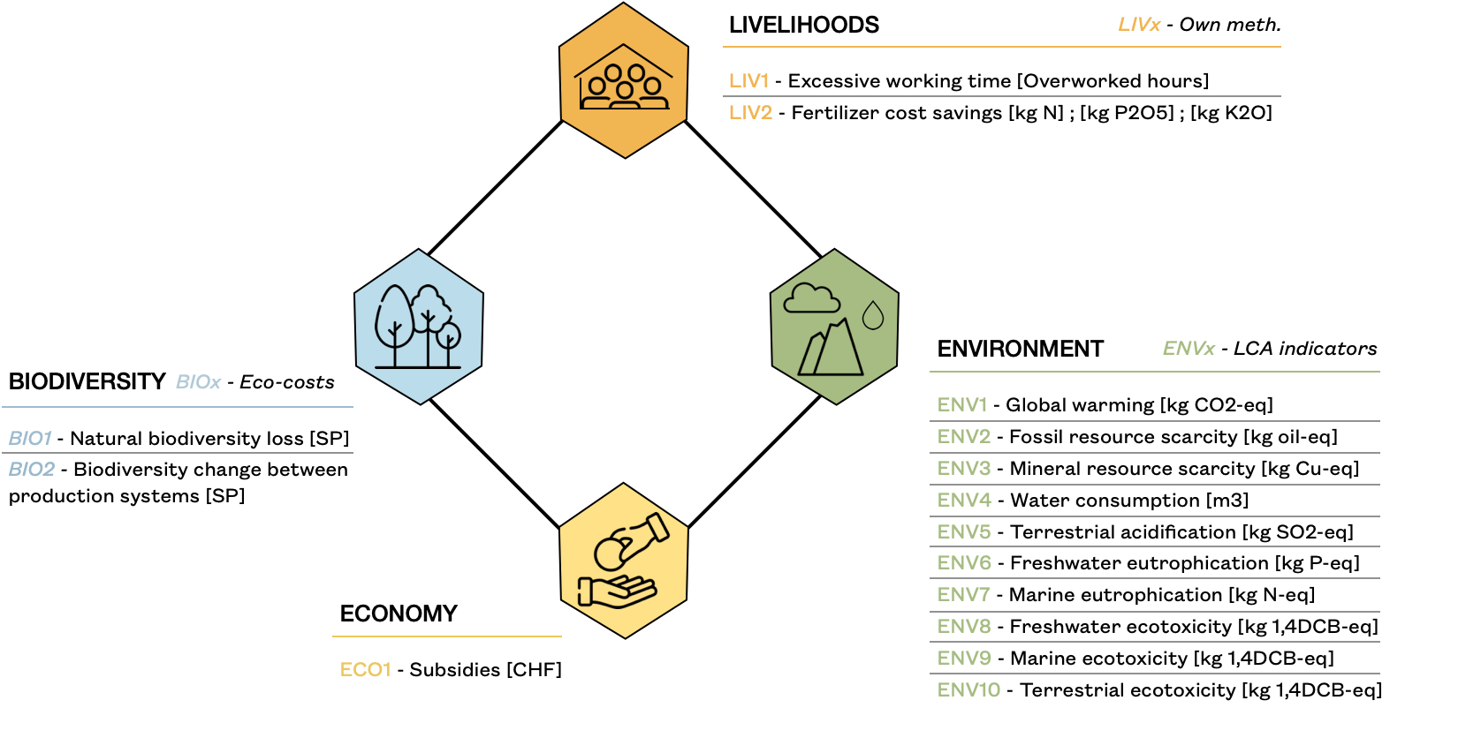
Introduction
Objectives
Methodology
Results
Conclusion
Challenges
Monetization factors
[CHF/metric ]
Prevention
Compensation
Restoration
The True Cost of Wine from a biorefinery perspective
Quantified
externalities
Notes:
(0’45)
This figure illustrates the impacts and indicators we considered to evaluate hidden costs and benefits, along with the valuation methods used to quantify the associated externalities.
For environmental impacts, we consider climate change, resource depletion, and ecosystem damage, all quantified using Life Cycle Assessment. Additionally, biodiversity is evaluated based on plant species richness.
Regarding livelihoods, we focus on wage conditions.
And on the economic side, we account for subsidies.
Finally, health impacts at the consumption level are excluded due to the relatively limited development of existing methodologies at this stage

Slide 14
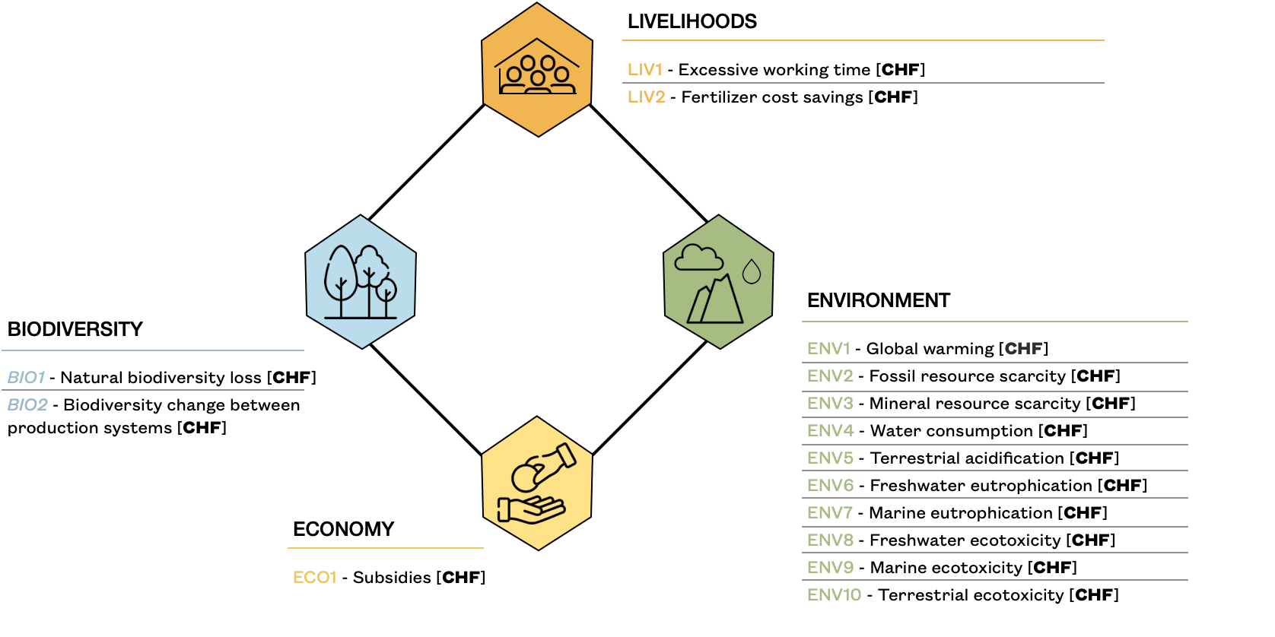
Introduction
Objectives
Methodology
Results
Conclusion
Challenges
Monetization factors
[CHF/metric ]
Prevention
Compensation
Restoration
The True Cost of Wine from a biorefinery perspective
Hidden
Costs & benefits
Notes:
(0‘30)
To monetize the quantified externalities, we apply monetization factors, provided by the True Price Foundation.
These factors are based on two main types of costs :
EVEN
Prevention costs, which represent the expense of switching to a less polluting alternative to avoid the quantified impacts.
OR
Damage costs, which reflect the expenses required to repair or address the damage.

Slide 15
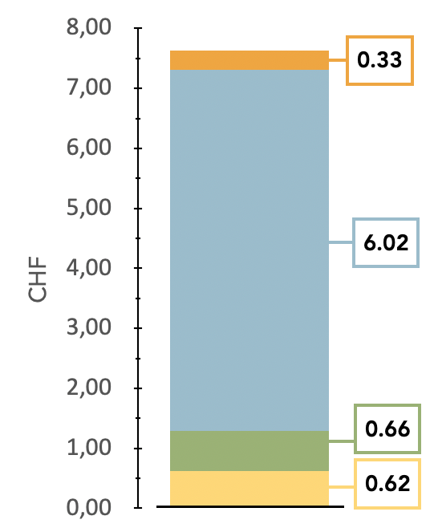
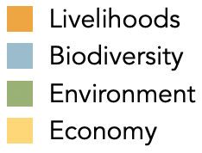
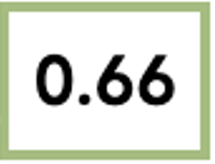
Introduction
Objectives
Methodology
Results
Conclusion
Challenges
CHF 7.63
41%
53%
1l wine
The True Cost of Wine from a biorefinery perspective
6%
Hidden costs
Excluding grape
pomace recovery
Notes:
(1’0)
This graph shows the h/i/dden costs of 1 liter of wine, excluding the recovery of gr/ai/pe pom/ai/ce, and how these costs are distributed across the different impact areas, represented by the colors.
The total hidden costs are estimated at 7.63 Swiss francs.
A smaller portion is attributed to economic h/i/dden costs and social externalities, accounting for 10% of the total.
The majority of h/i/dden costs are due to environmental externalities, particularly biodiversity loss generated at the primary production stage, with costs estimated at 0.66 and 6.02 Swiss francs, respectively.
This main result can be explained by the lack of genetic diversity in vines, the simplification of the agricultural landscape, or even the management of soils and underlying vegetation, although initiatives to promote biodiversity are encouraged in integrated production system.

Slide 16
Introduction
Objectives
Methodology
Results
Conclusion
Challenges
CHF 7.63
1l wine
The True Cost of Wine from a biorefinery perspective
Annual financial saving
CHF 4’780
Hidden costs
Excluding grape
pomace recovery
Notes:
(0’10)
Looking in more detail at the second most significant h/i/dden cost.

Slide 17
Introduction
Objectives
Methodology
Results
Conclusion
Challenges
1l wine
The True Cost of Wine from a biorefinery perspective
30%
36%
34%
Annual financial saving
CHF 4’780
Notes:
(0‘20)
This chart provides additional insights into the distribution of h/i/dden environmental costs across the various environmental externalities generated throughout the value chain.
What we observe here is a relatively balanced distribution, with no specific issue standing out in the case of wine.

Slide 18
Introduction
Objectives
Methodology
Results
Conclusion
Challenges
1l wine
The True Cost of Wine from a biorefinery perspective
41%
53%
Annual financial saving
CHF 4’780
6%
Notes:
(0‘35)
In this case, the pie chart provides insights into the distribution of environmental h/i/dden costs across the stages of the wine value chain.
We observe that most environmental externalities are generated during gr/ai/pe production, followed by the retail stage, with the winemaking process contributing less significantly.
This highlights a potential direction for action: in the sense of mitigating these costs, stakeholders should focus their efforts primarily on the first and third stages of the process.

Slide 19
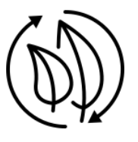
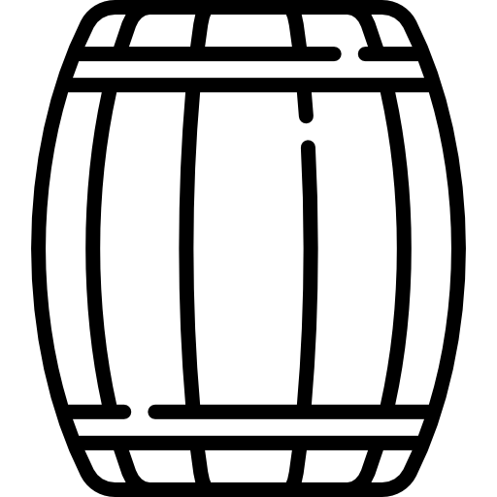
Introduction
Objectives
Methodology
Results
Conclusion
Challenges
Recovery path…
METHANIZATION
DISTILLATION
?
The True Cost of Wine from a biorefinery perspective
Recycled fertilizer use
At vineyard operation stage
Direct revenues
Product level
- 4 %
Cooperative level :
- CHF 4’780
Reduction of Livelihood Hidden Costs :
Indirect revenues
Notes:
The assessment of by-products recovery in the TCA of wine is conducted on only two categories of impact:
Impacts on livelihood
Impacts on the environment
This focus is due to the availability of reliable data at these two levels only and the time constraints of the study, which lasted only four months. These limitations restricted both data collection and the scope of the modeling.
The main findings are as follows:
Replacing synthetic fertilizers with gr/ai/pe pom/ai/ce valorized through Methanization can reduce livelihood hidden costs by approximately 4% per product. At the scale of a wine cooperative, this translates to a reduction of around 5’000 Swiss francs.
However, the potential benefits of using grape pulp from the distillation process could not be evaluated due to a lack of reliable data on economic agreements between distilleries and cooperatives. Nonetheless, this pathway could still offer potential economic advantages, such as direct or indirect revenue from the sale of grape marc and other distillation products and by-products.

Slide 20
Introduction
Objectives
Methodology
Results
Conclusion
Challenges
Recovery path…
METHANIZATION
DISTILLATION
Reduction of Environmental
Hidden Costs
5x
Agronomic recovery
Grap pulp: 93% lower net benefit
Energy recovery
Service energy: 34% greater
in environmental hidden costs
than ethanol
Renewable energy use
At the production, transformation and distribution stages
The True Cost of Wine from a biorefinery perspective
Recycled fertilizer use
At vineyard operation stage
Reduction of Environmental
Hidden Costs :
Product : - 3%
Swiss wine sector: - CHF 1’022’970
Notes:
Regarding the environmental impacts,
Both the agronomic and energetic recovery of gr/ai/pe pom/ai/ce via methanization result in a reduction of environmental h/i/dden costs by approximately 3% per liter of wine produced. At the scale of the Swiss wine sector, this corresponds to a reduction of around 1 million Swiss francs in environmental h/i/dden costs.
So, the net benefits across all environmental impact areas are five times greater than those of the distillation approach.
Regarding agronomic recovery, digestate from the methanization of gr/ai/pe pom/ai/ce provides a 93% higher net benefit compared to gr/ai/pe pulp from distillation.
Additionally, energy recovery through biogas from methanized grape pom/ai/ce reduces environmental h/i/dden costs by 34% more than the ethanol produced through the distillation process.

Slide 21
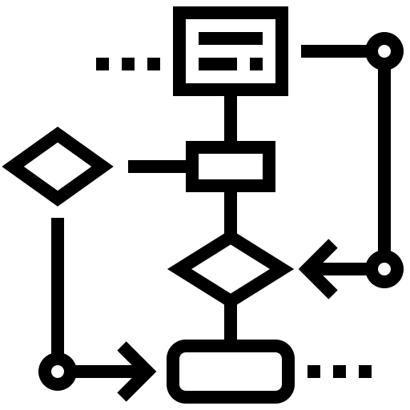
Introduction
Objectives
Methodology
Results
Conclusion
Challenges
Global Challenge
Lack of tools for many stakeholders to take effective action
Further research
Improve & extend present assessments
Evaluate other valorisation paths
Include all by-products of wine production
Combine several valorisation paths for the same by-product
Standardised TCAF methodology
Comparability of results
Compatibility for data exchanges
The True Cost of Wine from a biorefinery perspective
Systemic
Holistic
Consumer
Actors in the chain
Decision tool
Awareness
Initiate transition
Circular economy
Notes:
(1‘30)
To conclude..
The challenge of reducing social and environmental impacts is one that everyone must reflect on, especially within the context of climate strategies and, more broadly, the objectives of the Paris Agreement. However, not everyone knows how to proceed, as we often lack the right tools to guide us.
This is where the TCA approach becomes particularly valuable, as it is both systemic and holistic. When applied to the study of food systems, it enhances our awareness and transparency, helping us recognize the significance of the hidden costs—especially when compared to the selling price of a product, such as a bottle of wine.
For consumers, this approach provides clear evidence of the environmental and social impacts of their choices.
While measuring the relative proportion of each hidden cost allows us to identify the most significant externalities, which in turn, can help guide stakeholders across the production, transformation, and distribution stages to prioritize their actions more effectively
Finally, from a technical perspective, this approach supports circular economy strategies, such as methanization or distillation, where applicable. This insight is particularly useful for entrepreneurs, as it helps them make informed decisions by revealing the true costs behind their by-product management processes.

Slide 22
Introduction
Objectives
Methodology
Results
Conclusion
Challenges
Challenges and limitations
TCA method: still a field of research
Data availability
Methodology for externalities quantifications & monetization
Benefits accounting
By-product accounting on TCA
Scope definition: actors, extending system limits
Production costs accessibility (undunstunding full picture)
Know by-product management costs
Economic constraints & leverage points
for by-product valorization
Local criteria
Proximity to buyers
Market availability
Further research
Improve & extend present assessments
Evaluate other valorisation paths
Include all by-products of wine production
Combine several valorisation paths for the same by-product
Standardised TCA methodology
Comparability of results
Compatibility for data exchanges
The True Cost of Wine from a biorefinery perspective
Notes:
(1‘02)
Regarding the limitations or challenges encountered:
Firstly, the true cost methodology is still under development, which presents challenges in terms of data accessibility, identifying relevant indicators, and the lack of monetization factors, as well as benefits accounting.
Applying TCA to by-product recovery also poses challenges.
The first one is defining the system boundaries — deciding which actors to include and how far to extend the system limits.
Additionally, to understand the full picture, it is important to consider production costs, and more specifically in that case, the precise breakdown of by-product management costs. This remains difficult, yet it is essential for understanding economic constraints and identifying potential valorization opportunities.
Finally, by-product valorization options are heavily influenced by local factors, such as existing cooperation and the availability of markets for these by-products.

Slide 23
Introduction
Objectives
Methodology
Results
Conclusion
Challenges
Challenges and limitations
TCA method: still a field of research
Data availability
Methodology for externalities quantifications & monetization
Benefits accounting
By-product accounting on TCA
Scope definition: actors, extending system limits
Production costs accessibility (undunstunding full picture)
Know by-product management costs
Economic constraints & leverage points
for by-product valorization
Local criteria
Proximity to buyers
Market availability
Further research
Improve & extend present assessments
Evaluate other valorisation paths
Include all by-products of wine production
Combine several valorisation paths for the same by-product
Standardised TCA methodology
Comparability of results
Compatibility for data exchanges
The True Cost of Wine from a biorefinery perspective
Notes:
(0‘30)
These challenges highlight the need for further research to refine methodologies and standardize TCA approaches, to ensure the comparability of results, and enhance compatibility for data exchanges in tool development. Additionally, with more time, it would be interesting to improve and extend the current assessment by investigating additional by-products or valorisation pathways and integrating them to better reflect the system's diversity.

Slide 24
Introduction
Objectives
Methodology
Results
Conclusion
Challenges
Thank you for your attention !
Q&A time
The True Cost of Wine from a biorefinery perspective

Slide 25
REFERENCES
True Cost Initiative. 2022. TCA Handbook – Practical True Cost Accounting guidelines for the food and farming sector on impact measurement, valuation and reporting. http://tca2f.org/wp-content/uploads/2022/03/TCA_Agrifood_Handbook.pdf
FAO. 2023. The State of Food and Agriculture 2023. Revealing the true cost of food to transform agrifood systems. Rome. https://doi.org/10.4060/cc7724en
Economics of Ecosystems and Biodiversity (TEEB). 2018. TEEB for Agriculture & Food: Scientific and Economic Foundations. Geneva: UN Environment.
Natural Capital Coalition. 2016. Natural Capital Protocol.
R. N. Ratu, I. D. Velescu, F. Stoica, A. Usturoi, V. N. Arsenoaia, I. C. Crivei, A. N. Postolache, F. D. Lipsa, F. Filipov, A. M. Florea, et al. 2023. Application of agri-food by-products in the food industry. Agriculture, vol. 13, no. 8, p. 1559.
Office Federale de l’Agriculture (OFAG). 2024. L’année viticole 2023. statistiques vitivinicoles.
Association Suisse du Commerce des Vins (ASCV). 2023. Rapport annuel 2022.
Pfister, Richard, et al. 2019. Viticulture: Quelle protection contre les parasites et quel entretien du sol ?. Revue suisse de viticulture, arboriculture et horticulture, vol. 51, no. 4, p. 226-232.
The True Cost of Wine from a biorefinery perspective

Slide 26
REFERENCES
French ordinance no. 2010-1579. 2010. url: https://www.legifrance.gouv.fr
R. S. Khemani and D. M. Shapiro. 1993. Glossary of Industrial Organisation Economics and Competition Law. Directorate for Financial, Fiscal and Enterprise Affairs, OECD.
True Cost, TMG, and soil more impacts. True cost accounting agrifood handbook. en-us. tech. rep. https://tca2f.org/
L. M. Schmidt, L. F. Andersen, C. Dieckmann, A. Lamp, and M. Kaltschmitt. 2019. The « biorefinery approach » in Energy from Organic Materials (Biomass). Encyclopedia of Sustainability Science and Technology Series, p. 1050.
Confédération suisse. 2007. Ordonnance sur la viticulture et l’importation de vin. https://www.fedlex.admin.ch/eli/cc/2007/833/fr
L. Grappe. Quels sont les différents types de production viticole ?. https://lagrappe.ch/blogs/le-blog-des-grappistes/types-de-production
P. Schauenberg, OFAG. 2018. Ateliers économiques.
A. Crosnier, L. Jeangros, G. Baudry, G. Cisco, E.S. Meier, L. Spring, and D. Barjolle. 2024. A bite from true cost accounting for food: the case of bread.
V. Burg, C. Rolli, V. Schnorf, D. Scharfy, V. Anspach, and G. Bowman. 2023. Agricultural biogas plants as a hub to foster circular economy and bioenergy: An assessment using substance and energy flow analysis. Resources, Conservation and Recycling, vol. 190, p. 106770.
The True Cost of Wine from a biorefinery perspective

Slide 27
GLOSSARY
By-product: substance or product resulting from a production process that is neither a product nor a waste, whose economic recovery is total and which has a market backed by a quotation. Specialized economic agents, different from producers, often intervene to ensure its distribution⁹.
Externalities: situations when the effect of production or consumption of goods and services imposes costs or benefits on others which are not reflected in the prices charged for the goods and services being provided¹⁰.
Hidden costs: social and human impacts of food products that so far have either been unknown, ignored, or considered to be a necessary trade-off¹¹. These are also referred to as external costs.
Biorefinery: facility that converts biomass into a broad range of products for various markets (food, feed, materials, energy) and is characterized by low energy demand through high process integration and low waste production, as well as high flexibility towards changing markets for raw materials and products¹².
The True Cost of Wine from a biorefinery perspective

Slide 28
GLOSSARY
Quotas: initially established to ensure wine quality, they are set annually by the cantons based on demand and available wine stocks, while adhering to the federal maximum yield regulations outlined in the ordinance on viticulture and the import of wine¹³. Quotas are defined by grape variety, classification and wine-growing regions.
Integrated viticulture: sustainable vineyard management approach that balances quality production with envi- ronmental stewardship. It integrates the conservation of natural resources and adopts a rational management of inputs and waste. It reduces chemical use by promoting biological pest control and biodiversity. Additionally, it aims to ensure worker health and safety, support local socio-economic development, and optimize energy use¹⁴.
Protected Designation of Origin (PDO): Classification based on federal law, defining requirements in terms of geographical area (intra-cantonal), blending of wines (max. 10%), authorised grape varieties, production yield and minimum sugar content (respectively 1.4 kg/m2 or 1.2 kg/m2 and 15.2 °Brix or 17.0 °Brix depending on the colour of the wine and the Swiss region). Stricter cantonal requirements may be envisaged regarding blending rights, production yields and oenological practices¹⁵.
The True Cost of Wine from a biorefinery perspective

Slide 29
GLOSSARY
Hidden costs and benefits – Distinction of types
Couts externes (monétisation des externalités): Couts relevant du concept de l’externalité : ressource identifiable et accessible à un prix d’accès payés par les usagers, on parle d’externalité lorsque ce prix ne reflète pas le coût de la remédiation après dommage (ou remise en l’état après usage pouvant être socialement considéré comme normal). Eg d’atteintes aux ressource : Pollution ; destruction ; dommage réparable mais non réparé, atteinte à la fonction de reproduction de la ressource, dommage sur santé humaine et animale, atteinte à l’intégrité des personnes, etc…
Avantages sociétaux indirects: Aliénation de ressources non marchandes (air, biodiversité, accessibilité à certains services: mobilité, communication, informations… infrastructures qui relèvent du droit commun et dont les couts ne sont pas directement supportés par les entreprises. Cela inclus aussi l’accès à du personnel formé, qualifié et expérimenté ou animaux domestiques sélectionnés en soutient aux efforts de productivité. Selon les régimes fiscaux, le cout d’accès à ces ressources peuvent être reporté exclusivement sur les usagers (eg. Taxes directes), mais peuvent également être mutualisées → leurs couts sont reportés sur d’autres catégories que les entreprises qui en font un usage gratuit.
Dépenses sociétales directes: Dépenses publiques ou privées qui compensent des charges ou des dommages créés par des entreprises dysfonctionnelles dans leur usage des ressources naturelles ou humains, mais dont la remise en état est mutualisée de manière institutionnelle et systématique. Par exemple, des subventions aux entreprises pour des produits. (eg. subventions aux entreprises pour des produits qui polluent, charges que représentent les stations communales d’épuration des eaux usées, programmes de lutte chimique contre des insectes ravageurs des cultures, ou les virus ou bactéries portant atteinte à la santé animale ou humaine).
Ces compensations de coûts provoqués par des dérives dysfonctionnelles d’entreprises privées peuvent entraîner des dépenses reportées directement sur d’autres usagers privés quand elles ne sont pas mutualisées.
The True Cost of Wine from a biorefinery perspective

Slide 30
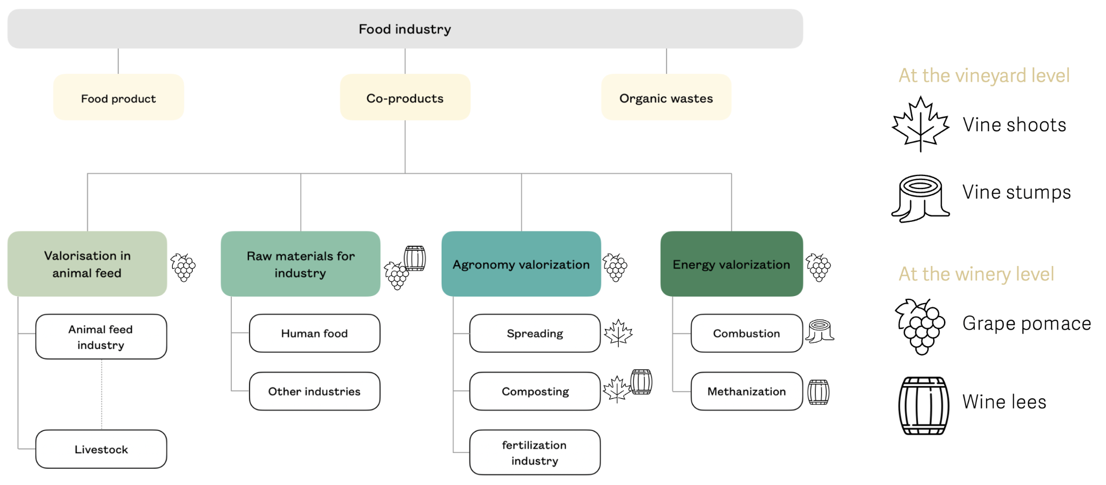
APPENDIX 1. Recovery pathways of wine by-products
By
The True Cost of Wine from a biorefinery perspective
Notes:
Throughout the wine production and processing chain, several by-products are generated, each of which can be valorized in different ways depending on their intended use. These by-products can be
directed towards four main categories: animal or human food, energy, agronomy, and industry. This classification is illustrated in the present Figure.
At the vineyard level
• Vine shoots: branches that develop after 1 yr, forming a ligneous biomass that is renewed each year during pruning. This biomass can be exploited energetically or agronomically, either by returning it to the soil with or without shredding, or by composting
• Vine stumps: Vine stumps are derived from uprooted vines, including dead or diseased vines, vine stumps represent ligneous biomass that can be valorized by combustion for heat production
At the winery level
• Grape pomace/marc: Grape marc is the solid residue obtained after the pressing of fresh or fermented grapes during winemaking, including skins, seeds and sometimes stems. This by-product has the highest potential for valorisation and can be used in a variety of ways. Energetically, it can be processed through methanization to produce renewable gas. Agronomically, it can be used in composting or spread to enhance soil quality. For food and industrial
applications, grape pomace is used in distilleries for alcohol production; seeds can be processed in oil mills or used for pharmaceutical purposes and in the food industry, particularly for the extraction of polyphenols and tannins; and grape pulp can be valorized as animal feed, organic fertilizer, or as a biomass fuel
• Wine lees: Wine lees refer to the various types of residues associated with winemaking. They include residues that settle in wine containers after fermentation, storage or authorised treatments. It also includes residues from the filtration or centrifugation of wine. Wine lees also include residues that settle in containers of grape must during storage or after authorised treatments, as well as residues resulting from the filtration or centrifugation of this must. These by-products can be valorised energetically by methanisation or in distilleries for industrial purposes such as alcohol extraction.

Slide 31
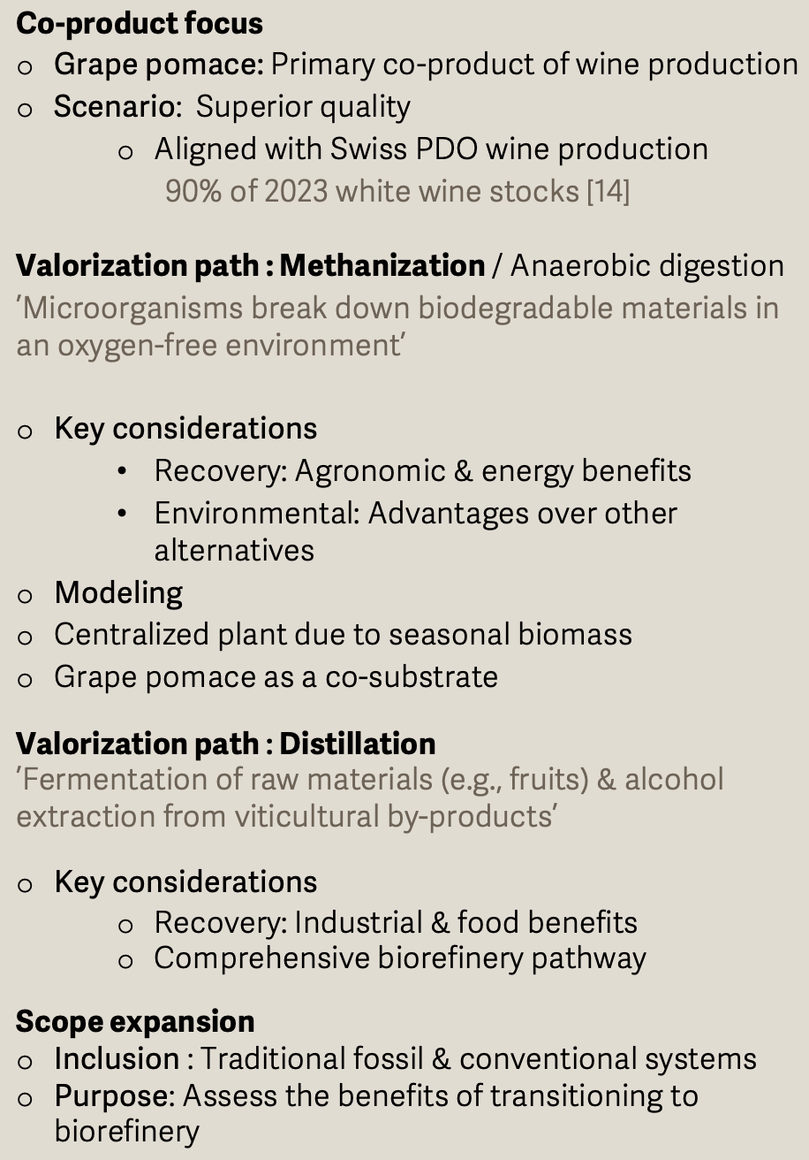
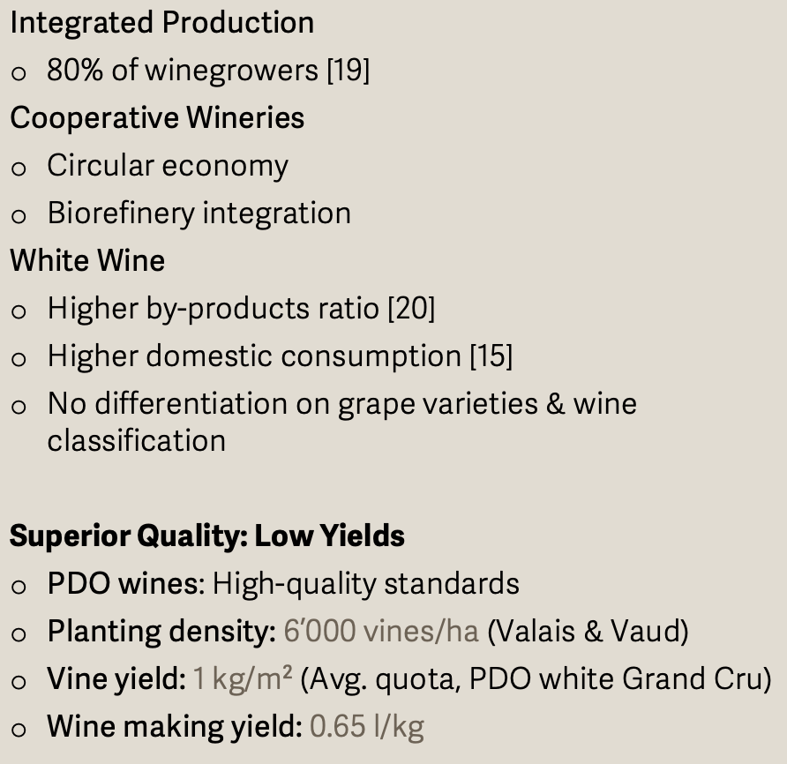
APPENDIX 2. Wine value chain – Modelization
Recovery of wine by-products
Wine production
The True Cost of Wine from a biorefinery perspective

Slide 32
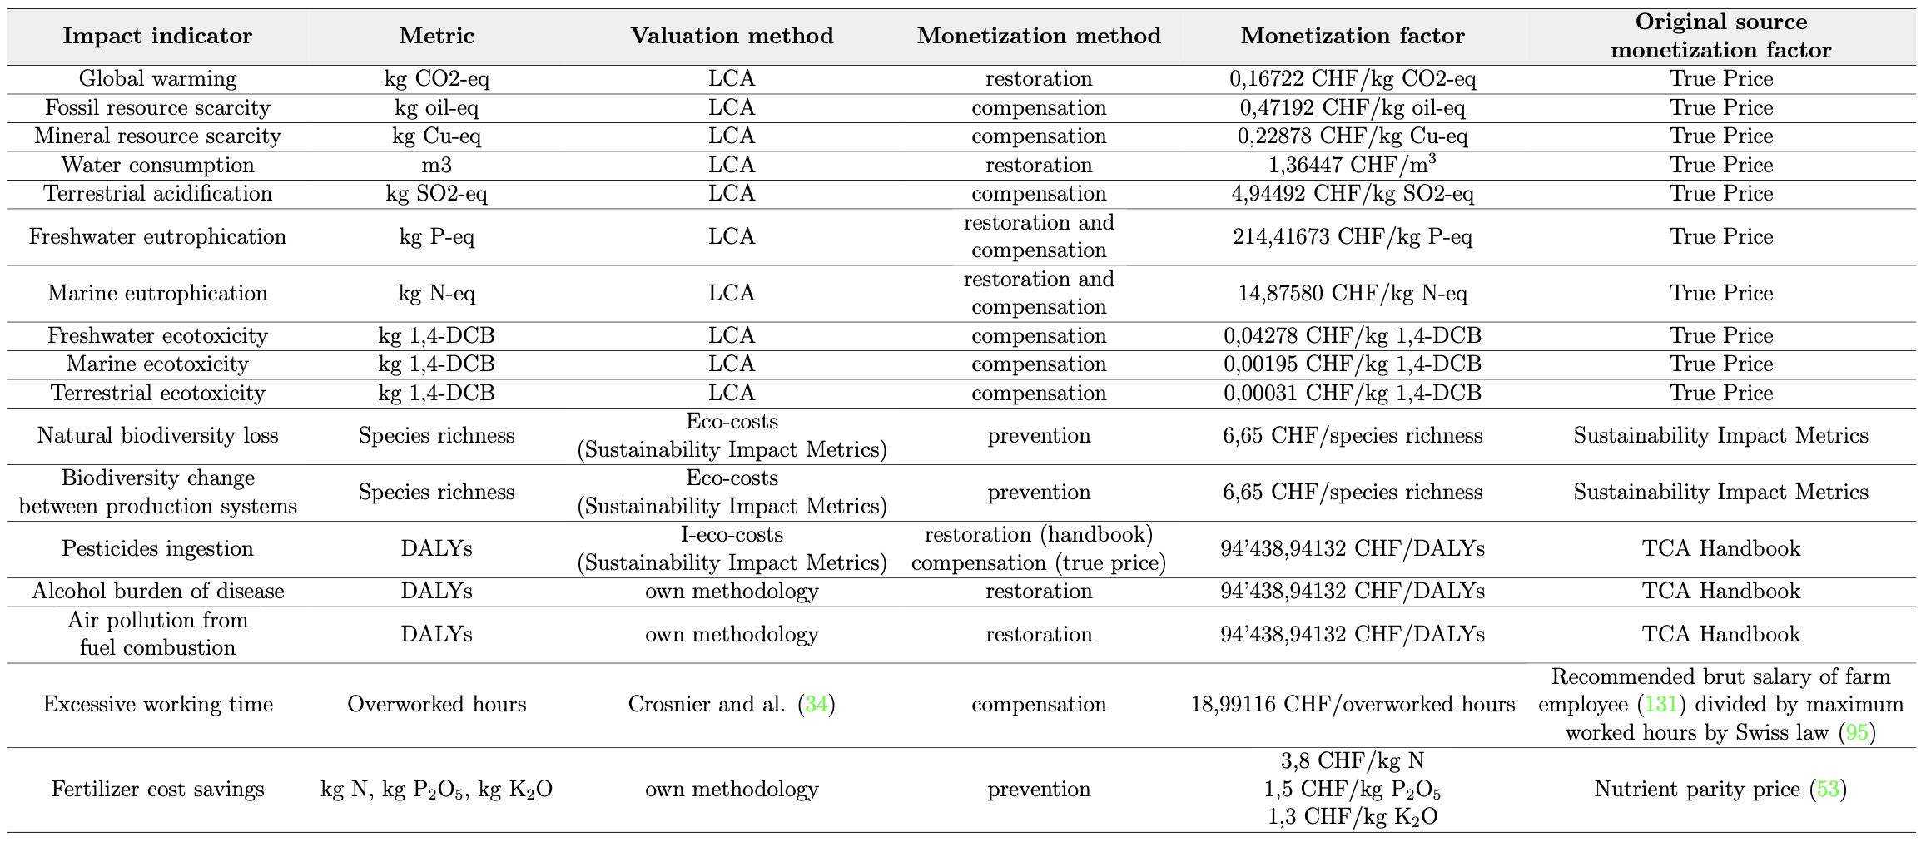
APPENDIX 3. Impacts – Indicators - Metrics
The True Cost of Wine from a biorefinery perspective
¹⁶
¹⁷

Slide 33
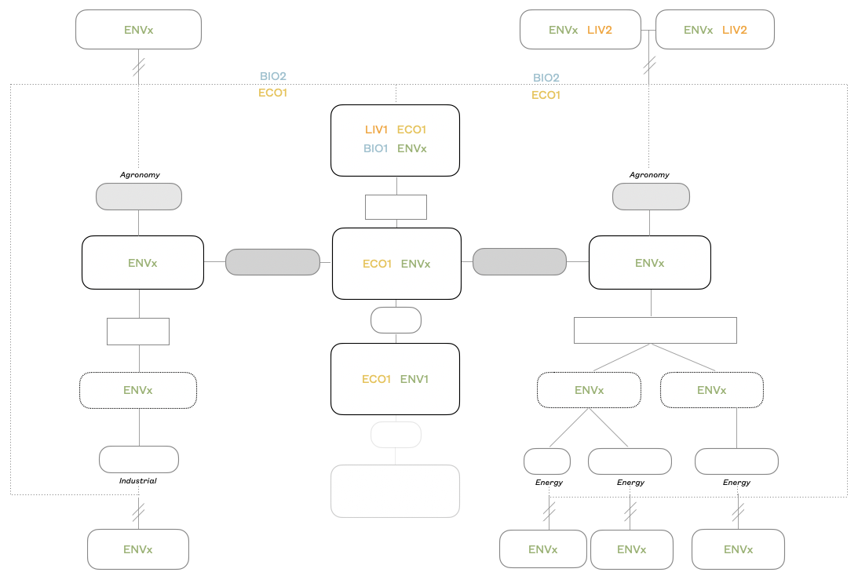
APPENDIX 4.
The True Cost of Wine from a biorefinery perspective

Slide 34
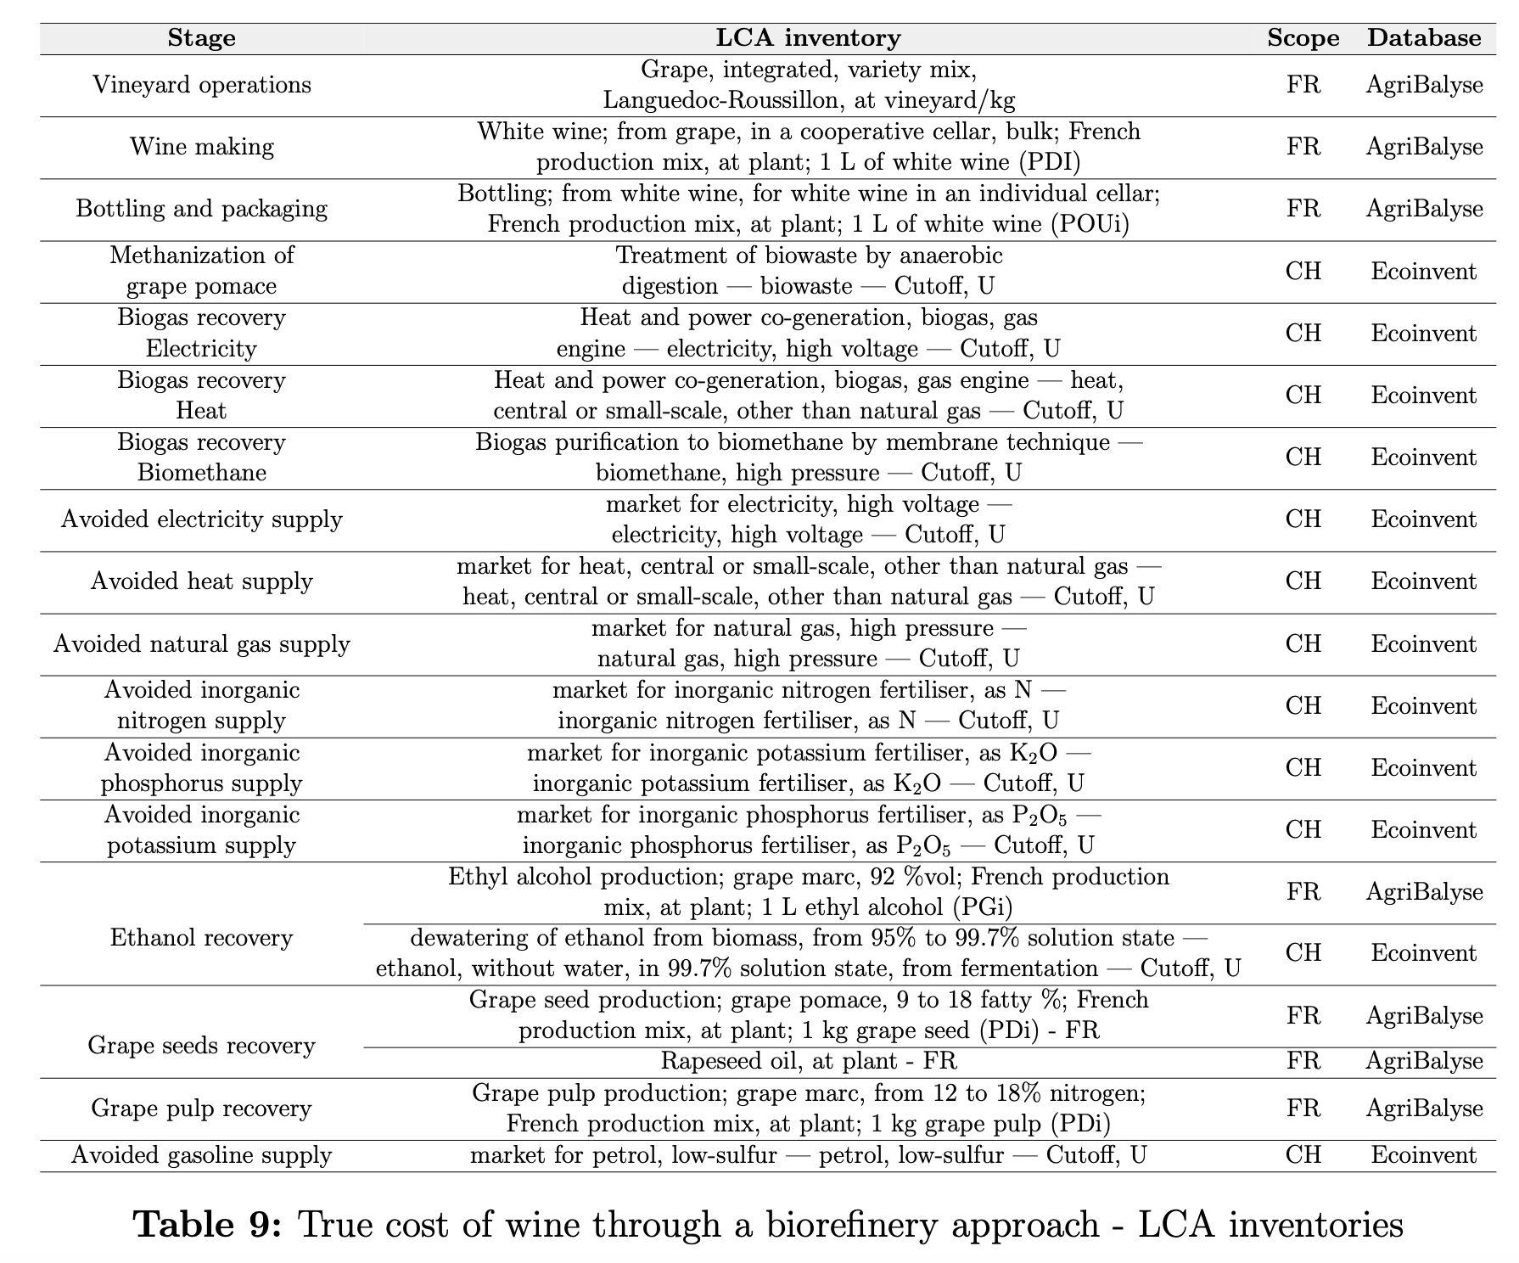
APPENDIX 5. ENV - LCA Inventories
The True Cost of Wine from a biorefinery perspective

Slide 35
