Slide 1
International Conference – 20-22 November in Parma Is there potential for GI products in Albania? The contribution of the Theory of Planned Behaviour on farmers’ production practices
Majlinda SHEHU
Valter HOXHA
Florjan BOMBAJ

Slide 2
Context and issues
Theoretical framework
Methodology
Results
Discussion
Conclusions
Diversity of mountain livestock systems
Small farms: low surplus
Product specificity but low added value
Informal market: location and proximity

Slide 3
Context and issues
Theoretical framework
Methodology
Results
Discussion
Conclusions
Strategic mechanisms for market organization
Compliance with hygiene standards
Physical infrastructure
Organization of transactions
Management of production resources
Equalityaccess
SUSTAINABILITY
Share capital
Support for local consultation processes
Promote the grouping of farmers into collective organizations

Slide 4
Context and issues
Theoretical framework
Methodology
Results
Discussion
Conclusions
There is an urgent need to bring about significant change in the local production system in order to make agriculture more sustainable.
Achieving such a transition of the food system is difficult:
Catalysts
Barriers
Pilot project applied in the Albanian context

Slide 5
Context and issues
Theoretical framework
Methodology
Results
Discussion
Conclusions
New Institutional Economics
Quality signs, a driving role for value chains(Bombaj et al., 2021)
Information asymmetry (Hoxha et al., 2023)
Localised Agrifood Systems (SYAL)
Dynamics of local production systems (Bombaj et al., 2022)
Territorial approach
Theory of planned behaviour
Risk aversion (Dessart et al., 2019)
Endogenous and exogenous factors (Barnes et al., 2022).

Slide 6
Context and issues
Theoretical framework
Methodology
Results
Discussion
Conclusions
The practices implemented by farmers are interconnected as sustainability strategies not only attempt to address individual farmers' challenges, but also contribute to overcoming shared challenges at local, national and broader levels.
If collective incentive mechanisms are well designed, they can be more effective than incentives based on individual behavior (Segerson, 2013).
Recognizing the multiple enablers and barriers to systemic change towards more sustainable agriculture: behavioral economics and the systems approach.
Collective incentive mechanisms that can increase cooperation between farmers are known (Barghusenet al., 2021).

Slide 7
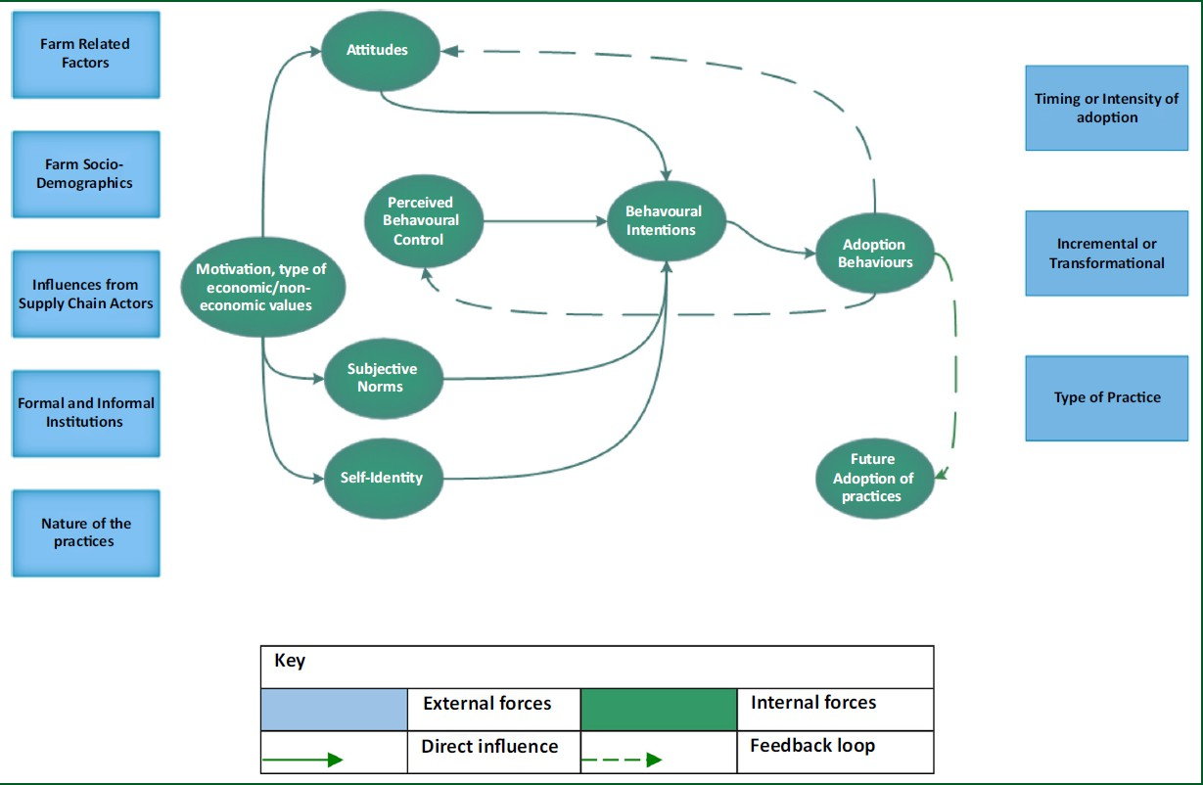
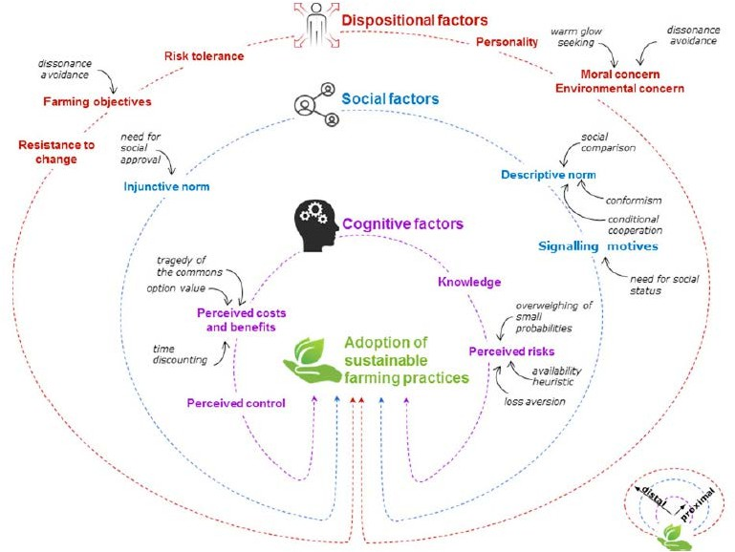
Context and issues
Theoretical framework
Methodology
Results
Discussion
Conclusions
Source: (Barnes et al., 2022)
Source: (Dessart al., 2019)

Slide 8
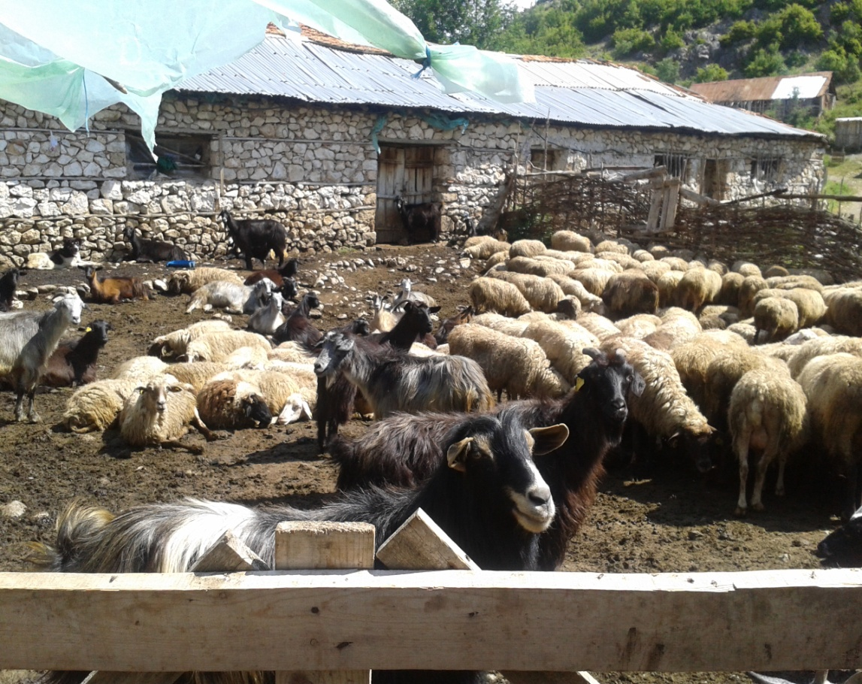
Context and issues
Theoretical framework
Methodology
Results
Discussion
Conclusions
Intermediate farms double perspective milk/meat
Specialization offarms:
physical capacities for animal production depends on availability of young labor
physical environment in which they find themselves.
subsistence farms

Slide 9
Market integration issues
Context and issues
Theoretical framework
Methodology
Results
Discussion
Conclusions
Subsistence farms
57%
No surplus Occasional sale
Intermediate farms
33%
More frequent sales Trend towards specialization
Specialized farms
10%
Surplus sold at market Specialization (meat)
Strong demand for fresh meat
Farm structure
High production costs
Lack of cooperatives
Sanitary control and labeling of food products

Slide 10
Context and issues
Theoretical framework
Methodology
Results
Discussion
Conclusions
Factors for transition
Product specificity Meat/Cheese
Short circuits
Strong demand for local animal products with specificity
Collective actions

Slide 11
Context and issues
Theoretical framework
Methodology
Results
Discussion
Conclusions
Barriers
Lack of safeguarding of specificity
Low governance of value chains
Lack of market power
High production costs

Slide 12
Context and issues
Theoretical framework
Methodology
Results
Discussion
Conclusions
Subsistence Farms: Surplus and Economic Viability
Expansion of local production systems
Inclusive rural development policies
NGOs; Associations; Diaspora:important actors

Slide 13
Context and issues
Theoretical framework
Methodology
Results
Discussion
Conclusions
A project (September 2023 - July 2024) examined Albanian farmers' adoption of sustainable practices, applying the Theory of Planned Behavior to study farmers’ intentions.
We assessed farmers’ beliefs, attitudes, social norms, perceived control, and behavioural intentions toward sustainable practices (e.g., crop rotation, reduced use of pesticides).
Data indicate that a 1.01 increase in attitude towards sustainable practices raises behavioural intentions by 0.1272, while social norms negatively impact intentions (-0.2968 for a 1.00 increase).
Perceived behavioural control showed a positive influence, with a 1.04 increase correlating to a 0.2014 increase in intentions.

Slide 14
Context and issues
Theoretical framework
Methodology
Results
Discussion
Conclusions
Strategic market regulation mechanisms
Public support to farm conditions and infrastructure
Harmonizing local identities and the renovation of tradition
Social Capital: participation in associative structures

Slide 15
Context and issues
Theoretical framework
Methodology
Results
Discussion
Conclusions
Given Albania's tourism appeal, local lamb products could offer economic value for farmers.
Urban consumers and tourists are willing to pay for local meat, suggesting the potential for short, high-quality value chains.
However, a lack of product specification or certification remains a barrier, as the meat—although produced from native breeds and using traditional methods—lacks a universal certification for authenticity.
Farms focus on individual rather than collective solutions, leaving no standard definition or certification for “traditional” products.

Slide 16
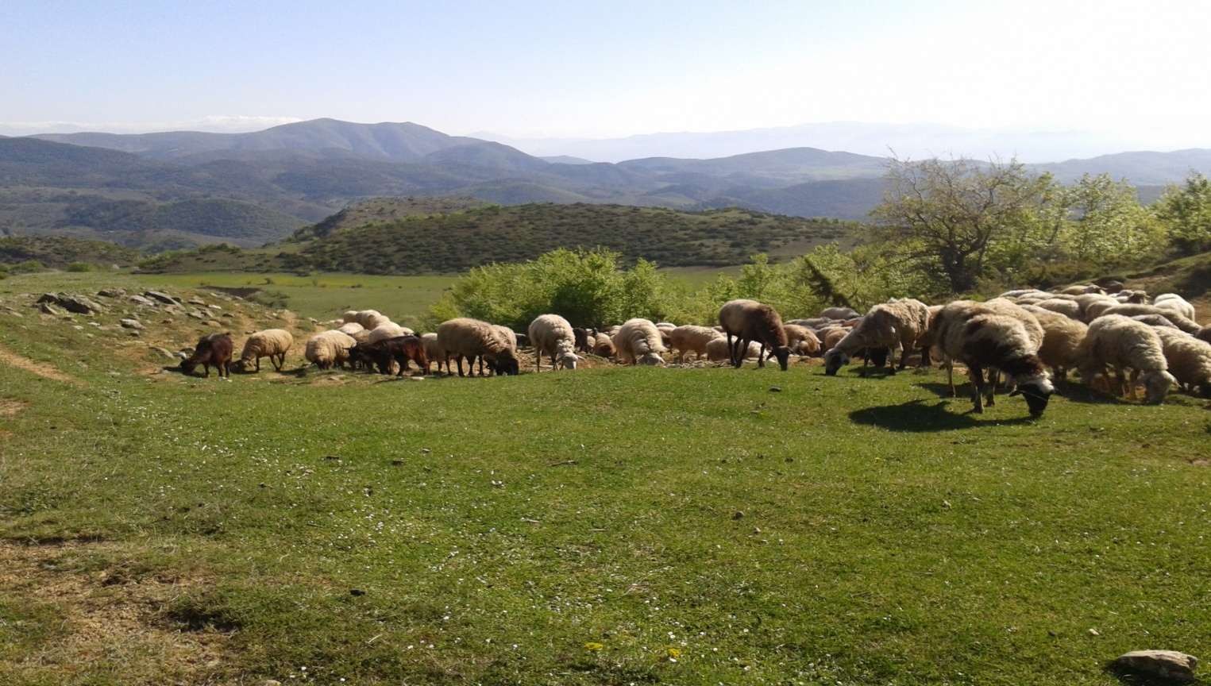
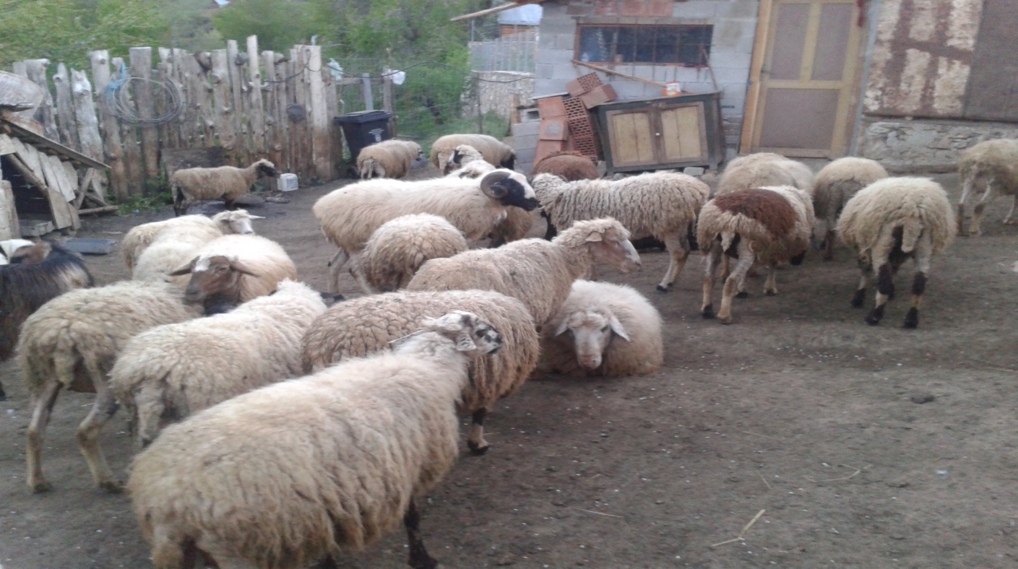
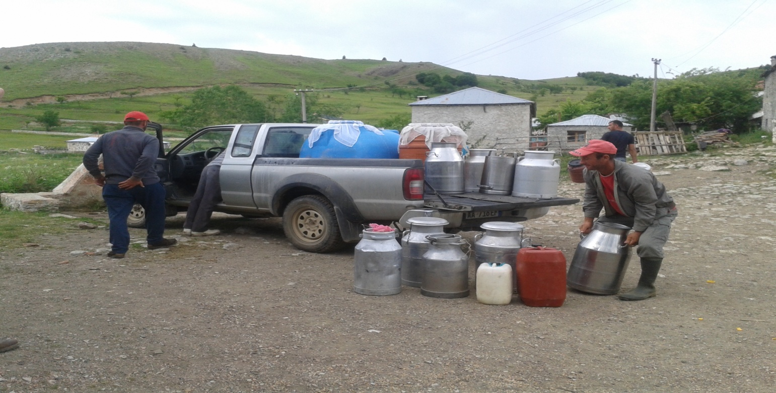
Thank you for your attention!

