Slide 1
International Conference Parma 2024
Workshop 2: Sustainability, Ethics, and Geographical Indications:
Towards Responsible Practices.
Local traditional agrifood products as activators of community-led processes of sustainable territorial development in marginal rural areas.
Matteo Mengoni, Andrea Marescotti, Pier Angelo Mori, Paola Scarpellini, Giovanni Belletti
Department of Economics and Management (DISEI), University of Florence (UNIFI), Italy.
Notes:
focus: PAT and inner areas

Slide 2
Regenerating cultural landscapes of inner areas in a people centered perspective
https://www.react-casentino.unifi.it/

Slide 3
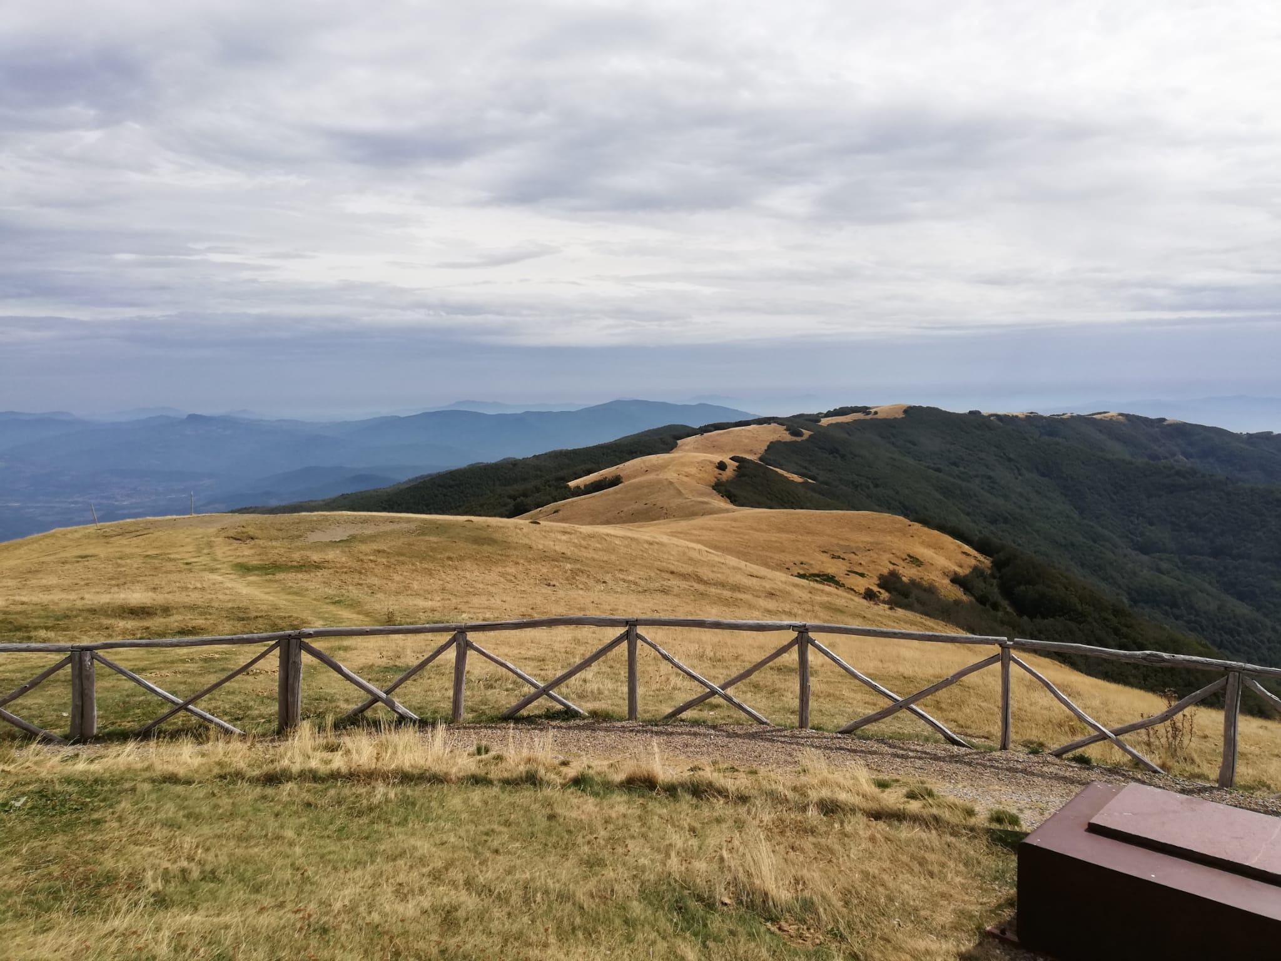
CULTURAL LANDSCAPES
Cultural Landscapes are defined as "cultural properties […] the combined works of nature and humankind, they express a long and intimate relationship between peoples and their natural environment” (UNESCO, World Heritage Committee,1992).
Cultural landscapes - cultivated terraces on lofty mountains, gardens, vineyards, sacred places, etc. - are part of our collective identity.

Slide 4
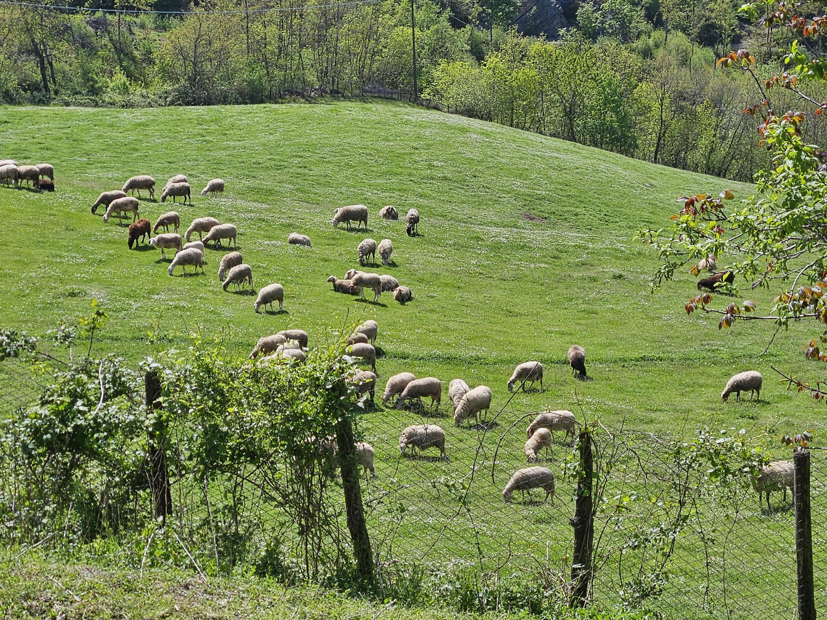
MARGINAL RURAL ("INNER") AREAS
Regions that are geographically remote, economically less developed, and often characterized by limited access to essential services and infrastructure.
They typically face challenges like depopulation and aging population, scarce economic and job opportunities, loss of cultural and natural heritage, difficulties in local governance.
In agriculture:
Land abandonment.
Few farms, scattered around vast territories with difficult accessibility and distant from markets and consumption places.
Aging farmers, decreasing n° of farms.
But:
Local typical products.
Traditional production processes and recipes.
Strong cultural and gastronomic identity.
Unique cultural landscapes.

Slide 5
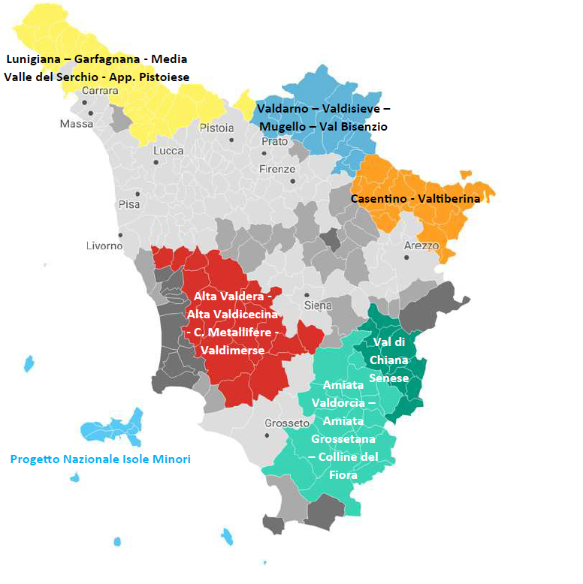
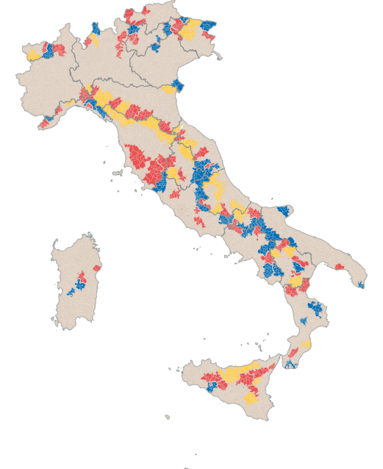
Italy 56 SNAI areas
Tuscany 7 SNAI areas
Italy’s National Strategy for “Inner Areas” (SNAI) is an innovative place-based policy for development and territorial cohesion to counteract marginalisation and demographic decline within “Inner Areas” throughout the Country.

Slide 6
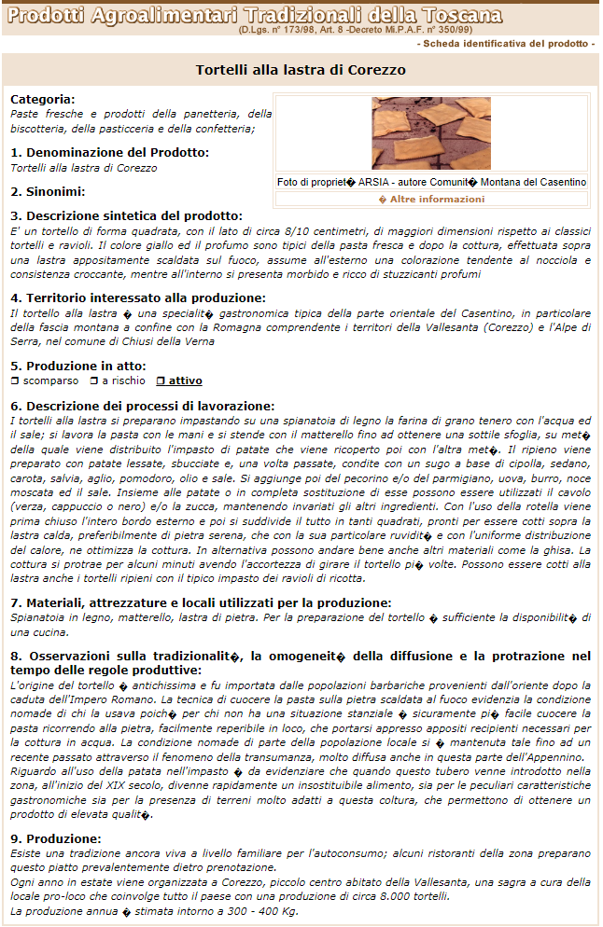
TRADITIONAL AGRIFOOD PRODUCTS (PAT)
Traditional agrifood products (PAT) are defined by the Italian law as products “obtained with processing methods, storage and maturation consolidated over time, homogeneous throughout the territory concerned, according to traditional rules, for a period not less than 25 years” (D.M. n. 350, 1993; D.L. n, 173, 1998;).
PATs are “expression of the Italian cultural heritage, like historical, artistic, architectural goods, because they are evocative of communities and territories, of memory and identity”. (d. interm. 09/04/2008).
They are included in a list set by the Italian Ministry of Agriculture, Food Sovereignty and Forestry in collaboration with the Italian Regions, counting nowadays more than 5000 products.
The inclusion in the PAT list is just informative (identifying sheet) and does not have any juridical or protection effect on the products, and also its signal on products and communication to consumers is a debated and a sensible issue.

Slide 7
TRADITIONAL AGRIFOOD PRODUCTS (PAT)
Small productions, at risk to disappear, and subject to a loss of connection with their territory of origin and/or to imitation.
PATs products can have interesting economic, social and cultural value, and be ‘activators’ of sustainable territorial development processes.
Public interest in PATs 🡪 Tuscany Region has started a Competence Center for Traditional Agri-food Products, a participatory working group aggregating experts, universities, producers' associations, public entities, etc. to discuss around PAT with the aim of identifying new opportunities for their economic valorisation.
Different evolutionary paths:
silent PATs (disappeared or at risk, unsure link with local resources, etc.);
evolution towards GIs (e.g., Ciliegia di Lari IGP);
evolution towards other forms of trademarks, such as collective geographical trademarks (e.g., Tortello Maremmano) or private trademarks registered by collective entities.
In Tuscany, 467 food products are registered as PAT.
In Casentino, 10 food products are registered as PAT.

Slide 8
FOCUS OF THE STUDY
PAT contribution to the activation of community-led territorial sustainable development processes.
Local traditional agrifood products (Tortello alla lastra di Corezzo (potato filled flatbreads), Farina di Castagne del Pratomagno (chestnut flour) e del Casentino, Pecorino del Casentino (sheep cheese)).
Tortello alla lastra di Corezzo:
In-person interviews with relevant actors.
Investigate local supply chain structure, territorial links, collective qualification and valorisation strategies, effect on the community.
Participatory research process.
SWOT matrix discussed and validated internally (research group) and externally (local actors).

Slide 9
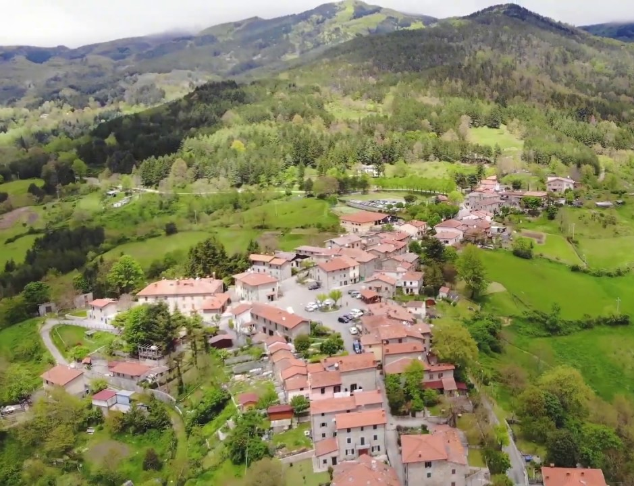
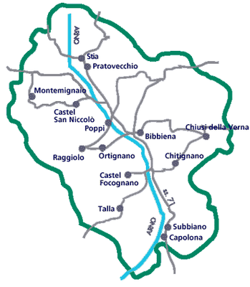
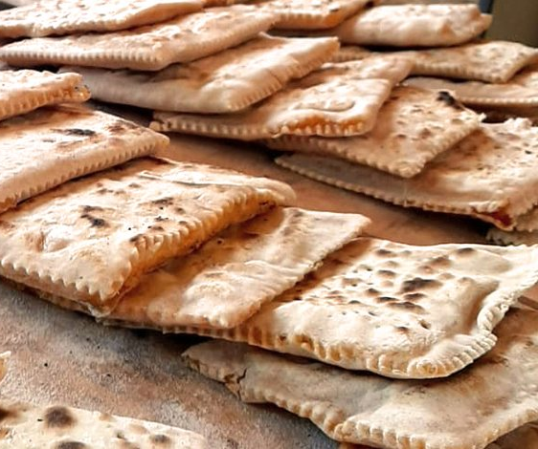
CASENTINO AND COREZZO
FIRENZE
Corezzo
COREZZO
AREZZO
TORTELLO ALLA LASTRA

Slide 10
CASENTINO AND COREZZO
CASENTINO
FIRENZE
CASENTINO
The first valley crossed by the Arno river, enclosed between the Appenine Mountains and the Pratomagno ridge, in the Arezzo Province.
Its rural landscape is characterised by a rich and complex combination of fragmented agricultural land, pastures, forests and chestnut groves.
Rapid abandonment of agricultural activity and depopulation in the Casentino threatening its socio-economic balances and rural landscape.
The marginalisation of Casentino have preserved a rural landscape of great value, a potential fulcrum of ‘alternative’ territorial development strategies, based on retro-innovation, network economies and capable of enhancing the value of origin products.
Corezzo
AREZZO
COREZZO
COREZZO
Small hamlet in the municipality of Chiusi della Verna (Arezzo), located at 760 m.a.s.l.
Next to the Casentino Forests National Park and some famous religious monasteries (Camaldoli and La Verna monasteries).
Around 80 inhabitant during winter, the village repopulates during summer.
Since the 1950s, the village has suffered a progressive depopulation (migration down to other villages in the Arno valley, or to closer towns (Florence, Arezzo)).
Notes:
m.a.s.l = metres above sea level
Ridge = dorsale

Slide 11
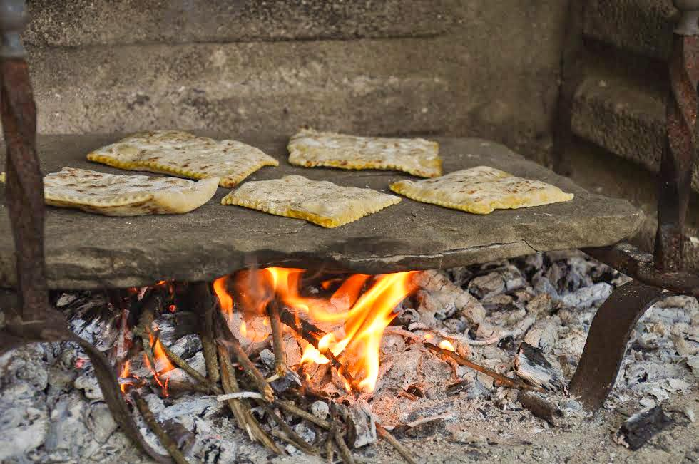
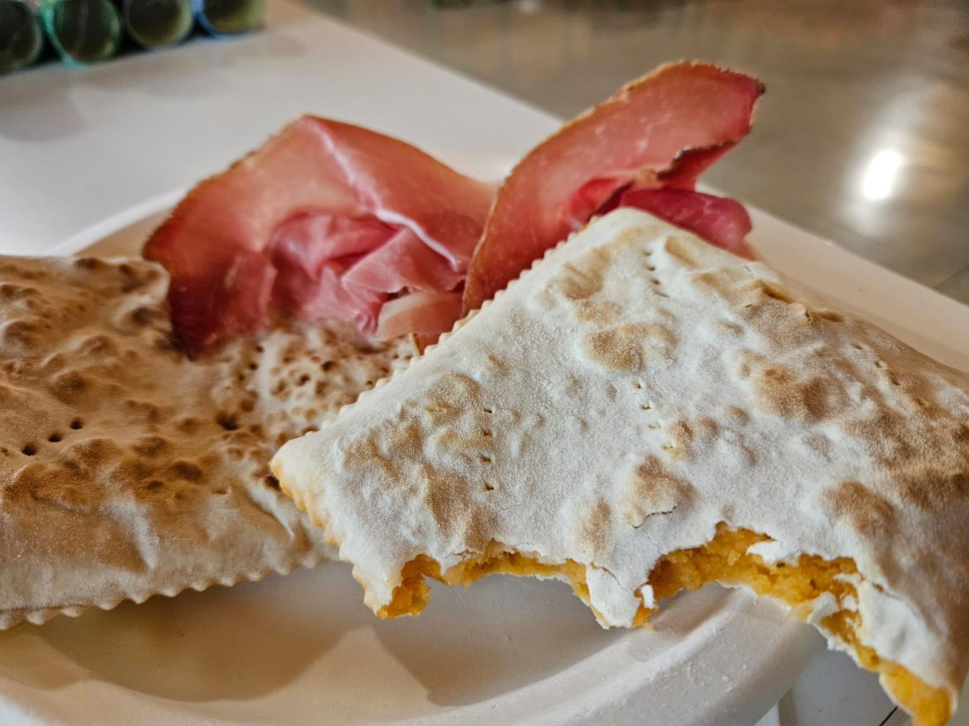
TORTELLO ALLA LASTRA DI COREZZO
Potato filled flatbreads typical of the Tuscan-Emilian Appenine region.
Can be grilled on an electric plate, cooked in the oven or on a slate on fire.
Corezzo’s Tortello specificity: cooked on a slate roof tile (“lastra”) heated over a fire.
Traditional product of family cuisine.
With the depopulation of Corezzo, Tortello remained present only at the community level (not at the economy level), and was in danger of disappearing completely.
Until a few years ago, only one restaurant in the village still served Tortello.

Slide 12
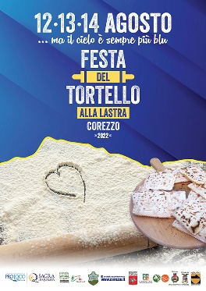
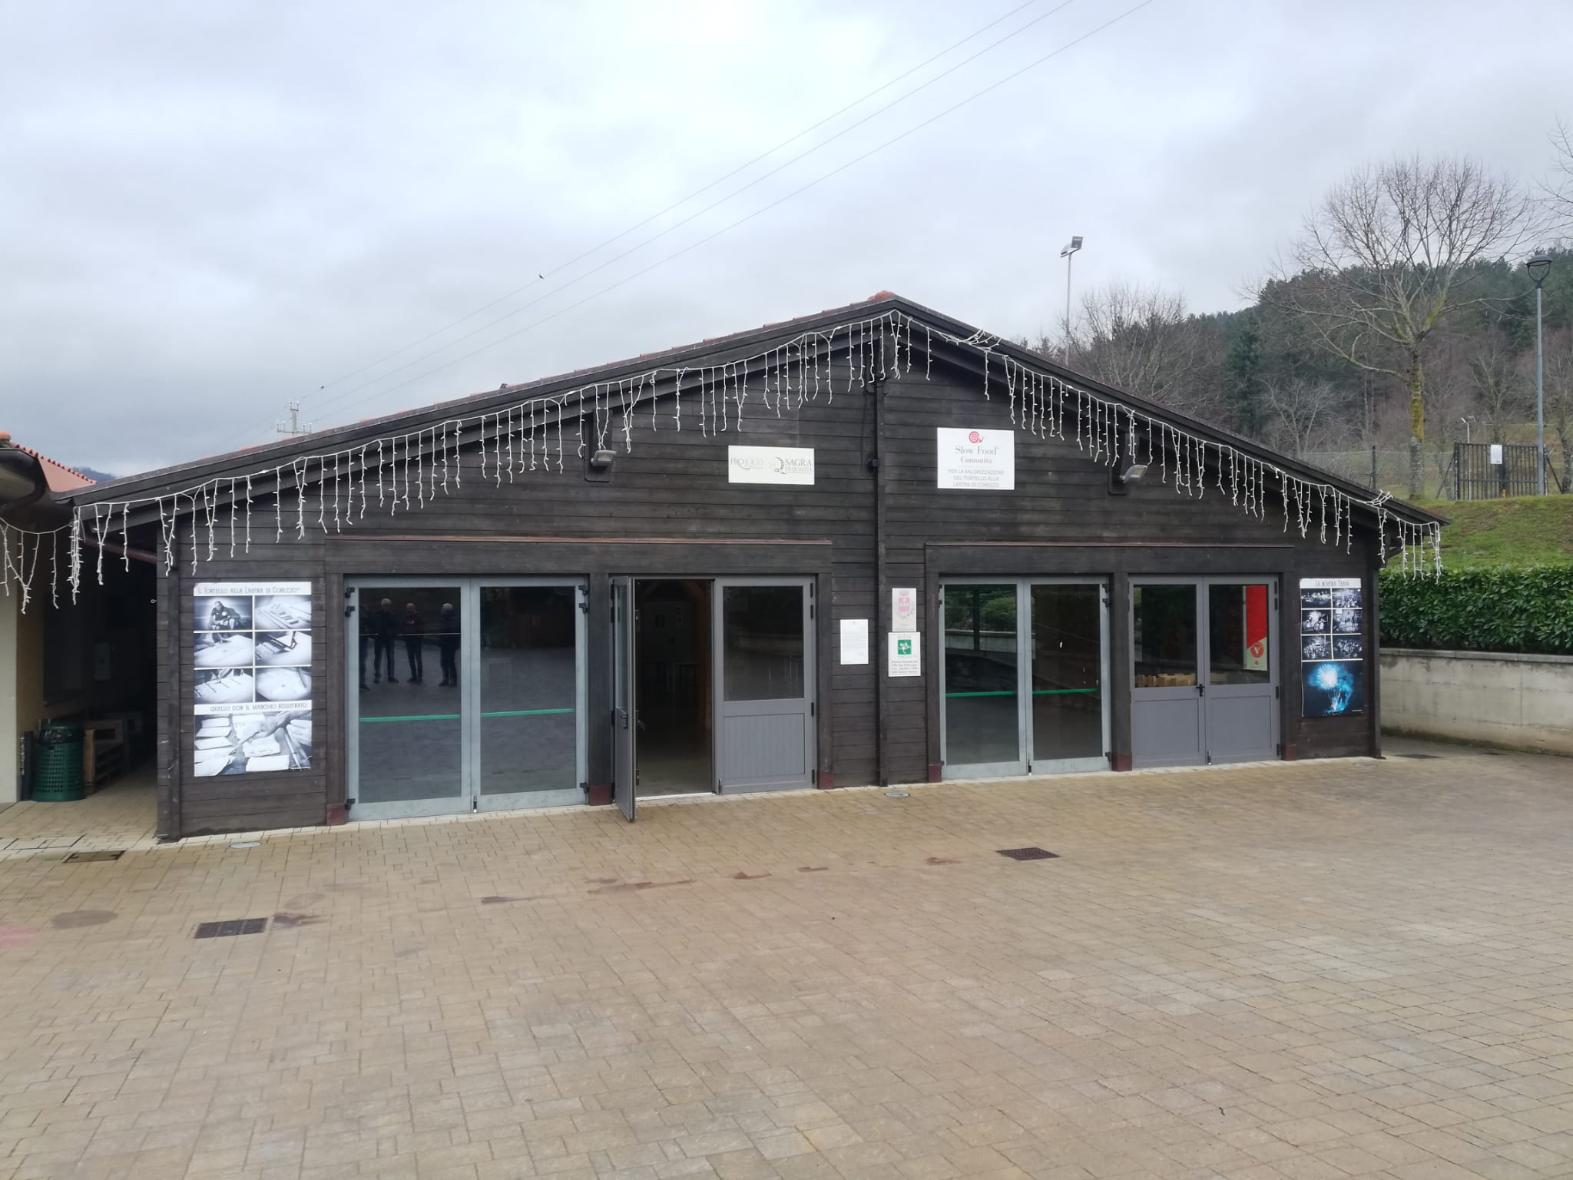
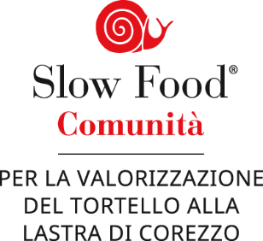
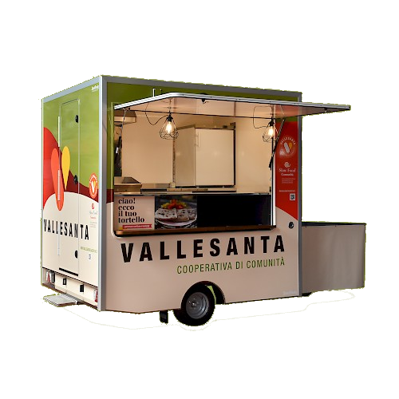
THE TORTELLO EVOLUTION PROCESS
Informal community group linked to the local church and the local soccer team
COMMUNITY DIMENSION
PRODUCT DIMENSION
Creation of the “Slow Food Community for the Valorization of Tortello alla Lastra di Corezzo”
Building of a community multifunctional centre with collective kitchen
Creation of
“Pro loco Corezzo” association
Creation of Vallesanta community-based cooperative
1st edition of the "Festa del Tortello" festival in Corezzo
1995
1996
2010
2018
2019
2021
2022
Registration of “Tortello alla Lastra di Corezzo” as a Traditional Agrifood Product (PAT)
®
Registration of the private label “Tortello alla Lastra ®"
Participation to food fairs (e.g., Slow Food Terra Madre) with the food truck
Tortello accessed local and non-local supermarkets

Slide 13
FINAL CONSIDERATIONS
Origin products can be a lever for sustainable territorial development processes.
Local communities plays a crucial role in the activation of local resources, in the construction of product’s identity and in its qualification to consumers and the external society.
Attempt to create a locally-closed supply chain, from the re-activation of local agriculture and raw materials production (flour, potato, etc.) down to the retail of the final product (tortello) to local restaurants and shops.
Fundamental role of local community-based associations and cooperatives in feeding and combining activism and entrepreneurship in the local community, generating community economies.
Importance of networks within and outside the community/territory of reference (e.g., Casentino Forests National Park, Slow Food, etc.)
Interconnection between the “origin product economy”, other proximity economies (e.g., school meals, tourists house cleaning, tourists cooking classes, etc.) and other economic sectors (e.g., tourism).
Contribution to invert some negative structural trends (new employment, new resident inhabitants, touristic flows).

Slide 14
THE ‘VIRTUOUS CIRCLE’ OF VALORISATION OF ORIGIN PRODUCTS
LOCAL SPECIFIC RESOURCES
(supply chain and territory)
EXTERNAL EFFECTS
Other sectors and actors of the territory
Activation
Reproduction
LOCAL ACTORS
(supply chain and territory)
MARKET
OTHER WAYS
RECOVERY
VALORISATION
Identification
and sharing
Remuneration
ORIGIN PRODUCT
Other sectors and actors of the territory
SOCIETY
Qualification
Adapted from Belletti et al., 2003; Vandecandelaere et al., 2010; Belletti and Marescotti, 2011.

Slide 15
International Conference Parma 2024
Workshop 2: Sustainability, Ethics, and Geographical Indications:
Towards Responsible Practices.
THANK YOU FOR YOUR ATTENTION
Matteo Mengoni*, Andrea Marescotti, Pier Angelo Mori, Paola Scarpellini, Giovanni Belletti
* matteo.mengoni@unifi.it

