Slide 1
The Comte cheese specification
Preserving identity for sustainability

Slide 2
Introduction
Comté cheese
Press cooked cheese
Made with raw milk
Matured for at least 4 months
1st PDO cheese in France
More than 60 000 tons sold in 2023

Slide 3
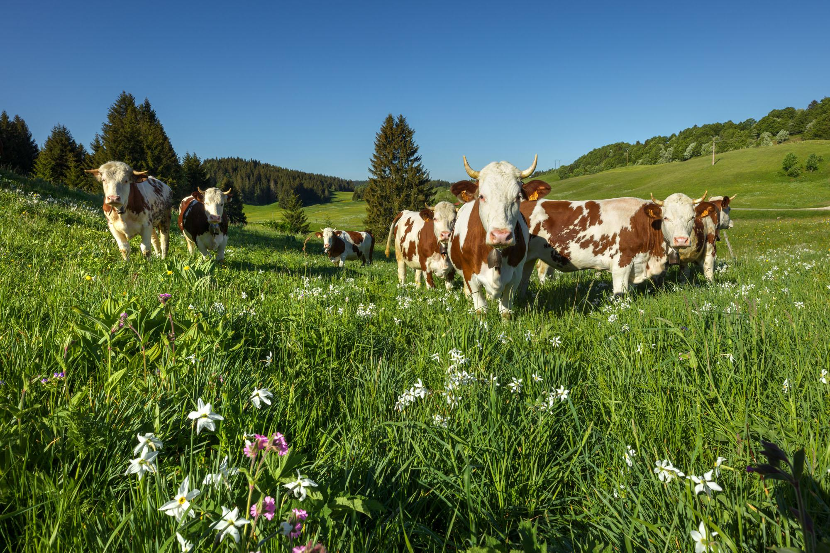
Keys informations 1/2
3 departments
280 000 ha
2400 farms
140 « fruitières » / workshop
14 maturing cellars
7 000 direct jobs / 7 indirect jobs = 14 000 direct and indirect jobs

Slide 4
Keys informations 2/2
A cooperative model
125 cooperatives on 140 workshops
Milk price
Above the price of the standard milk
Supply regulations rules
To controlled growth
Structuration of the agriculture in the PDO zone
More than 85% of the amount of milk produced in the zone income in a dairy that transform milk in Comté cheese mostly

Slide 5
A remunerative milk price for farmers (Source : DRAAF)

Slide 6
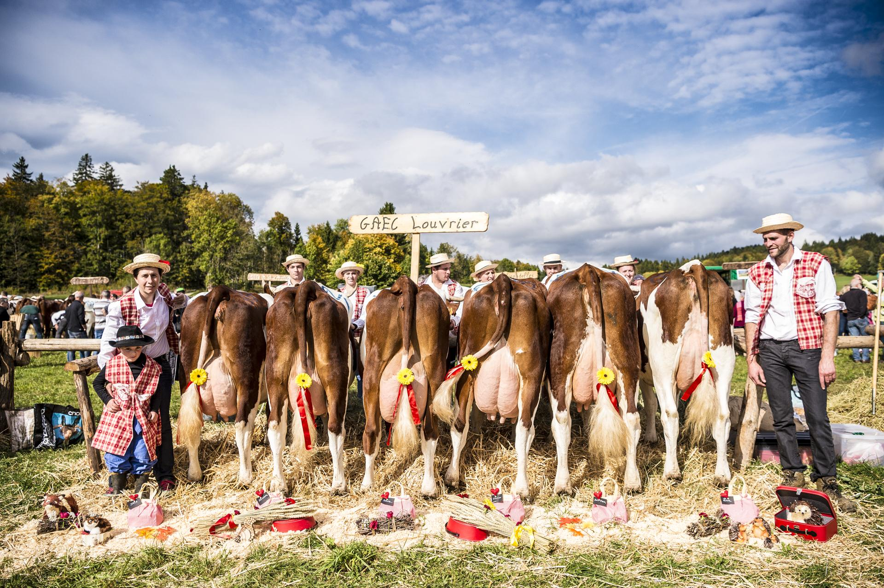
Comte specifications : a tool to protect identity of a PDO
10 revisions since 1976

Slide 7
Production measures
Cows : local breeds (Montbeliarde & Simmental)
Limitation of the individual productivity
Milk produced mainly from forage grown on the farm
50% of permanent grasslands on the farm
Cap on nitrogen fertilisation
1,3 ha of grassland per dairy cow
Limit on the number of cows per work unit.

Slide 8
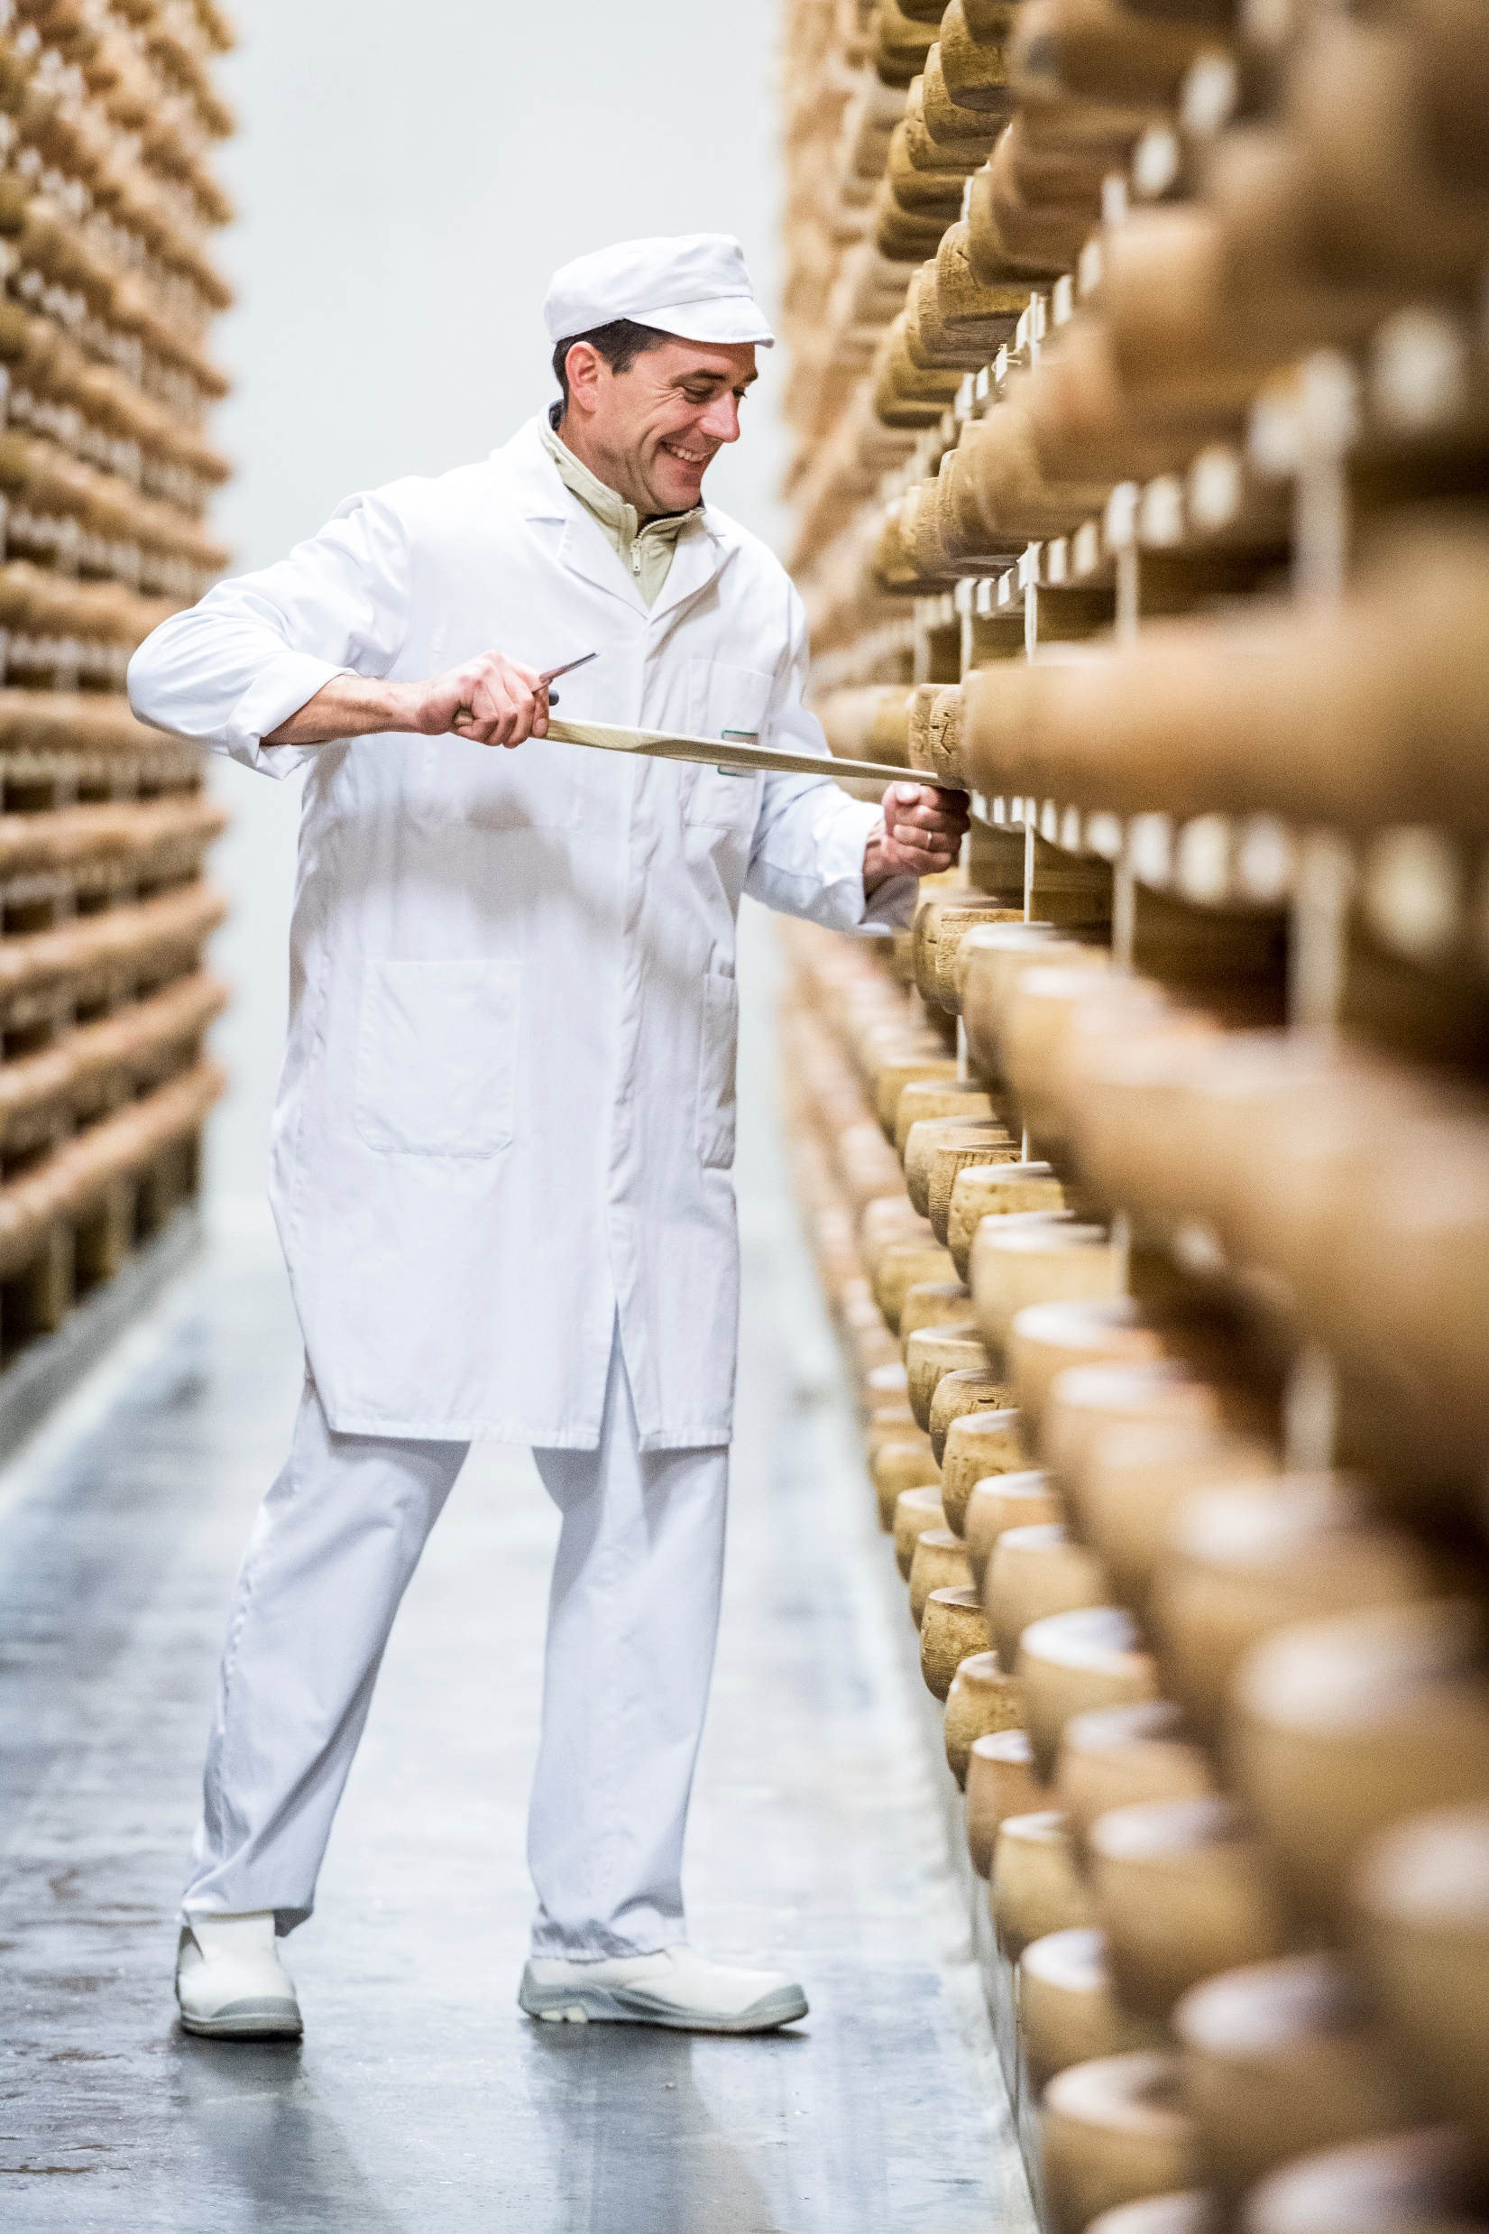
Transformation and ripenning measures
Milk renneted within 24 hours
Collection radius from the cheese dairy: 25km maximum
Packaging and pre-packaging in the zone.
Framing of workshop growth
Ban on mergers above 7.5 million liters of milk in the new merged plant
Ban on the automation of manufacturing processes

Slide 9
Why this specifications preserve the identity and the quality of the Comté ?
Cheese made from cows that feed on fodder produced in the area, which contains all the richness of the natural elements of the terroir.
Milk processing in small cooperative workshops
Comté was born to provide outlets for agricultural production in difficult conditions:
Today's objective is to enable producers to make a living from their activity in the region.
Specifications target to protect the link between the terroir and the product.

Slide 10
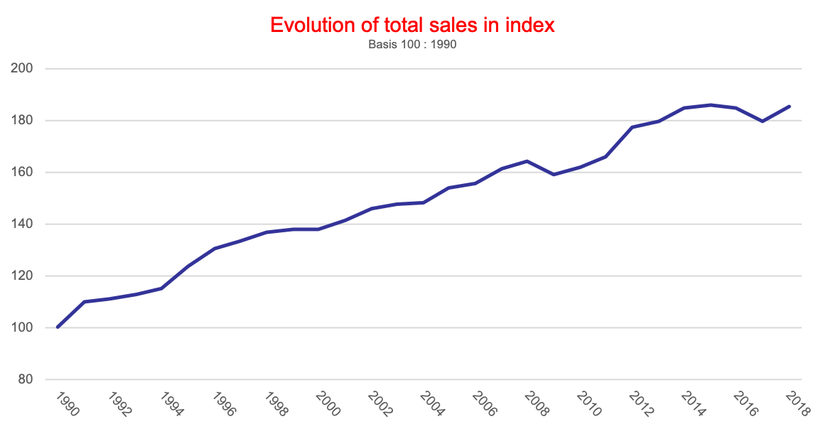
Regulation : a steady growth

Slide 11
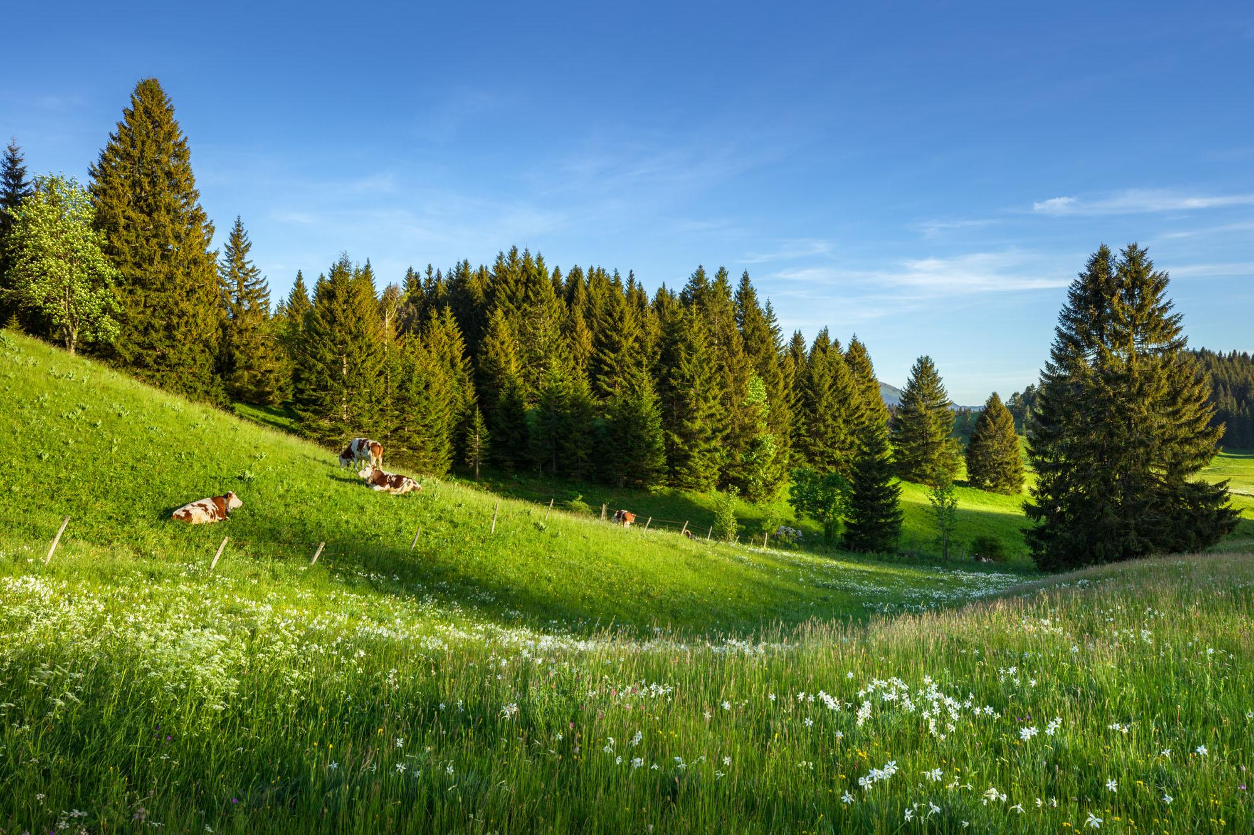
Why this measures help sustainability ?
How do these measures promote sustainability?
Why does preserving identity and the link to the terroir promote sustainability?

Slide 12
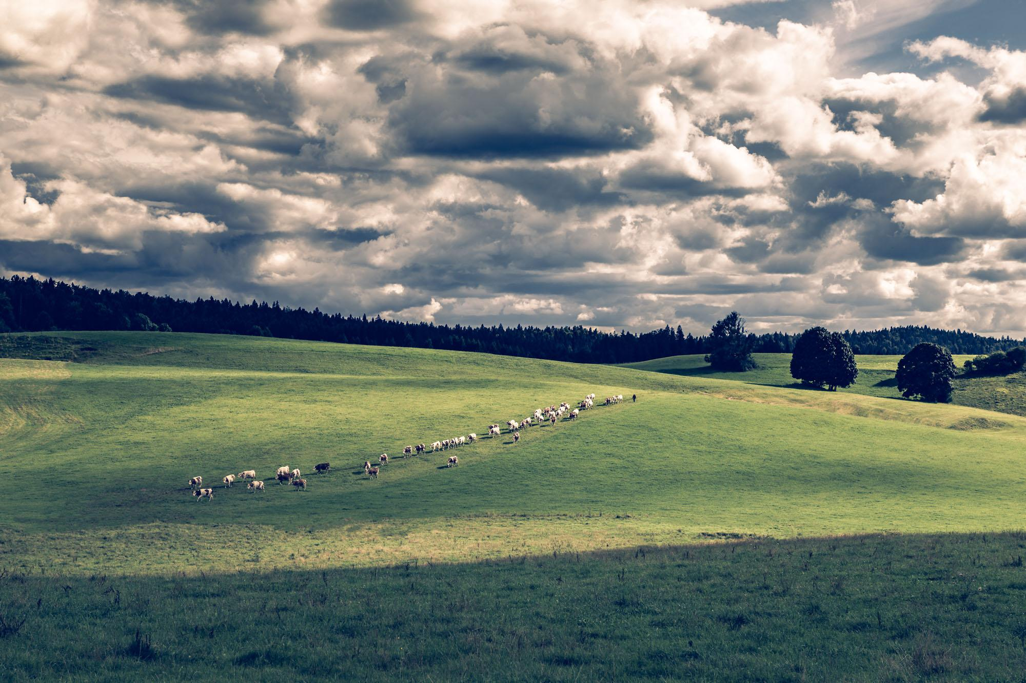
Environmental sustainability
Maintenance of natural areas and landscapes.
Help the fodder autonomy : limits the impact on climate change and the biodiversity.
Management of fertilization at plot level to decrease inputs use.
Working for animal welfare

Slide 13
Economic sustainability
Limit the size of the farms
Keeping farms at a size that allows them to be passed on to future generations
Enabling all players in the sector to be in control of their decisions and their production facilities right up to the end of the value chain.
Promote better product quality.
Remuneration that enables economic players to live and invest

Slide 14
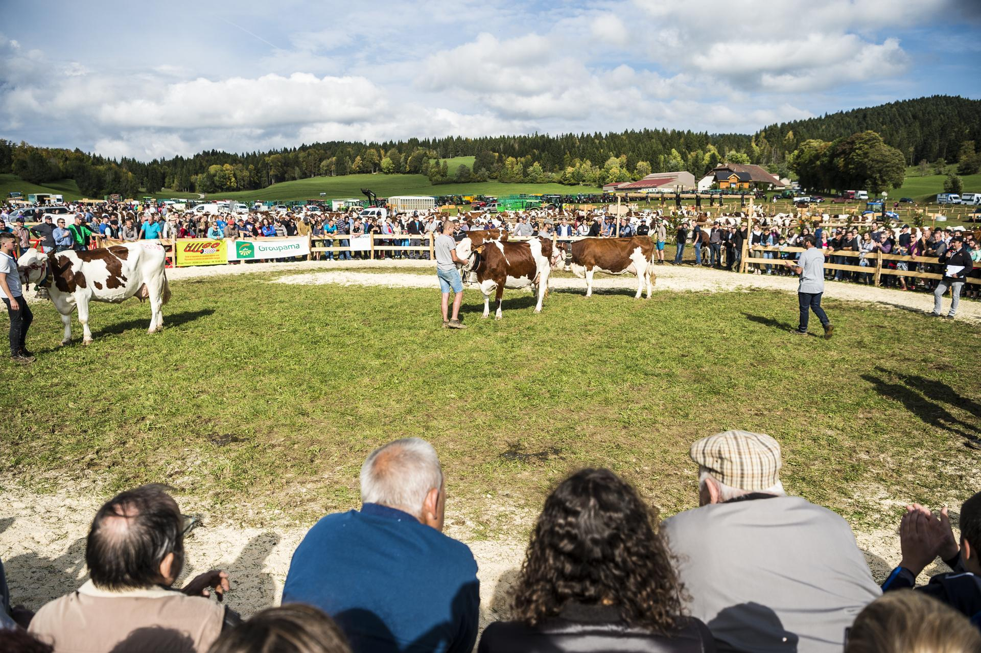
Social sustainability
Professional farmer who holds the capital and does run the farm.
Strengthening farmers’ position in the value chain : maintain a truly efficient cooperative model.
Enabling everyone to get involved in the life of their cooperative and the sector.
Preservation of social capital and know-how.

Slide 15
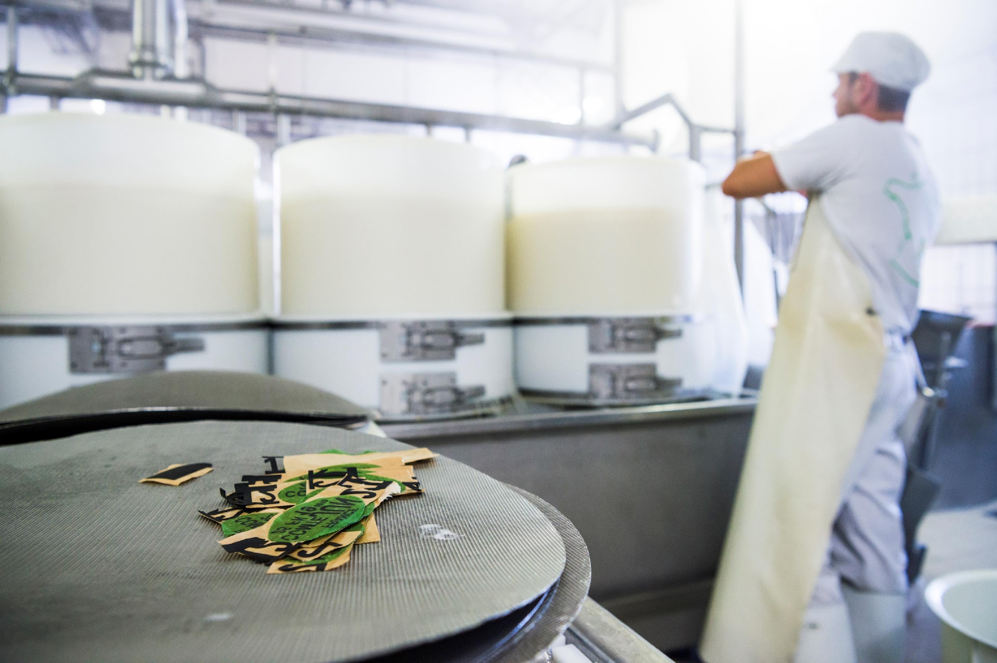
Terroir , ethic and sustainability
Preserving the identity of a product from a terroir = preserving sustainability.
Terroir includes economic, natural and social elements 🡪 the result of a construction process that gives the product its unique characteristics.
Preserving identity means acting to maintain production that is adapted to its terroir.

Slide 16
Social capital, specifications and ethics of the players in the sector
In the Comté sector, social capital is an essential cause of the success.
Ethics: principles that are binding on all those involved in the sector and that govern their actions.
Specifications : expression of the ethics of the players.
Without shared ethics and social capital: no specifications.

Slide 17
A virtuous circle
Strengthens and protects
Social capital
Sense of belonging, ethics, sharing information : enable the fair sharing of added value and the adoption of specifications.
Interdependence between the various economic players in the production chain: strengthening social capital and sustainability.
Specifications
Make it possible

Slide 18
Conclusion
The challenges of preserving the sector's identity as a vector for sustainability
Adoption of more restrictive measures
Stakeholder cohesion and commitment in a more individualistic society
Acceptance of a long-term vision

Slide 19
Thank you !

