Slide 1
Enhancing sustainability and innovation through Geographical Indications in organic fruit breeding
International Conference on "The Role of Origin in the Sustainability of Localised Food Systems, in particular, the role of circular economy in Geographical Indications"
Parma, 21/11/2024
Mariagiulia Mariani

Slide 2
Agenda
Needs and potential of the Organic Fruit Breeding sector
The role of Social Innovation: InnOBreed project
GIs as Social Innovation
Case studies
Conclusions

Slide 3
The context
Geographical Indications in the EU are aligning with biodiversity goals, incentivizing:
sustainable farming practices,
cultural practices and landscapes,
social processes related to biodiversity management
(Bérard et al., 2008, Belletti et al., 2015; Bowen & Zapata, 2009)
Impact on biodiversity varies.
embracing agro-ecological practices, which focus on soil health, organic methods, and local adaptations
incorporating sustainability criteria that specifically address biodiversity conservation
addressing single vs. multiple varieties or techniques
economic and power relations between stakeholders.

Slide 4
The goal of the presentation
GI
Innovation
Biodiversity
Innovation
… in the Organic Fruit Breeding Sector
conservation
innovation

Slide 5
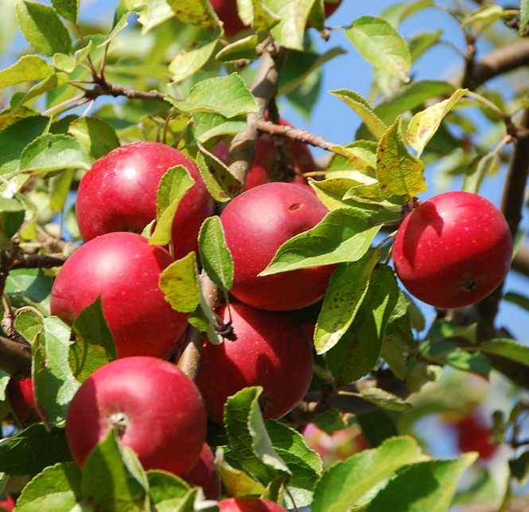
Challenges in the Organic Fruit Breeding sector
Multitrait varieties are needed to address pest resistance, abiotic stress tolerance, and nutritional enhancement.
Cultivars tailored to organic practices and environments.
Multifunctional varieties serving multiple purposes, including landscape aesthetics and socio-economic support.
Aligning with evolving consumer preferences to ensure market demand and economic viability for farmers.
(Chable et al. 2020)

Slide 6
Organic Fruit Breeding: a crucial sector for system redesign
Organic fruit breeding
Sustainable Agricultural Practices
Climate Adaptation and Resilience
Innovation
Agrobiodiversity
Sustainable Diets
Local Empowerment

Slide 7
An emerging approach to innovation: Social Innovation
Social Innovation
Needs
Process / social interaction
Aims
Moving from a discontent with innovation as we know it, and its ability to deliver just and sustainable outcomes
Needs of integrating including other processes, actors and purposes

Slide 8
Social Innovation in the Organic Fruit Breeding
Social innovation in the organic fruit breeding sector refers to the development of new perspectives and social practices that address social, environmental, and market challenges faced by the sector, especially by organic fruit growers, and the overall society and planet.
It comprises a reconfiguration of social relationships based on trust, participation, and knowledge exchanges between different actors, from farmers to consumers.
It aims to improve the well-being, empowerment, and inclusion of all stakeholders involved in the production and consumption of organic fruits while promoting social, economic, and environmental sustainability in the long term.
EU funded Horizon 2020 InnOBreed (Innovative Organic Fruit Breeding and Uses) project.
https://innobreed.eu/

Slide 9
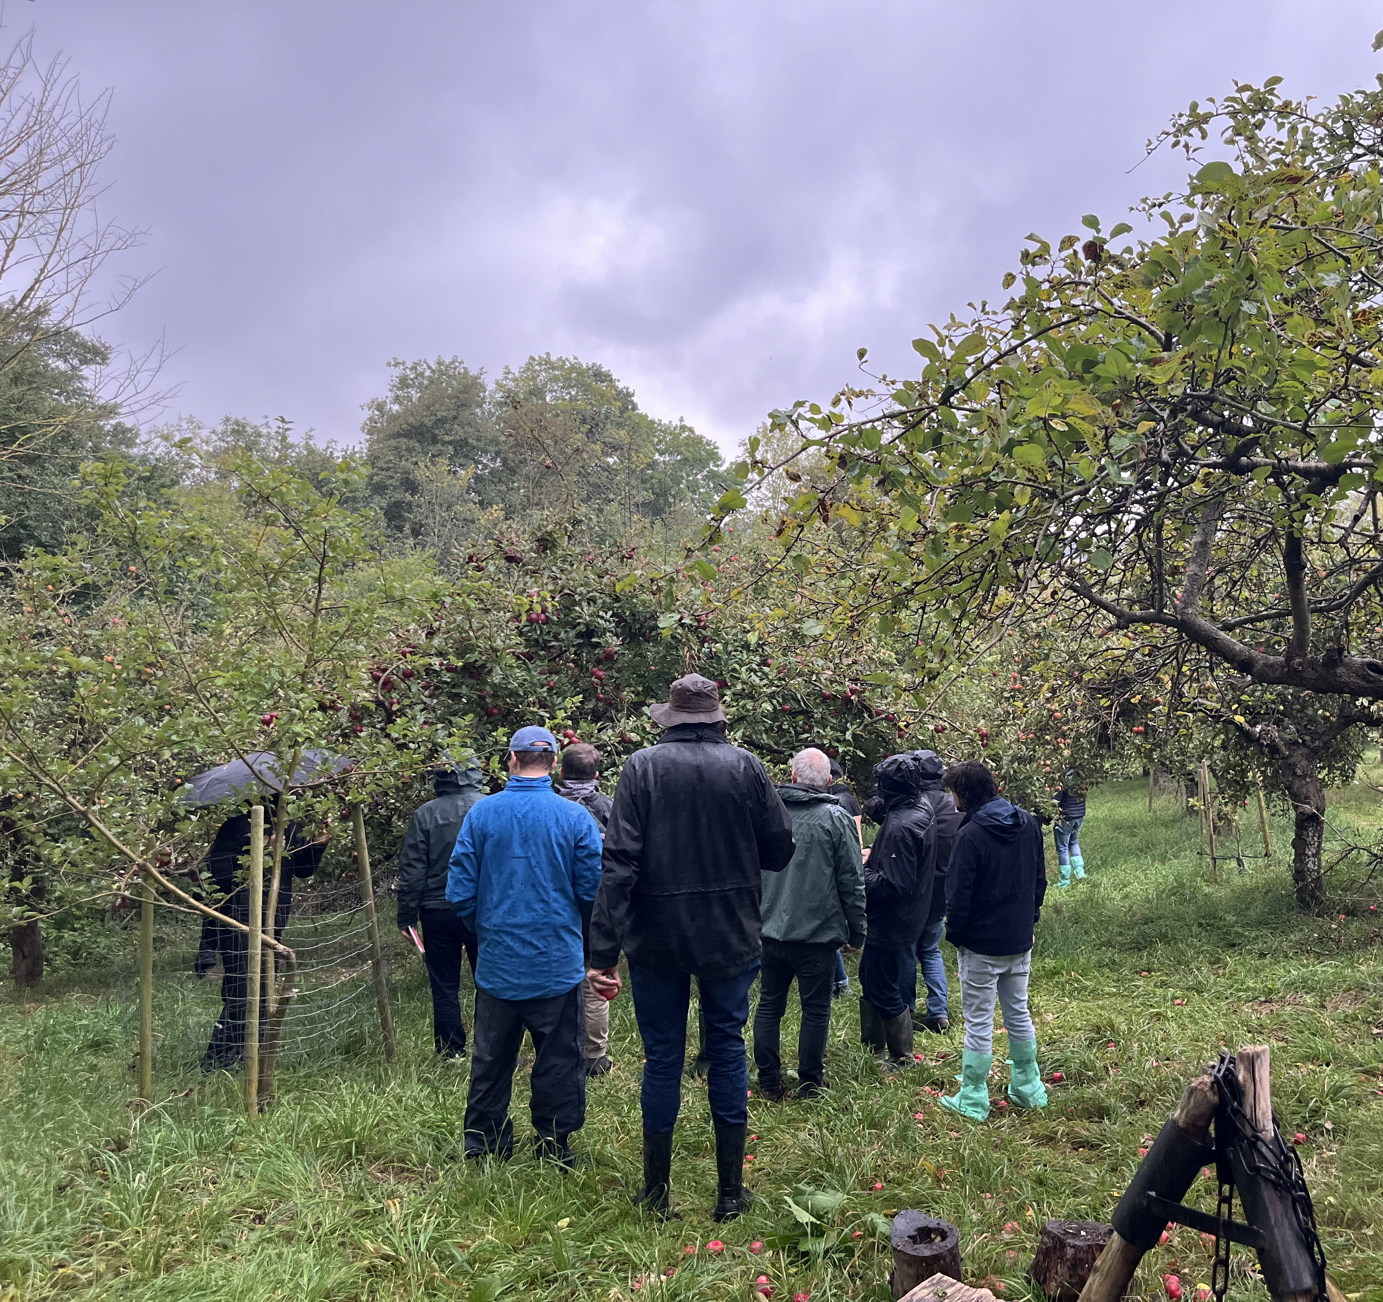
GIs as Social Innovations in the Organic Fruit Breeding
addressing specific social needs and generating solutions within rural communities, promoting rural development, community empowerment, and biodiversity conservation.
foster local collaboration between producers, consumers, and researchers
lead to innovative strategies for conserving biodiversity at the local level, e.g. participatory breeding programs, the development of new production techniques, and governance models that prioritize sustainability.

Slide 10
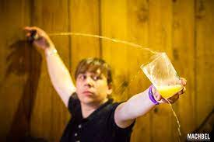
Cases: PDO Sidra de Asturias (Spain)
Developer | Need/Aim | Process | Output
PPP (Ministry, cider apple producers and cider houses, SERIDA and Asturian population) | Value the genetic diversity of apple varieties and encourage their use. Defend a traditional product (cider). Enhancing local rural economy and development. | Participative development of varieties. End-users’ involvement, e.g., connection with consumers. Cultivating trust base community and relations. Exchanging experiences, knowledge and info | Vertical connection in the sector. Innovative partnership with research and civil society organizations. New communication tools and supports. Events for sharing taste and heritage.
A PDO for Asturian cider that involves over 70 traditional apple varieties, managed through a public-private partnership that fosters collaboration and biodiversity conservation.

Slide 11
Cases: PDO Susina di Dro (Italy)
Developper | Need/Aim | Process | Outputs
Operative group of Trento province. | Enhancing local and/or rural development. Increasing economic opportunities in rural areas. Protection of agricultural biodiversity. | Participative development of varieties. End-users’ involvement, e.g., connection with consumers. Establishing connections with organic networks. Cultivating trust base community and relations. Exchanging experiences, knowledge and info. | Innovative market models, e.g.: -Multifunctionality and integration of tourism. -New options for the growth of the organic market, e.g., collaboration with public procurement. Conservatories or other means of ensuring access to fruit plants. Exchanges of fruit plants among gardeners, farmers, scientists and researchers.
A participatory initiative focused on improving the local plum variety through genetic and sanitary selection, ensuring high-quality nursery materials while involving a wide range of stakeholders.

Slide 12
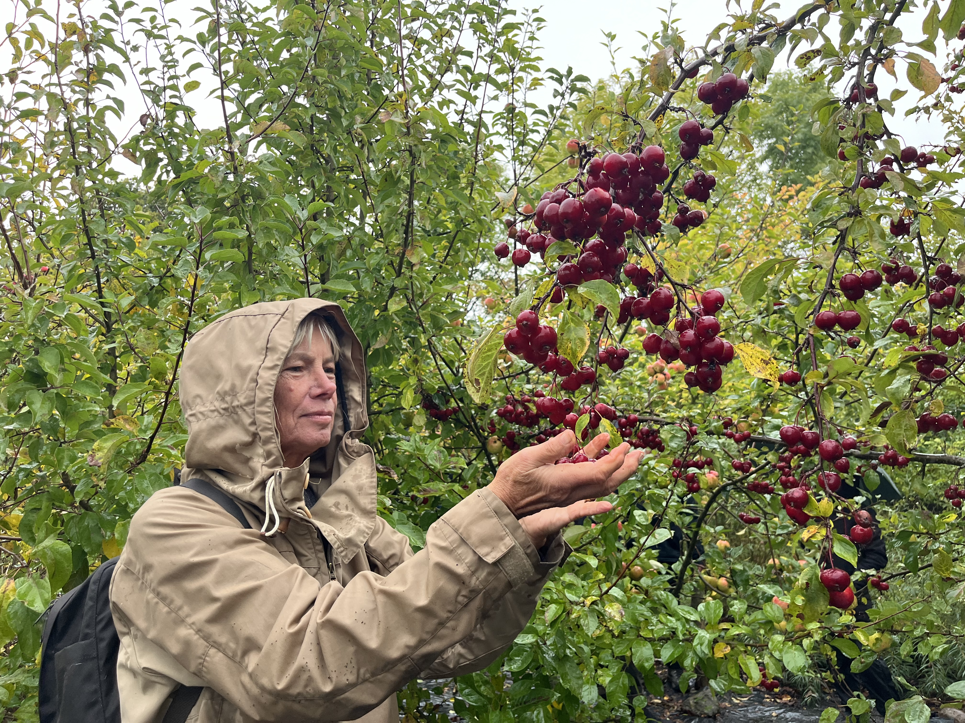
Governance-Focused SI in OFB
Aligns with policies on organic certification and biodiversity.
Uses "quality schemes" for financial incentives and collaboration.
Focuses on collaborative breeding of local varieties.
Meets policy requirements and seizes market opportunities.

Slide 13
Conclusions: which elements for transformation?
Stakeholder Engagement
Multi-stakeholder governance promotes active participation and shared ownership. Power dynamics may still favor established actors, potentially marginalizing others.
Knowledge Exchange
Crucial for collaboration and reinforcing governance structures Knowledge sharing influences policies, innovation, and resilience
conservation
innovation

Slide 14
Thanks for your attention!
Mariagiulia Mariani
mariagiulia.mariani@agr.unipi.it

