Slide 1
International Conference – 20-22 November in Parma Workshop 1. Sustainability Elements of Geographical Indications Sustainable commitments and socio-economic challenges of livestock Geographical Indications in Occitania GUIBERT Cécile, Université Toulouse Jean Jaurès, France

Slide 2
Past successes of quality chains and current sustainability challenges
There are some well-known examples of the success of French GIs, in terms of territorial development and maintaining traditional production in areas disadvantaged by agricultural modernization (as in mountain areas)
Quality chains have intrinsic qualities in terms of sustainability, because they differ from standard productions and because of their link to a terroir
=> this argument is strongly asserted by economic players, but the reality of situations is very heterogeneous.

Slide 3
Past successes of quality chains and current sustainability challenges
The agricultural transition challenges also concern them, and they are already active on these issues
Today's challenges are exacerbated for all livestock sectors, including DPO, PGI and the French Label Rouge:
Controversy surrounding livestock farming, animal welfare and the environment
Major structural socio-economic difficulties (farm renewal, farmers incomes, inequalities in value sharing, farmers living and working conditions, cost-efficiency of processing operators of retailers etc.).

Slide 4
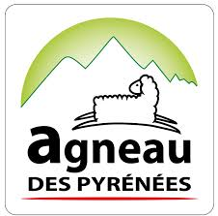
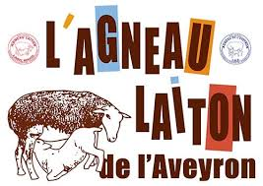
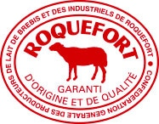
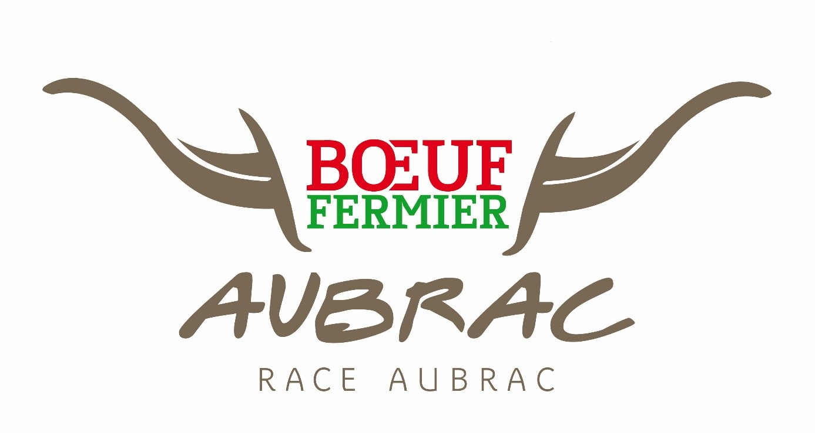
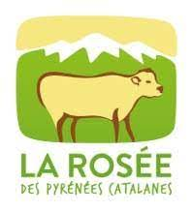
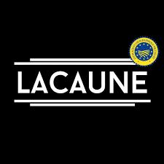
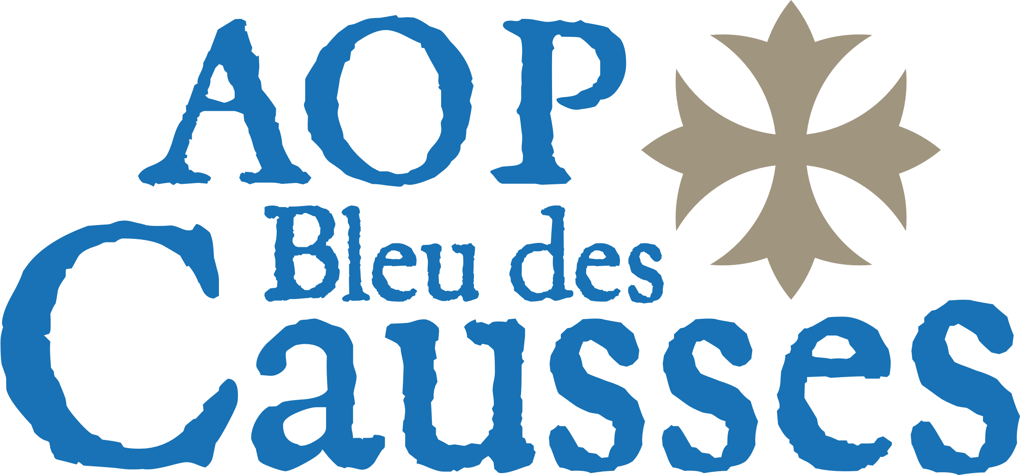
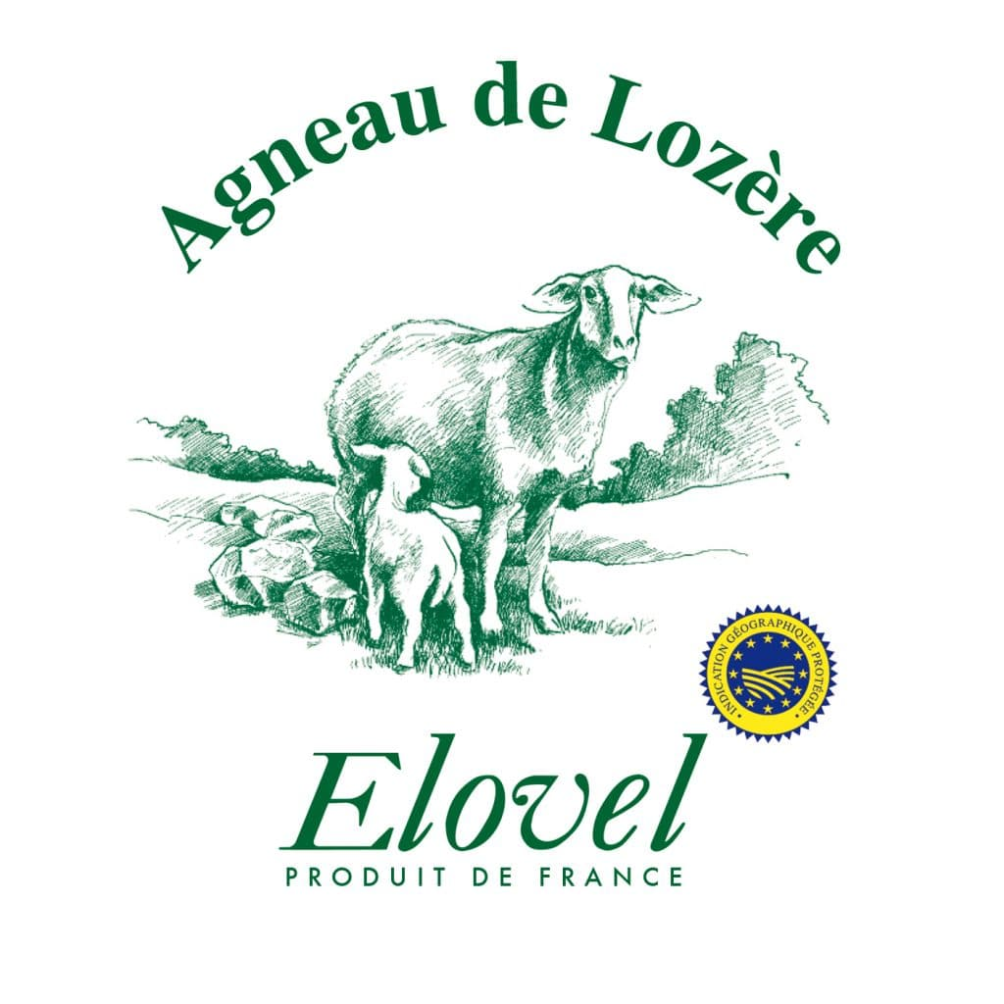
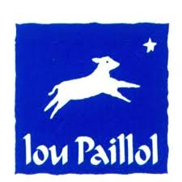
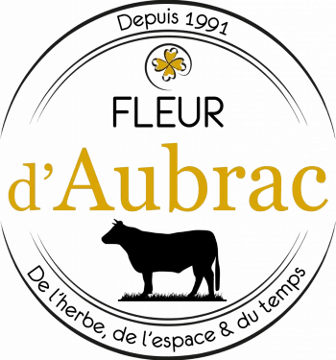
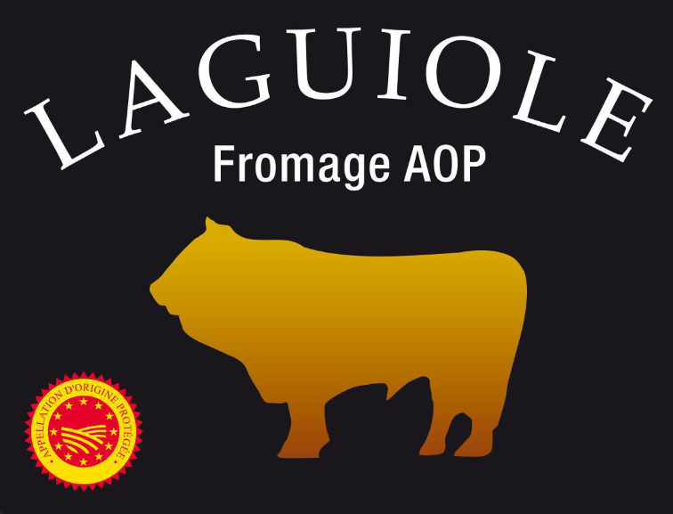
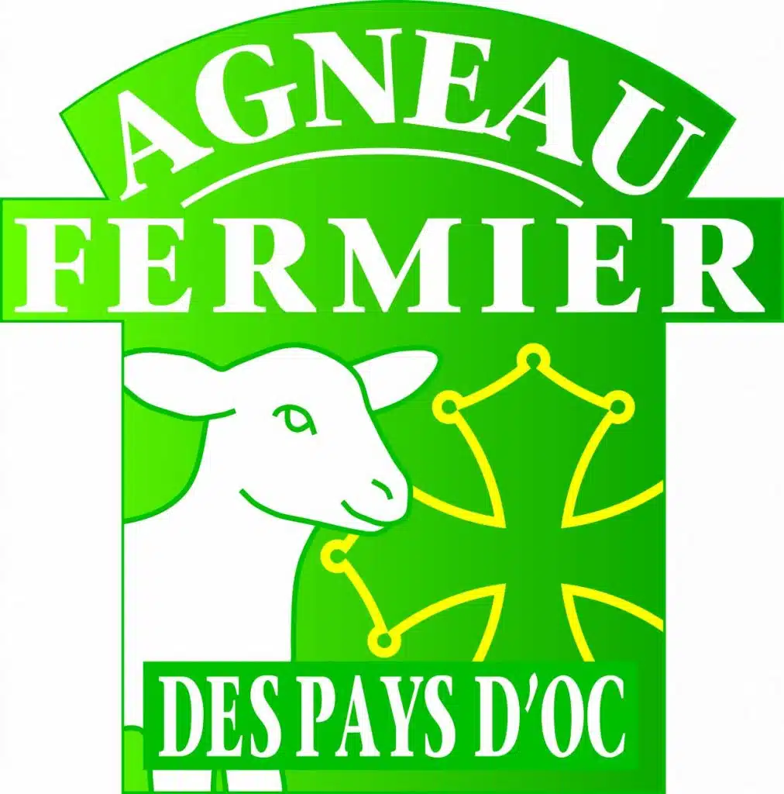
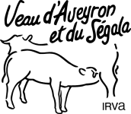
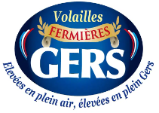
An abundance of sustainability initiatives... on several scales
A geography thesis on these Geographical Indications for livestock farming in the Occitanie region of southern France, examining the role of territorial anchorage in their transition dynamics => a study of the historical trajectories and current actions of some thirty meat and cheese products
Method : an analysis of specifications, review of scientific literature and qualitative interview survey of most of these agricultural sectors between 2019 and 2023

Slide 5
An abundance of sustainability initiatives... on several scales
One of the main findings is that, to meet the challenges of sustainability, these sectors are trying to be present at all scales : European federation for hardy breeds, national PDOs federation, regional cooperations, territory projects, agri-food company initiatives for sustainability, working groups between farmers, etc.
Another important result shows the embeddedness, not only of scales of action, but also of sectoral and territorial logics.

Slide 6
But some structural socio-economic challenges are difficult to overcome
There is a finding of concern, revealing the difficulties and socio-economic fragility of some GIs, even for long-established GIs
There are examples of apparently good social, environmental and economic performance (PDO Porc Noir de Bigorre, for example), but the survival of some GIs is under direct threat.
These structural challenges may be exacerbated by the political context of agricultural transition ; or, for some, the efforts made towards sustainability may be swept away by an unresolved structural problem, or difficulties in complying with new regulatory requirements

Slide 7
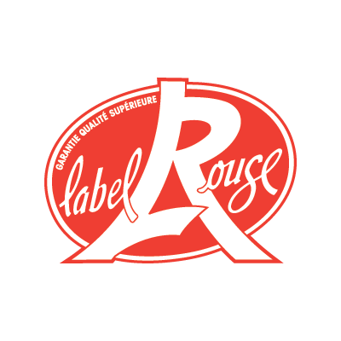
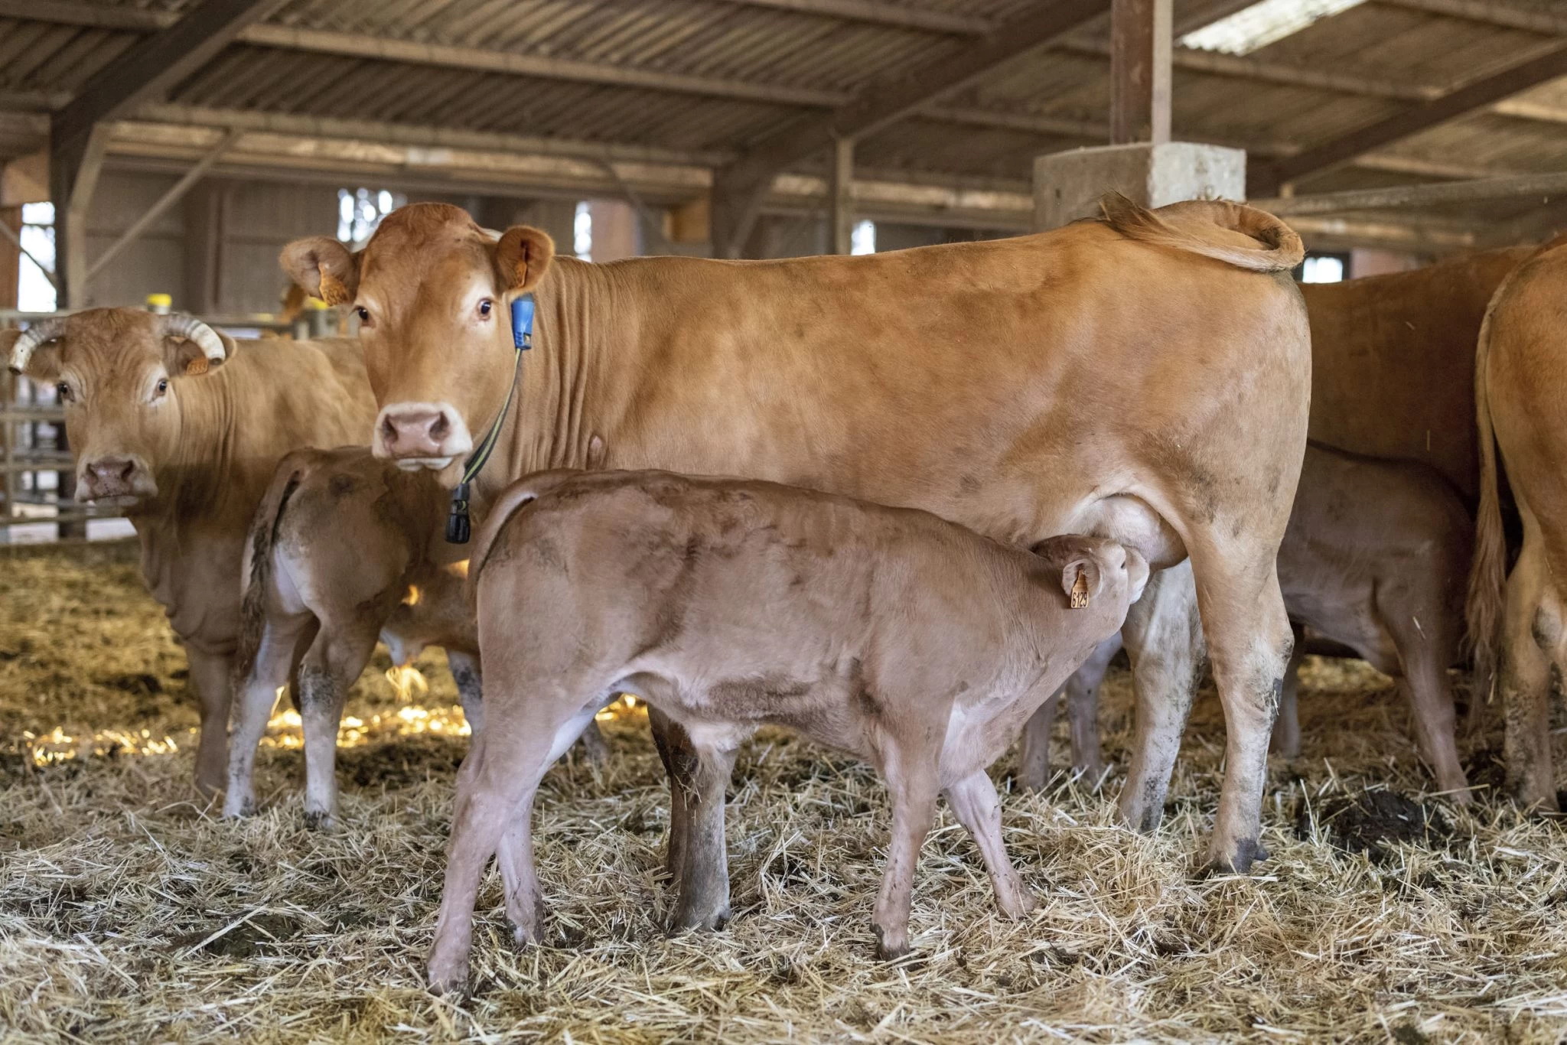
But some structural socio-economic challenges are difficult to overcome
Veau d’Aveyron et du Ségala (PGI ; Label Rouge)
- a traditional veal breeding sector, located in the departments of Tarn and Aveyron, with a wide range of distribution channels (department stores, butchers, restaurants, etc.).
- characterized by a strong and active collective on issues such as value sharing, best environmental practices and product quality; but also, by an imbalance of power in favor of economic players in the slaughtering and trading sectors
- weakened by structural problems of value-adding in the beef sector, and by the difficulties experienced by mass retailers (like Auchan)
- endangered by low farm renewal in the coming years, a demographic erosion of producers to come

Slide 8
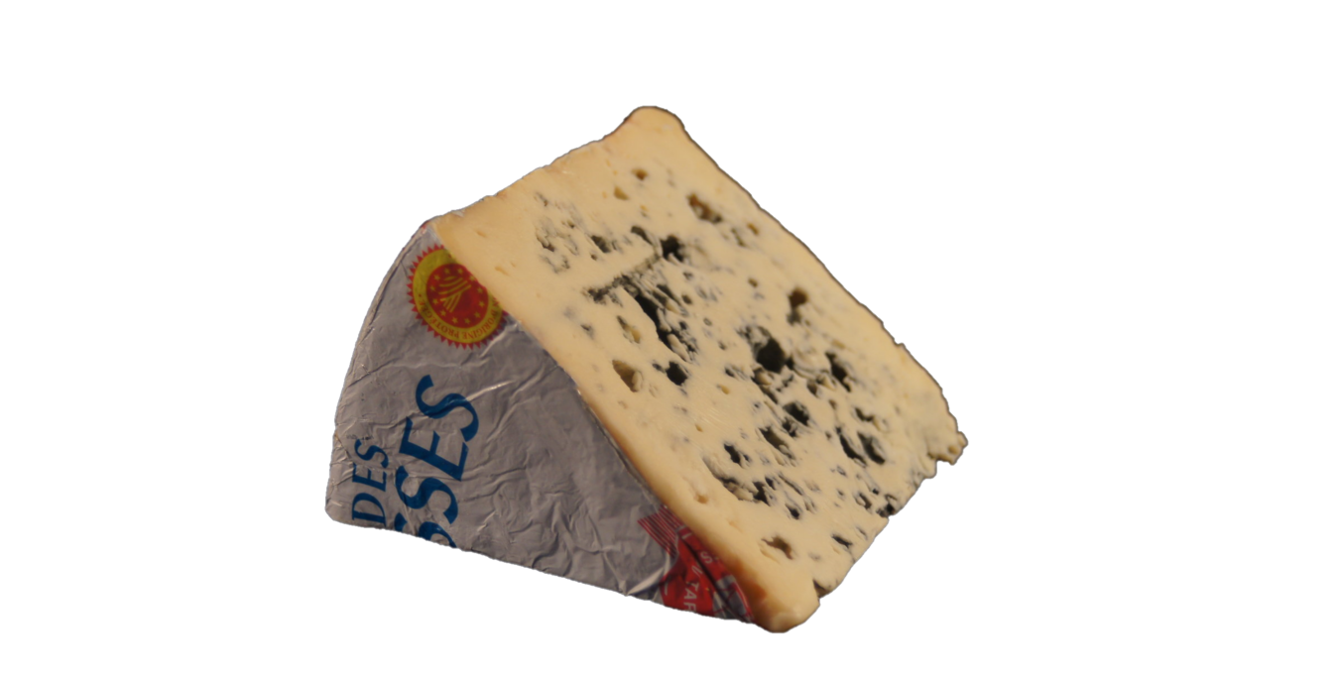
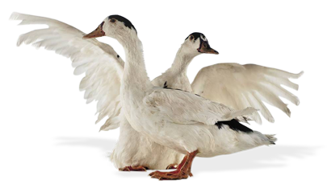
But some structural socio-economic challenges are difficult to overcome
Bleu des Causses (PDO)
A blue-veined cheese made from cow's milk, produced by an industry close to the Roquefort industry in Aveyron.
In a difficult position due to the collapse in sales volumes... and a prevailing feeling of powerlessness in the face of the changes required in terms of sustainability.
Canard à foie gras du Sud-Ouest (PGI)
- animals raised for foie gras production, corn-fed according to the farming traditions of south-western France
- it has been hard hit by the impact of successive bird flu outbreaks on production capacity
- and whose consumption is being called into question, for economic reasons (luxury products in a context of inflation) and animal welfare.

Slide 9
Prospects: what capacities for action do GIs have for their transition to sustainability?
By their very nature, these GIs have advantages for sustainability, but they are not always objectified or promoted.
GIs are active on transition issues, but vary in their degree of commitment...
Inequalities in the ability to take action to achieve sustainability goals become apparent
An example is how Corporate social responsibility (CSR) has been adopted and deployed by manufacturers and major industries… versus a lack of financial and engineering resources for the most modest sectors to bring about change or to highlight the good practices they have already implemented.

Slide 10
Thank you for listening ! cecile.guibert@purpan.fr

