Slide 1
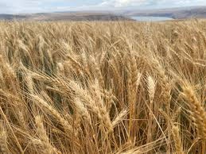
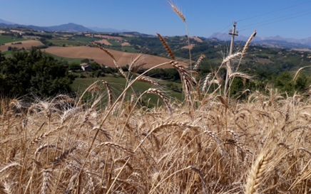




The Central Role of Biodiversity
Gianni Galaverna
University of Parma, Italy
ODT Forum 2024, Parma Gianni Galaverna, UNIPR

Slide 2
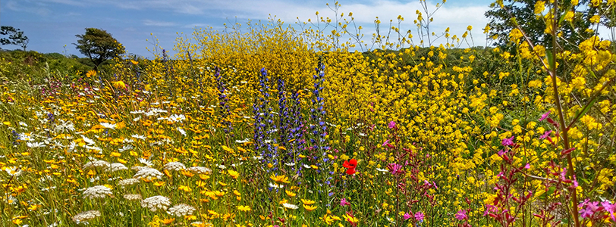
The Biodiversity
Art. 2, Convention on Biological Diversity, CBD
“The variability among living organisms from all sources including, inter alia, terrestrial, marine and other aquatic ecosystems and the ecological complexes of which they are part; this includes diversity within species, between species and of ecosystems”
https://www.cbd.int/convention/articles?a=cbd-02
ODT Forum 2024, Parma Gianni Galaverna, UNIPR

Slide 3
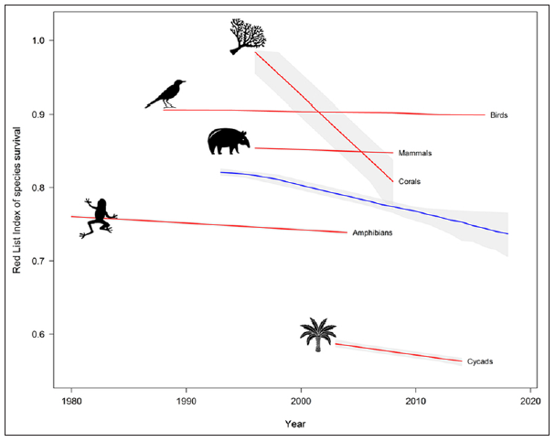
The Biodiversity Loss
The Red List Index (RLI) of species survival for mammals, birds, amphibians, reef-forming corals and cycads.
The blue line indicates the overall RLI for all the taxa combined.
Rate of species extinction is estimated to be 100-1000 times greater today than a millennium ago.
Philip J. Landrigan et al., Annals of Global Health, 2024, 90(1): 1, 1–23.
ODT Forum 2024, Parma Gianni Galaverna, UNIPR

Slide 4
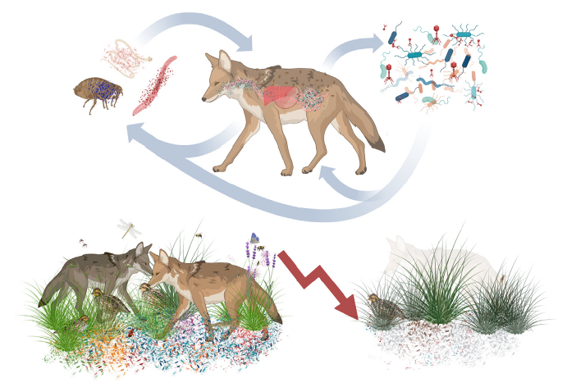
The overlooked Biodiversity Loss
Eukaryotic organisms exist as holobionts: a unit of biological organization composed of a host and all physically associated microbiota.
Loss of organismal habitats
Loss of microbial symbionts
affecting ecosystem resilience and extinction risks of other host species.
Morten T. Limborg et al. Trends in Ecology & Evolution, October 2024, Vol. 39, No. 10 889
ODT Forum 2024, Parma Gianni Galaverna, UNIPR

Slide 5
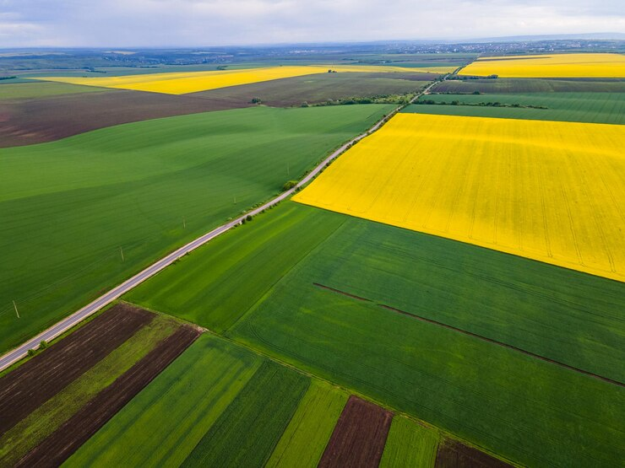
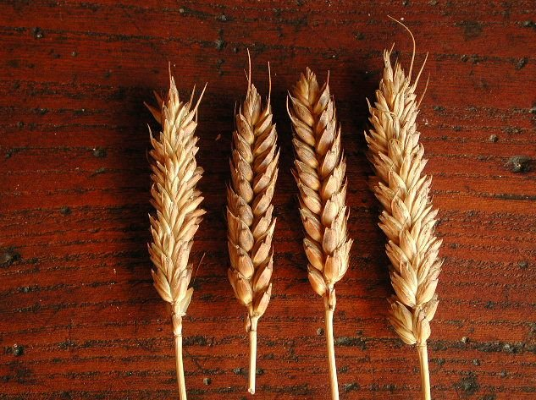
Agrobiodiversity
“The diversity of living organisms, including animals, plants, bacteria, etc., used in agriculture”
Differences among species
Differences among individuals within variety
Differences among varieties within species
D. Wood, J.M. Lenne, Agrobiodiversity: characterization, utilization, and management, CABI Publishing, New York, 1999.
ODT Forum 2024, Parma Gianni Galaverna, UNIPR

Slide 6
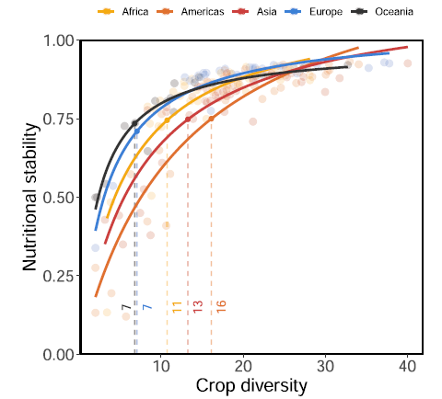
Why does it matter? Crop Diversity and Nutritional Stability
Nutritional stability = ability of a food system to afford nutrients despite perturbations.
The higher the number of cultivated species, the higher the nutritional stability.
Charlie C. Nicholson et al., Nature Communications, 2021, 12: 5310.
ODT Forum 2024, Parma Gianni Galaverna, UNIPR

Slide 7
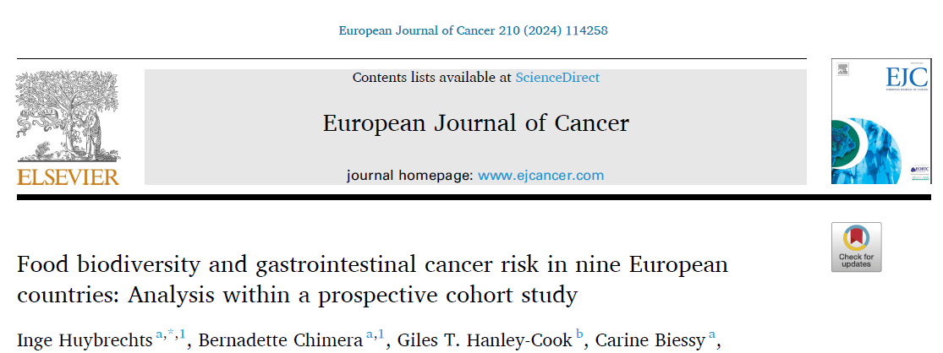
Why does it matter? Food Biodiversity and Health
The consumption of a diet with high
dietary species richness can potentially balance the benefits of a healthy
diet with the harms of exposure to carcinogenic toxic environmental
chemicals, with a possible “diluting effect”.
Dietary species richness (DSR) was inversely associated with overall gastrointestinal cancer risk and the risk of specific gastrointestinal cancer types, independent of sociodemographic, lifestyle, and other known dietary risk factors.
ODT Forum 2024, Parma Gianni Galaverna, UNIPR

Slide 8
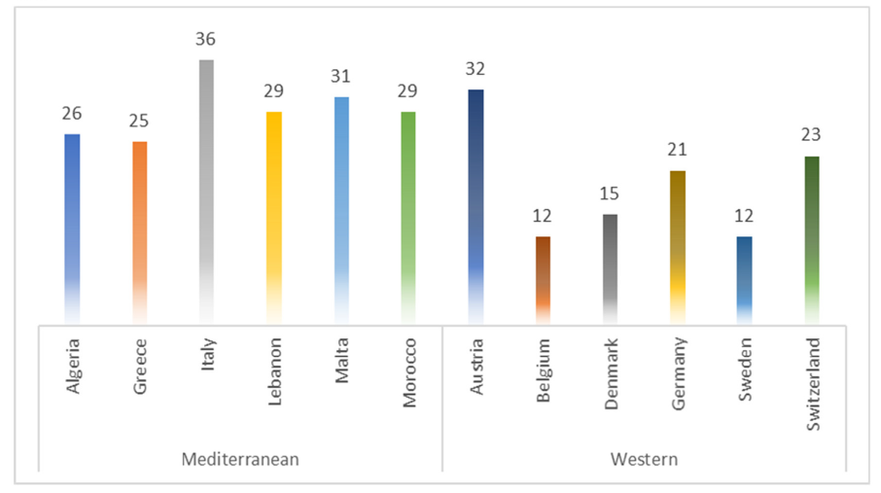
Interlinkage between Biodiversity and Diet: the MED Diet Case
Number of majorly cultivated food plants (species, subspecies, varieties, and races).
Konstadinos Mattas et al., Advances in Nutrition, 2023, 14: 570.
ODT Forum 2024, Parma Gianni Galaverna, UNIPR

Slide 9
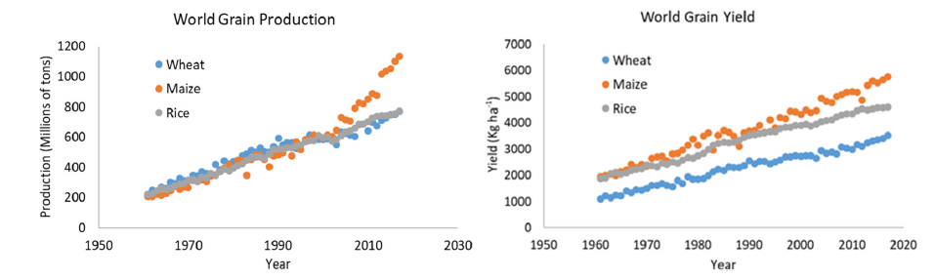
Productivity increase - Loss of agrobiodiversity
Wheat, maize and rice >50% of consumers’ plant-derived calories
FAO, Faostat database
Production increased, cultivated area not grown in proportion
Increase in yield, associated with improvements in production technology, selection of higher-yielding varieties, and intensification of agriculture.
Release of improved cultivars - gradual homogenization.
Decline of diversity and wider acceptance of only a few cultivars have been pervasive across crops, cereals and non-cereals alike (10% of the variety of crops cultivated in the past).
ODT Forum 2024, Parma Gianni Galaverna, UNIPR

Slide 10
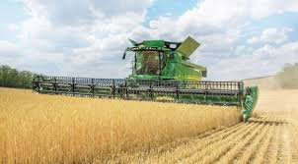
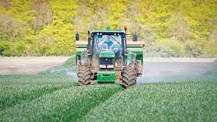
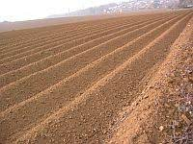
Intensive grain production systems: limits
Based on monocultures: breeding of elite crop lines or hybrids adapted to the homogeneous cropping conditions of modern agriculture
High chemical inputs (fertilizers and pesticides) and simplified rotations
Ample labor needed to prepare the land.
Severe soil and environmental disturbance such as:
water contamination
reduction in biodiversity associated with the application of pesticides and with the extensive cultivation of genetically similar plants.
global climate change: increase in annual variability, stagnation in yields and CO₂ increase
ODT Forum 2024, Parma Gianni Galaverna, UNIPR

Slide 11
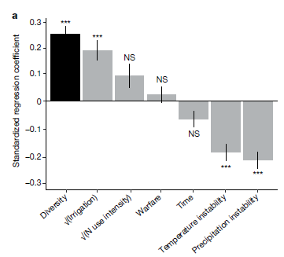
A message from ecology
Determinants of national caloric yield stability (summed annual kcal harvest of all edible crops in a
nation, divided by the total hectares of cropland).
Higher Diversity
Higher Productivity
Higher Resilience
Renard D, Tilman D. 2019. National food production stabilized by crop diversity. Nature 571: 257–260
Litrico I, Violle C. 2015. Diversity in Plant Breeding: A New Conceptual Framework. Trends in Plant Science 20 (10): 604–613
ODT Forum 2024, Parma Gianni Galaverna, UNIPR

Slide 12


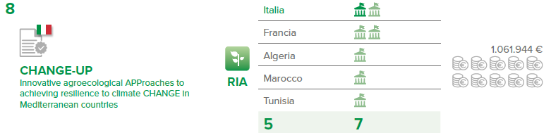





How to bring diversity back to the fields?
Change-up: the project
https://changeupproject.com/
Cereals (wheat)
Evolutionary Populations (EPs)
New Perennial Grains (NPGs)
ODT Forum 2024, Parma Gianni Galaverna, UNIPR

Slide 13
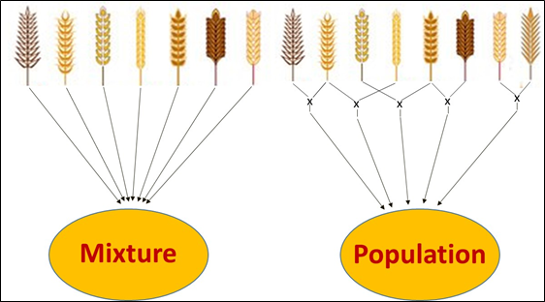
Evolutionary Populations of Cereals
Evolutionary genetic improvement (EPB, Evolutionary Plant Breeding), based on the use of:
mixtures, obtained by mixing seeds of different varieties of the same species (static). Once planted, they can cross in a natural way and gradually adapt to the soil and climatic characteristics (dynamic).
intraspecific evolutionary populations, obtained by mixing the seed obtained by crossing a certain number of varieties in all possible combinations.
Wolfe MS, Ceccarelli S. 2020. Journal of the Science of Food and Agriculture 100: 4119–4123
ODT Forum 2024, Parma Gianni Galaverna, UNIPR

Slide 14
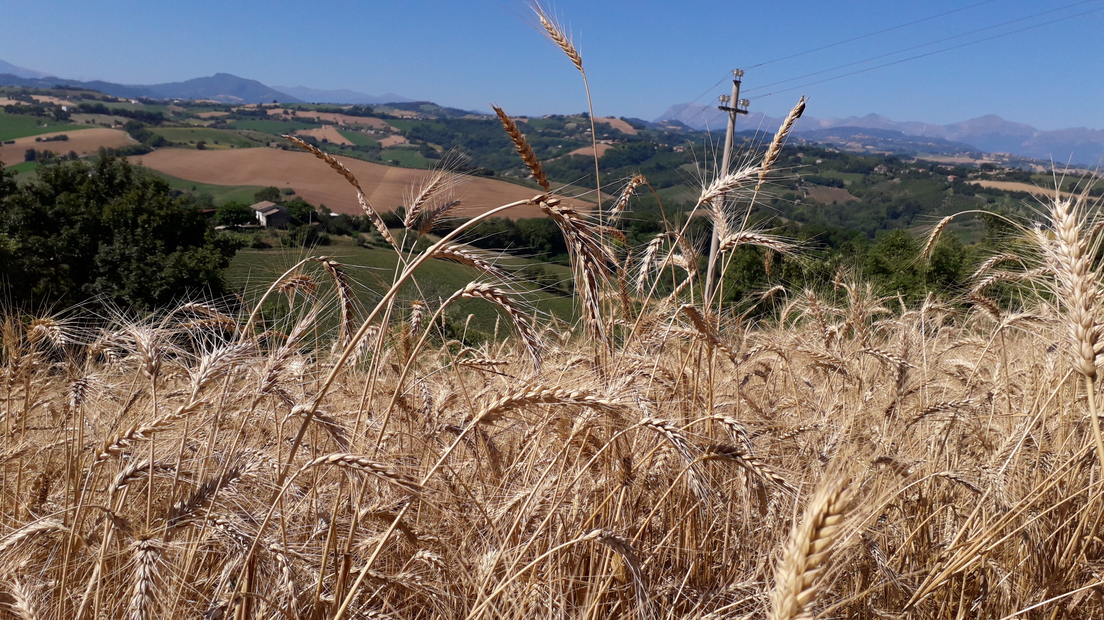
EPs: characteristics
Cereal EPs possess a high degree of within crop genetic diversity (heterogeneity), thus holding an inherent higher buffering capacity than homogeneous varieties to adapt to various abiotic and biotic stresses.
EPs are therefore well suited to low input and organic agriculture due to their ability to produce good and stable yields even when the availability of resources decreases or when climatic conditions become extreme.
Farmers owners of the seeds.
Ceccarelli S, Grando S. 2022. Evolutionary Plant Breeding with an Introduction to Participatory Plant Breeding, The Alliance of Bioversity International and CIAT, Rome pp 125.
ODT Forum 2024, Parma Gianni Galaverna, UNIPR

Slide 15
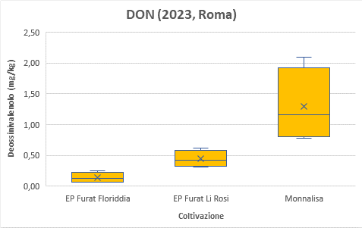
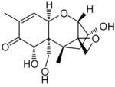
Resistance to biotic stress: pathogenic fungi and mycotoxins
Deoxynivalenol (DON)
Fusarium Head Blight (FHB)
EPs
MV
Dilution effect of biodiversity: difficulties for the fungus to spread all over the field.
ODT Forum 2024, Parma Gianni Galaverna, UNIPR

Slide 16
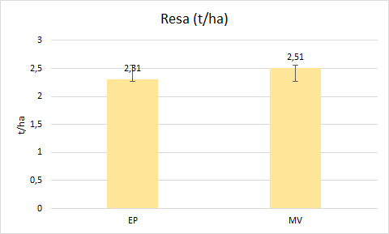
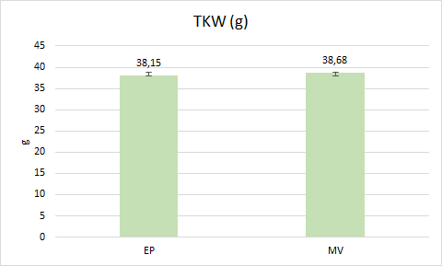
Are they giving good yields?
Tunisia
Grain Yield (t/ha)
TKW (g)
Grain yields comparable with modern variety (and even higher).
ODT Forum 2024, Parma Gianni Galaverna, UNIPR

Slide 17
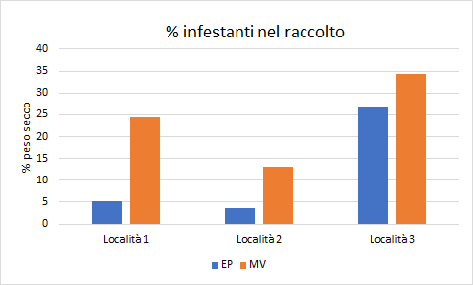
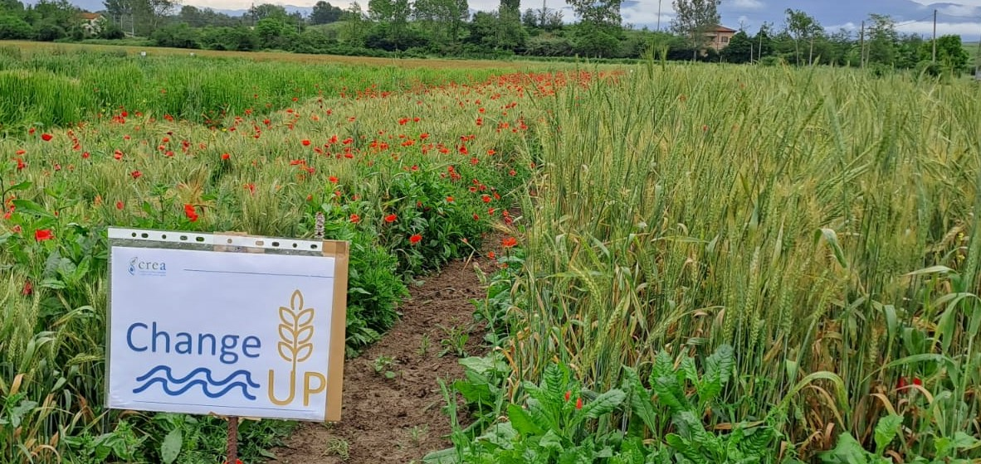
Is it possible to control weeds?
Poppy plants
% of weeds in the harvest
MV
EP
% dry weight
MV
EP
Locality 1
Locality 2
Locality 3
Morocco
Italy (Rome)
Weeds are better controlled, in the absence of preventative treatments.
ODT Forum 2024, Parma Gianni Galaverna, UNIPR

Slide 18
Biodiversity of EPs regenerates soil health
Increased microbial diversity
MV
EPs
EPs
EPs improve soil quality by increasing soil microbial biodiversity and microbial process as well as SOM.
MV
Increased microbial activities
ODT Forum 2024, Parma Gianni Galaverna, UNIPR

Slide 19
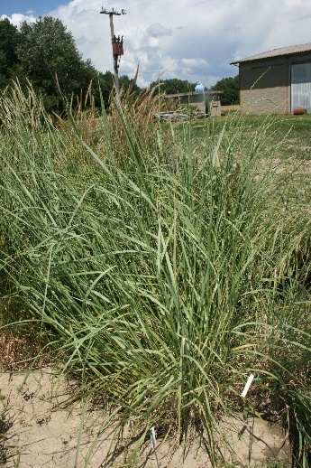
New perennial grains: characteristics
New species obtained by hybridization and/or domestication:
Able to regrow after harvest, holding great potential in ameliorating soil physical-chemical properties, biodiversity and food web composition.
Perennial soil cover reduces the need for tillage, protects soil against erosion and increases soil C storage through the reduction of soil organic matter oxidation.
They could also be used as forage or for biofuel production (marginal lands).
ODT Forum 2024, Parma Gianni Galaverna, UNIPR

Slide 20
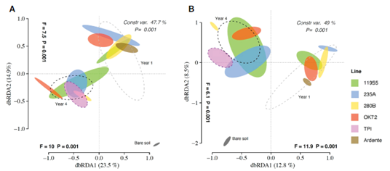
New perennial grains: soil microbial diversity
Perennials.
Annual.
Year 1.
Year 4.
Year 1.
Year 4.
Variation of soil microbiota and increase of biodiversity.
Marta Bertola et al., Front. Plant Sci. 2023, 14:1172857.
ODT Forum 2024, Parma Gianni Galaverna, UNIPR

Slide 21
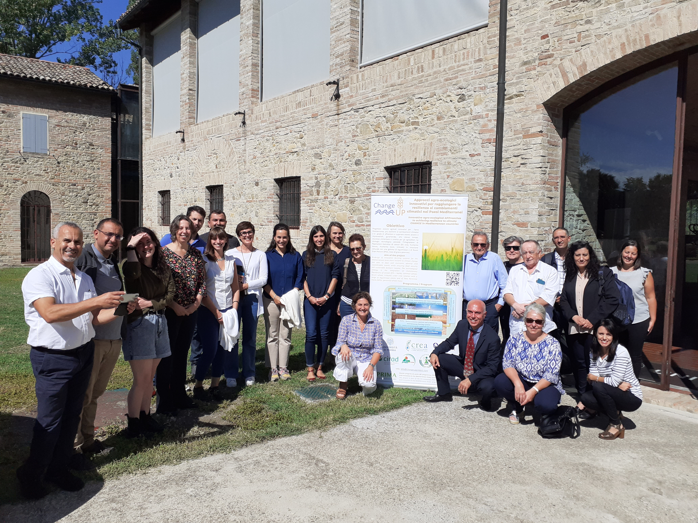
Thank you
Take home messages
Cultivate biodiversity!
Diet biodiversity not only in terms of species but also in terms of varieties.
Local adaptation vs. wide adaptation.

